Slide 1
GEOL 4049/4055 Assessment Department of Geology University of Puerto Rico
Stephen Hughes
Assessment Coordinator
October 18, 2016

Slide 2
GEOL 4049/4055 (“Topico”)
4049: Undergraduate Research I
4055: Undergraduate Research II
Both are required for the BS in Geology.
Projects are supervised by individual faculty members (currently n=12).

Slide 3
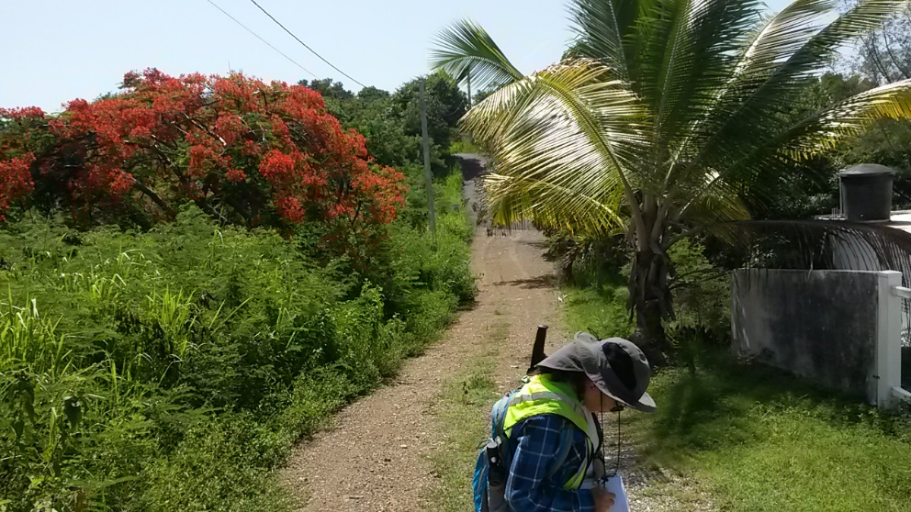
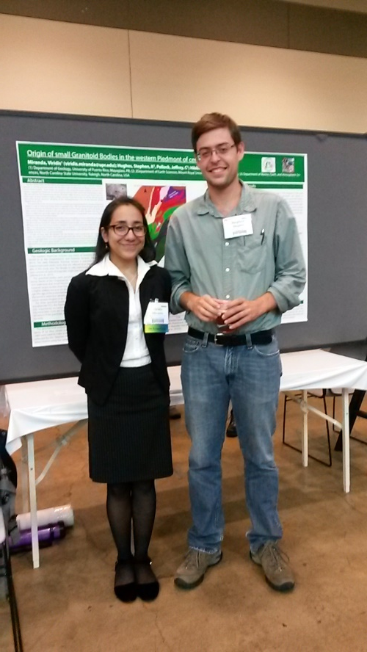
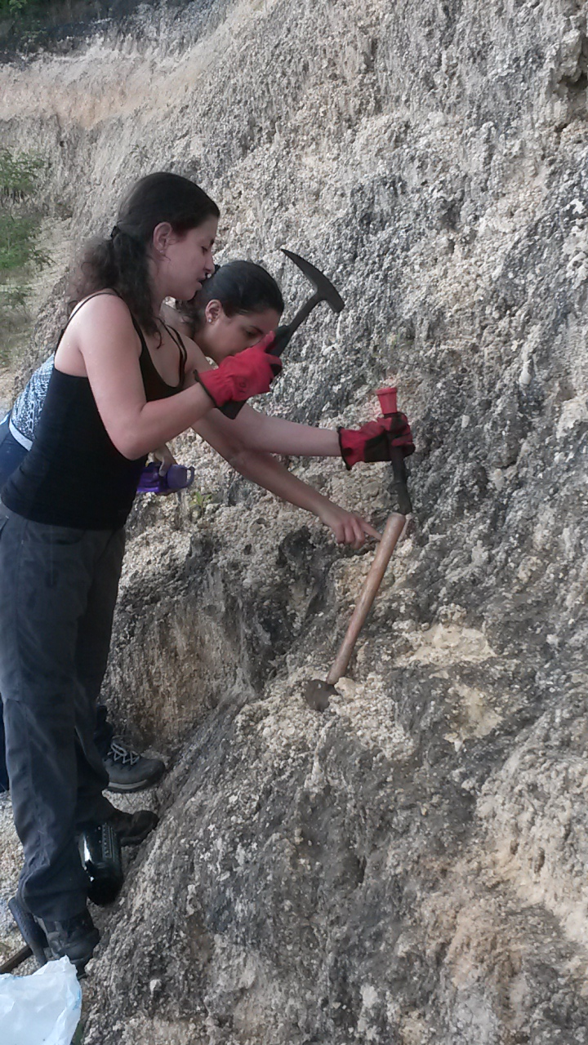
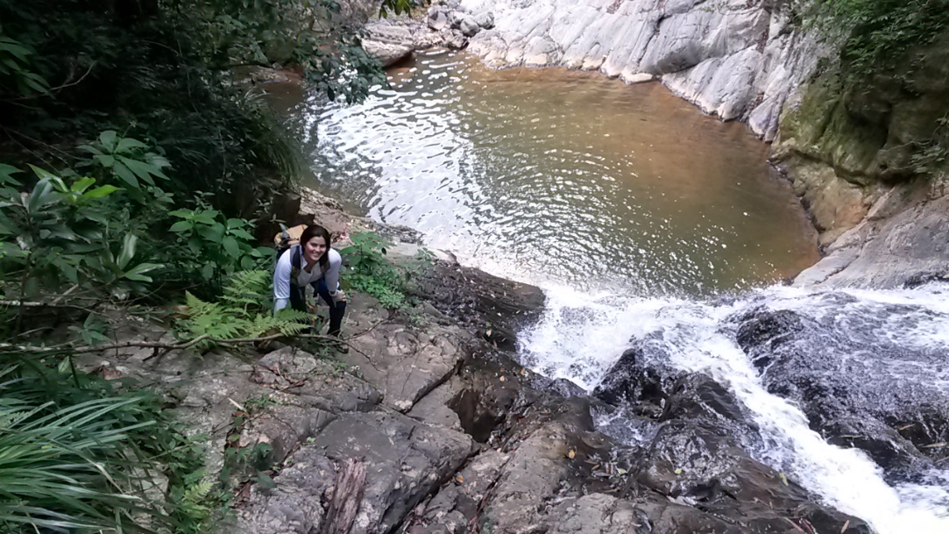
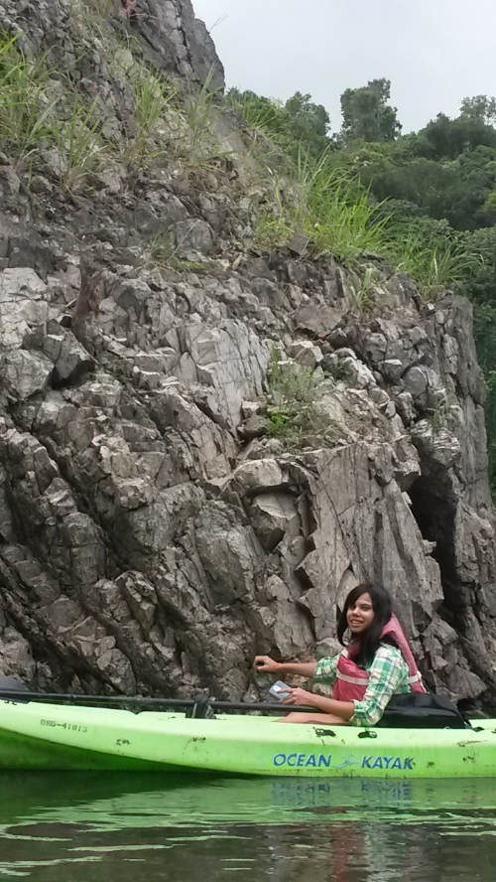
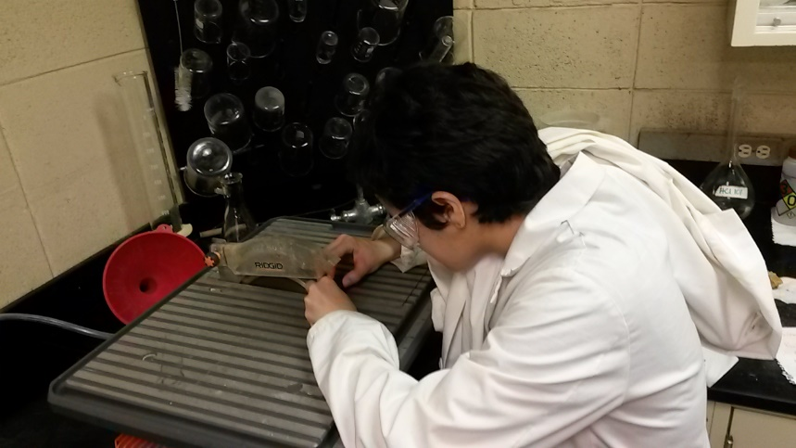
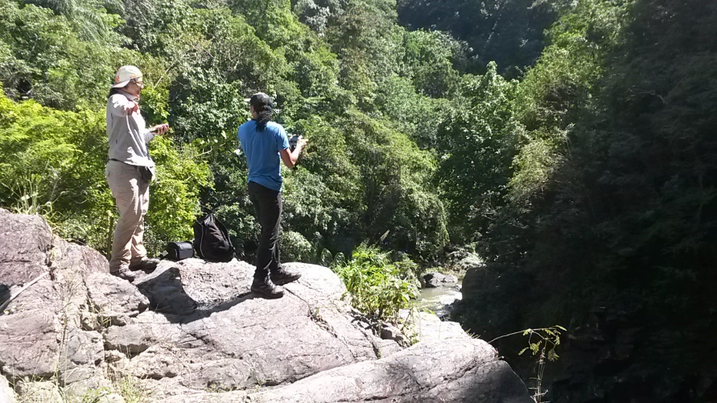

Slide 4
Motivation
“Increased” numbers of Topico students
Does this increase affect the quality of individual experiences? (too many students per faculty)
Is one semester of research sufficient to achieve our departmental goals? (emphasis on research exposure)
Change to undergraduate curriculum??

Slide 5
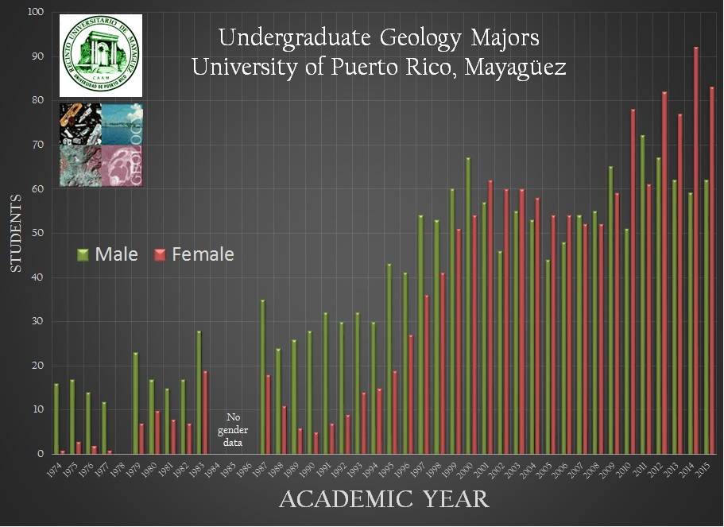

Slide 6
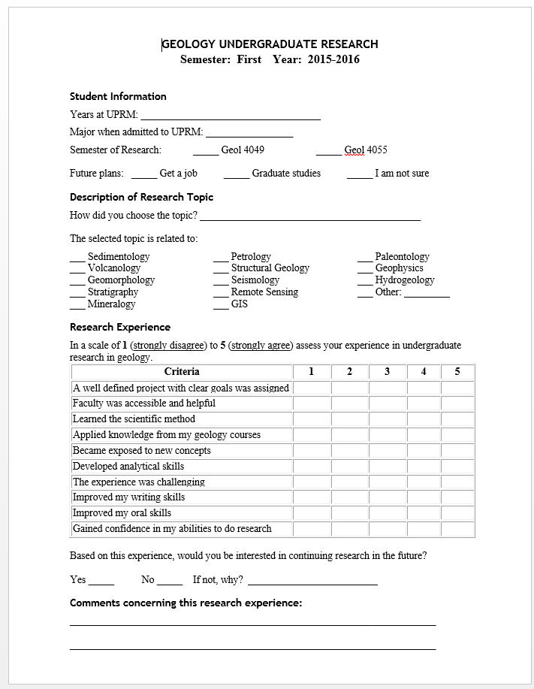
Assessment Tool

Slide 7
Assessment Tool

Slide 8
Assessment Tool

Slide 9
Assessment Tool

Slide 10
Previous Analysis (Fall 2004 – Fall 2006)

Slide 11
Assessment of Several Aspects
5=Strongly Agree
1=Strongly Disagree

Slide 12
Assessment of Several Aspects
5=Strongly Agree
1=Strongly Disagree

Slide 13
Conclusions-Courses
Major differences were found between students registered in the first semester (Geol 4049) and in the second semester (Geol 4055) in the following aspects only:
Well Defined Project
Applied Knowledge from Courses
Gained Confidence in Research
According to them, the first semester had more impact in those aspects than the second semester.
The differences of the other evaluated aspects, however, were low between the two groups.
This assessment suggests that only one semester of research could be enough to impact the learning process of our students.

Slide 14
Conclusions-Courses
Major differences were found between students registered in the first semester (Geol 4049) and in the second semester (Geol 4055) in the following aspects only:
Well Defined Project
Applied Knowledge from Courses
Gained Confidence in Research
According to them, the first semester had more impact in those aspects than the second semester.
The differences of the other evaluated aspects, however, were low between the two groups.
This assessment suggests that only one semester of research could be enough to impact the learning process of our students.

Slide 15
Current Survey
Data from:
Same Survey tool
Y | Y | Y | Y | Y |  |  |  |  |  |  |  | Y | Y | Y | Y
F08 | S09 | F09 | S10 | F10 | S11 | F11 | S12 | F12 | S13 | F13 | S14 | F14 | S15 | F15 | S16

Slide 17
Current Survey
Data from:
Same Survey tool
142 responses
71 for GEOL 4049
71 for GEOL 4055
Y | Y | Y | Y | Y |  |  |  |  |  |  |  | Y | Y | Y | Y
F08 | S09 | F09 | S10 | F10 | S11 | F11 | S12 | F12 | S13 | F13 | S14 | F14 | S15 | F15 | S16

Slide 18
Results
The experience was challenging
Developed analytical skills
 | Strongly Disagree |  |  |  | Strongly Agree |  | Avg.
4049 | 1 | 0 | 2 | 9 | 59 |  | 4.76
4055 | 0 | 2 | 1 | 8 | 60 |  | 4.77
 | Strongly Disagree |  |  |  | Strongly Agree |  | Avg.
4049 | 0 | 1 | 1 | 18 | 51 |  | 4.68
4055 | 0 | 2 | 1 | 9 | 59 |  | 4.76

Slide 19
Results
The experience was challenging
Developed analytical skills
 | Strongly Disagree |  |  |  | Strongly Agree |  | Avg.
4049 | 1 | 0 | 2 | 9 | 59 |  | 4.76
4055 | 0 | 2 | 1 | 8 | 60 |  | 4.77
 | Strongly Disagree |  |  |  | Strongly Agree |  | Avg.
4049 | 0 | 1 | 1 | 18 | 51 |  | 4.68
4055 | 0 | 2 | 1 | 9 | 59 |  | 4.76

Slide 20
Results
Gained Confidence
Applied knowledge from my geology courses
 | Strongly Disagree |  |  |  | Strongly Agree |  | Avg.
4049 | 2 | 2 | 3 | 8 | 56 |  | 4.61
4055 | 0 | 4 | 4 | 9 | 54 |  | 4.59
 | Strongly Disagree |  |  |  | Strongly Agree |  | Avg.
4049 | 0 | 1 | 1 | 11 | 58 |  | 4.77
4055 | 0 | 2 | 2 | 6 | 61 |  | 4.77

Slide 21
Results
Became exposed to new concepts
Learned the scientific method
 | Strongly Disagree |  |  |  | Strongly Agree |  | Avg.
4049 | 0 | 1 | 2 | 6 | 61 |  | 4.82
4055 | 0 | 1 | 2 | 5 | 63 |  | 4.83
 | Strongly Disagree |  |  |  | Strongly Agree |  | Avg.
4049 | 0 | 0 | 3 | 7 | 60 |  | 4.81
4055 | 0 | 1 | 4 | 4 | 62 |  | 4.79

Slide 22
Results
A well defined project
Faculty was accessible/helpful
 | Strongly Disagree |  |  |  | Strongly Agree |  | Avg.
4049 | 4 | 1 | 5 | 11 | 50 |  | 4.44
4055 | 0 | 4 | 2 | 6 | 59 |  | 4.69
 | Strongly Disagree |  |  |  | Strongly Agree |  | Avg.
4049 | 3 | 1 | 6 | 9 | 52 |  | 4.49
4055 | 0 | 2 | 3 | 14 | 52 |  | 4.63

Slide 23
Results
Improved my writing skills
Improved my oral skills
 | Strongly Disagree |  |  |  | Strongly Agree |  | Avg.
4049 | 2 | 0 | 1 | 13 | 54 |  | 4.67
4055 | 0 | 3 | 6 | 15 | 47 |  | 4.49
 | Strongly Disagree |  |  |  | Strongly Agree |  | Avg.
4049 | 2 | 0 | 2 | 14 | 52 |  | 4.63
4055 | 2 | 1 | 6 | 13 | 49 |  | 4.49

Slide 24
Results
Many students filled all “Strongly Agree”
4049 = 30/71 (42%)
4055 = 29/71 (41%)

Slide 25
Results
Many students filled all “Strongly Agree”
4049 = 30/71 (42%)
4055 = 29/71 (41%)
Biggest differences between 4049/4055:
4055 reported more development of analytical skills
4055 reported equal or more exposure to new concepts
supervisor and project issues seem to go more smoothly for 4055
4055 reported less improvement in oral/writing skills

Slide 26
Results
Many students filled all “Strongly Agree”
4049 = 30/71 (42%)
4055 = 29/71 (41%)
Biggest differences between 4049/4055:
4055 reported more development of analytical skills
4055 reported equal or more exposure to new concepts
supervisor and project issues seem to go more smoothly for 4055
4055 reported less improvement in oral/writing skills
Agreement with previous assessment:
≠
=
≠
≠

Slide 27
Thoughts
When is the survey administered?
Immediately after final presentation
Abundance of students reporting all 5’s
Trust in self reporting?

Slide 28
Conclusions
The number of students enrolled in GEOL 4049 or GEOL 4055 has fluctuated but hasn’t grown too much for our faculty.
Students report mostly equal experiences, which indicates they continue advancing in their 2nd “Topico”
Data not sufficient to suggest elimination of both requirements from undergraduate curriculum. May actually support keeping both requirements.

Slide 29
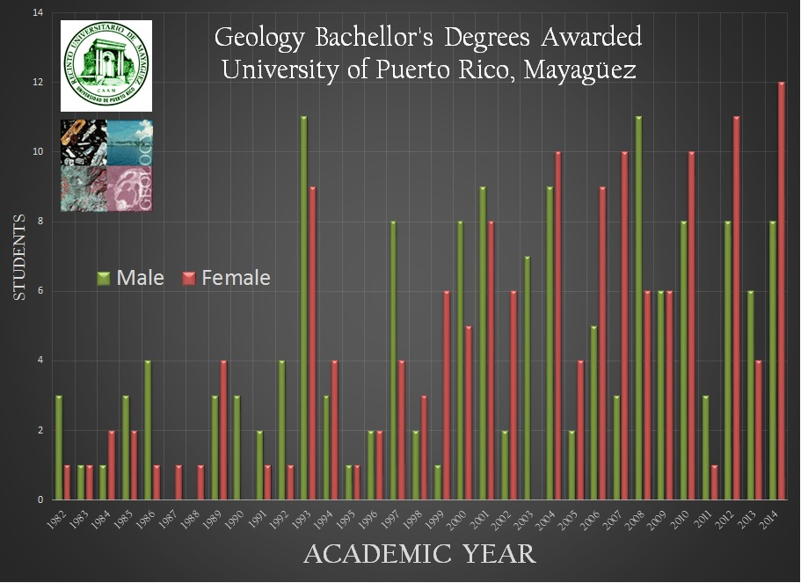

Slide 30
Bonus Data
(and maybe more useful for assessment)

