Slide 1



RESEARCH AREAS
Vijay K. Goyal, PhD
Director, CAUSE
Emmanuel Arzuaga, PhD
Associate Director, CAUSE
Agustin Rullán, PhD
Dean of College of Engineering
Oscar Perales, PhD
Associate Dean of Research & Innovation

Slide 2

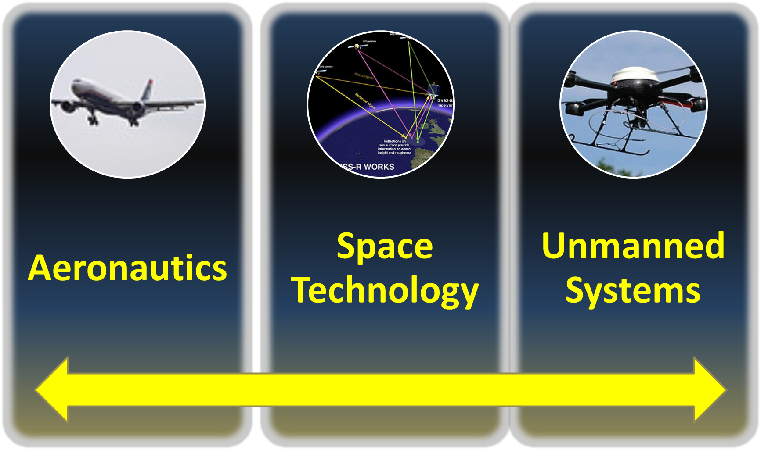
RESEARCH
DIRECTORATES
Research

Slide 3
THRUST AREA 1:
Dynamic and Control Systems
Department of Electrical and Computer Engineering
Department of Mechanical Engineering
Department of Civil Engineering
Research Competence Fields

Slide 4
Dynamic and Control Systems
Nonlinear modeling and control of physical dynamic systems
Autonomy
Stability and optimization
Robustness, perturbation analysis, estimation/observability, adaptability
Intelligent flight systems, genetic/neural-network
Stochastic analysis for uncertain systems
Noise control

Slide 5
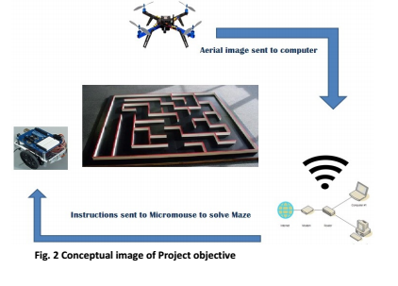
Diagnosis, Control, and Prognosis for Unmanned Systems
Prof. Eduardo Ortiz, Eduardo.ortiz7@upr.edu
UPRM: Development of Algorithms to Diagnose, Control and Predict the Performance of Multiple Unmanned Systems using Sensors and Real-Time Collaboration.

Slide 6

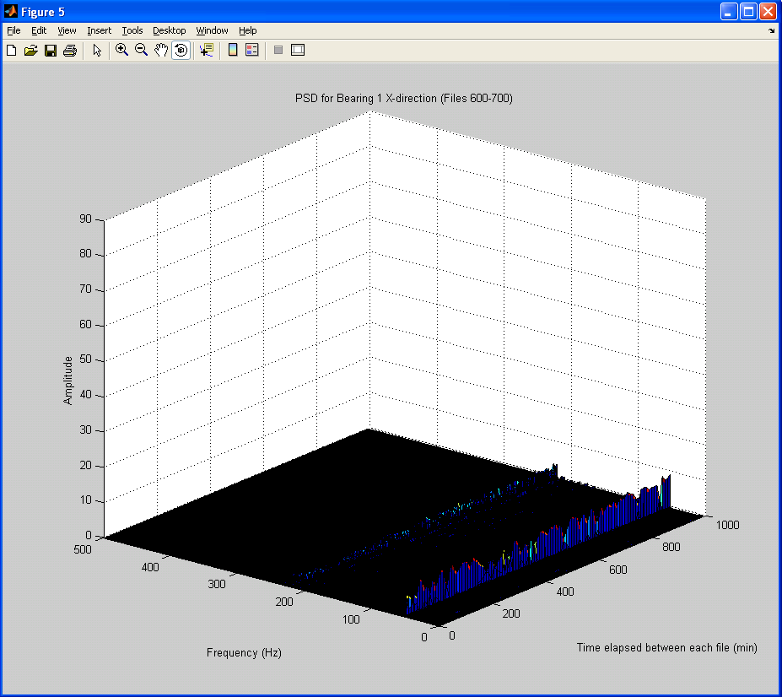
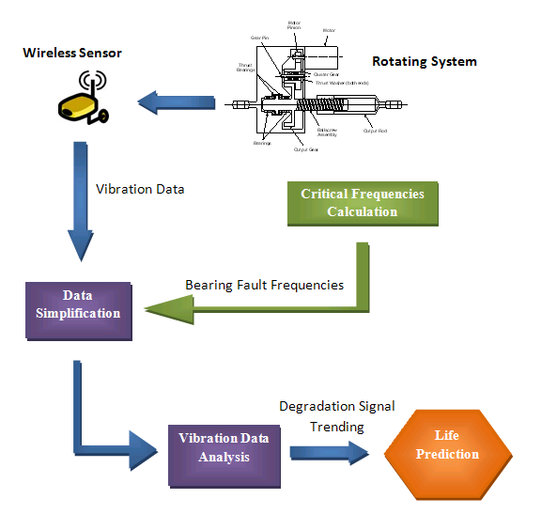
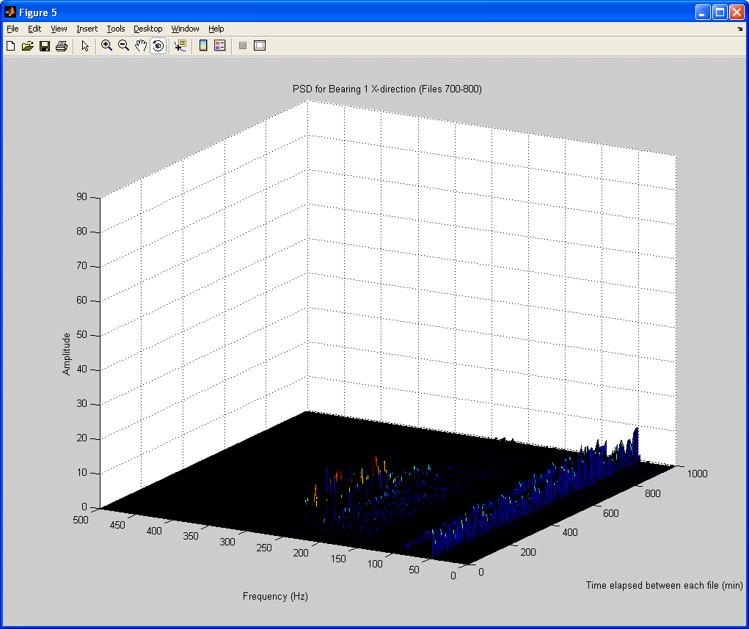
Low-Error Data-Driven Life Prediction Model for Bearing Failure due to Localized Defects
The amplitude of Ball Pass Outer Frequency (BPOF) starts to increase
Prof. Vijay K. Goyal, vijay.goyal@upr.edu
Sidebands around BPOF indicating the severity of the fault

Slide 7
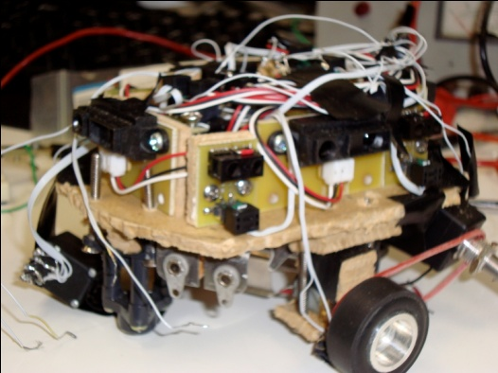


Power Electronics and Nonlinear Control:
Smart Robot Design
Power Electronics for
Smart Robot Design
Prof. Eduardo Ortiz, Eduardo.ortiz7@upr.edu
Micromouse

Slide 8
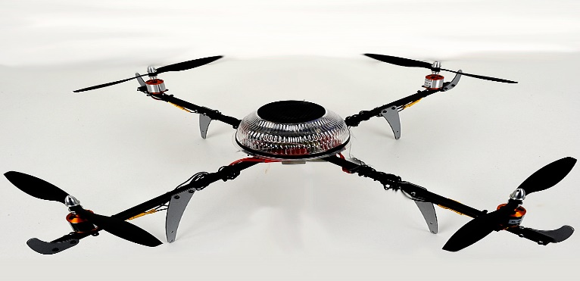
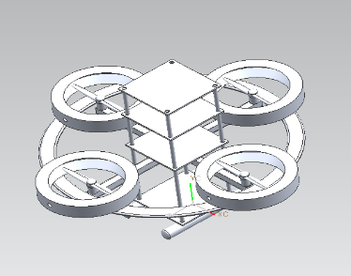
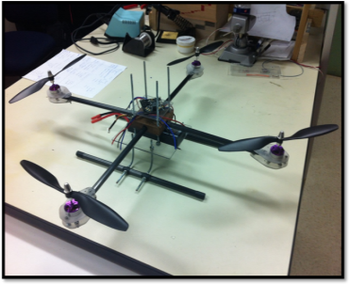



Power Electronics and Nonlinear Control:
Unmanned Aerial Vehicles
The Quadcopter
Power electronics, controls, and robotics for UAV’s.
Prof. Eduardo Ortiz, Eduardo.ortiz7@upr.edu

Slide 9
THRUST AREA 2:
Materials and Structures
Department of Mechanical Engineering
Department of Civil Engineering
Department of General Engineering
Department of Electrical and Computer Engineering
Research Competence Fields

Slide 10
Materials and Structures
Theoretical, experimental, computational, and contemporary methods
Nonlinear deformation, instability and collapse, damage evolution, nondestructive evaluation,
Contact and friction through constitutive modeling,
Multi-scale (spatial or temporal), Multi-physics analysis, computational methods, or experimental techniques,
Failure of composite built structures: static, cyclic and dynamic loading conditions.
Wave propagation
Ballistic and Impact

Slide 11
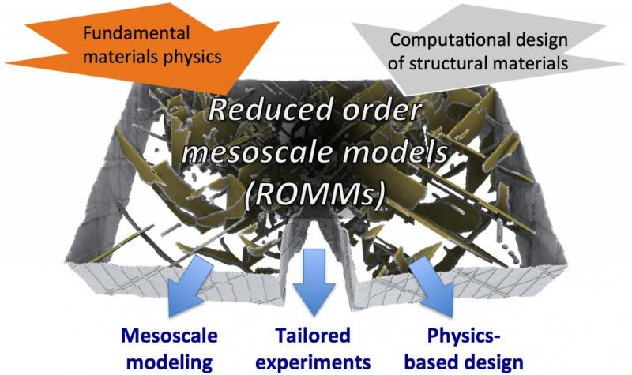
Reduced Order Computation
Prof. Vijay K. Goyal, vijay.goyal@upr.edu

Slide 12

Robust Bird-Strike Modeling Using LS-DYNA
Lagrangian
Prof. Vijay K. Goyal, vijay.goyal@upr.edu
Arbitrary Lagrange Eulerian
Smooth Particle Hydrodynamic

Slide 13
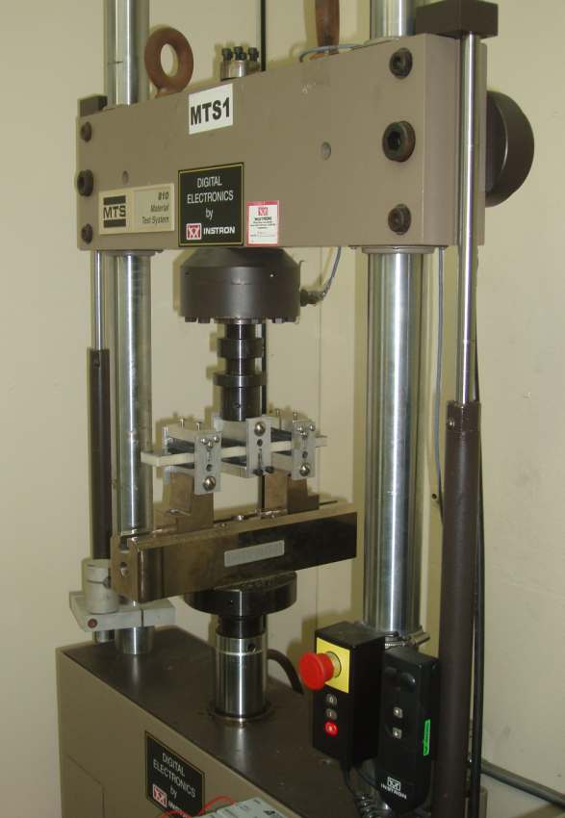
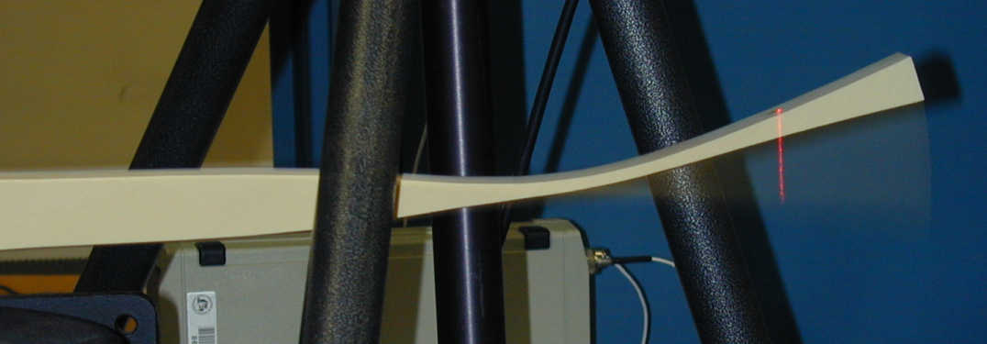
Vibration Research That Yields Three-Point Bending Data of Sandwich Composites and Constituents
Background:
Fatigue testing is typically performed on servo-hydraulic machines at a rate of 0-3 Hz.
Typical S-N-P curves require 15 data points per stress ratio tested
A S-N-P curve using 4 stress ratios obtained at 1-Hz requires 694.2 days this is equivalent to $16,666.66 at a rate of $1.00/ hr
Objective:
Develop vibration algorithm for fatigue testing
  order magnitude faster than conventional technique
  applicable to materials not affected by testing at increased frequency
  yield significant cost savings in testing
Procedure should be easy to implement and replicate
Validation can be verified with conventional testing
Develop applicability procedure to ensure that geometry of test region yields same conventional testing geometry (possible future pending work)
Prof. Frederick Just, Frederick.just@upr.edu

Slide 14
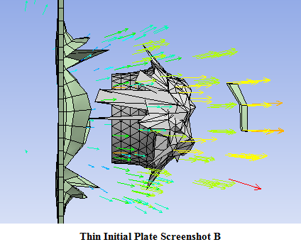
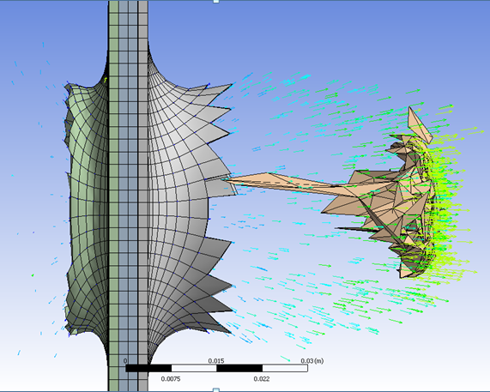
Optimization for Decrease Fragment Exit Velocity Using Barrier Protection
NSWCDD
Prof. Vijay K. Goyal, vijay.goyal@upr.edu

Slide 15
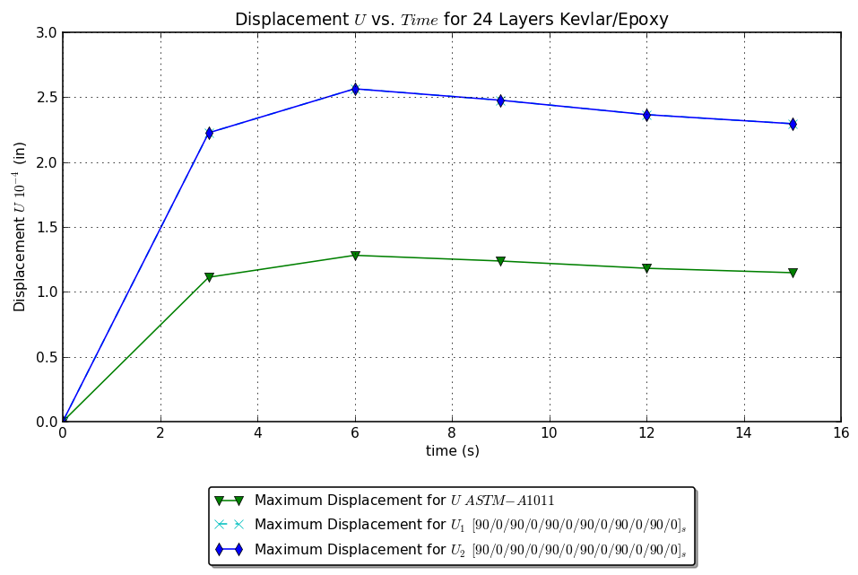
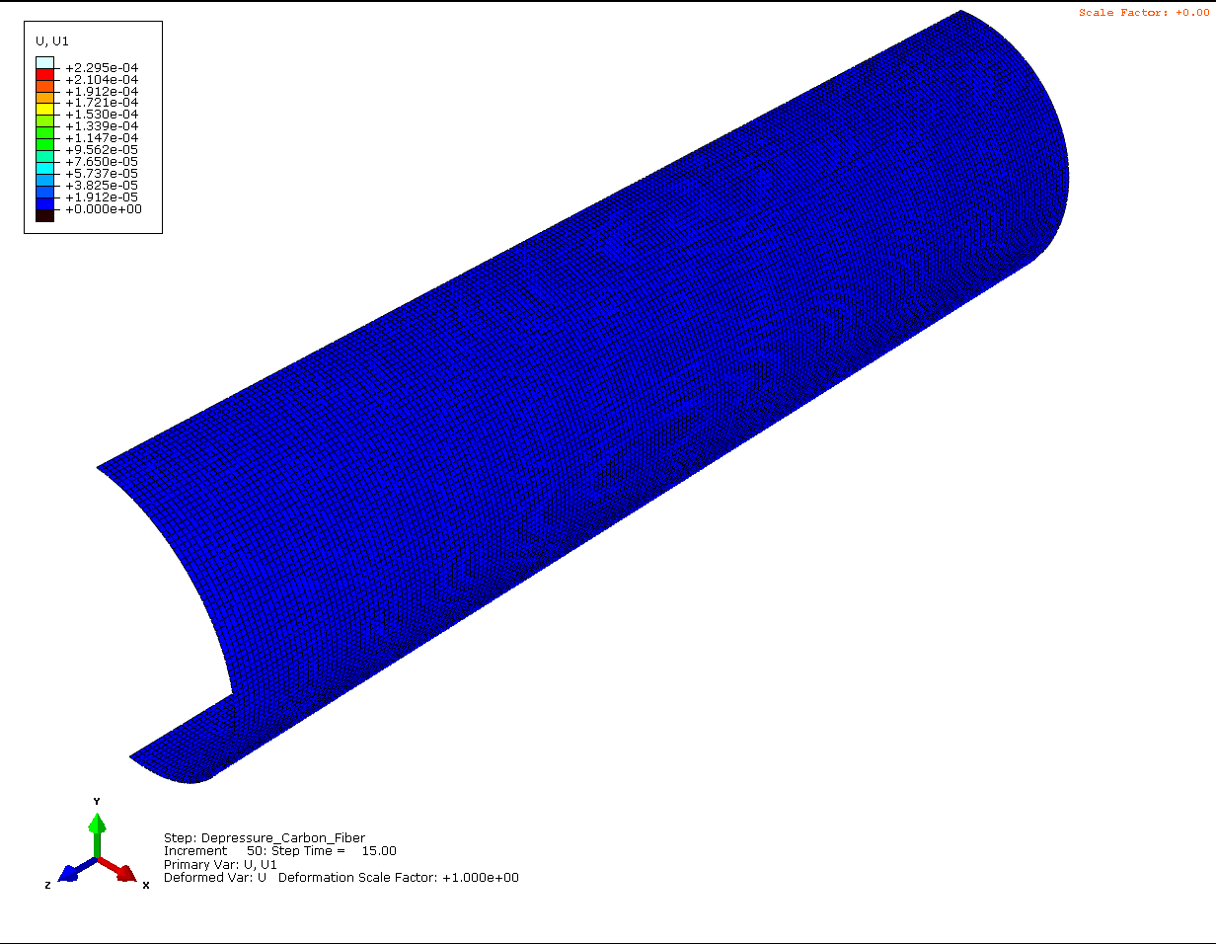
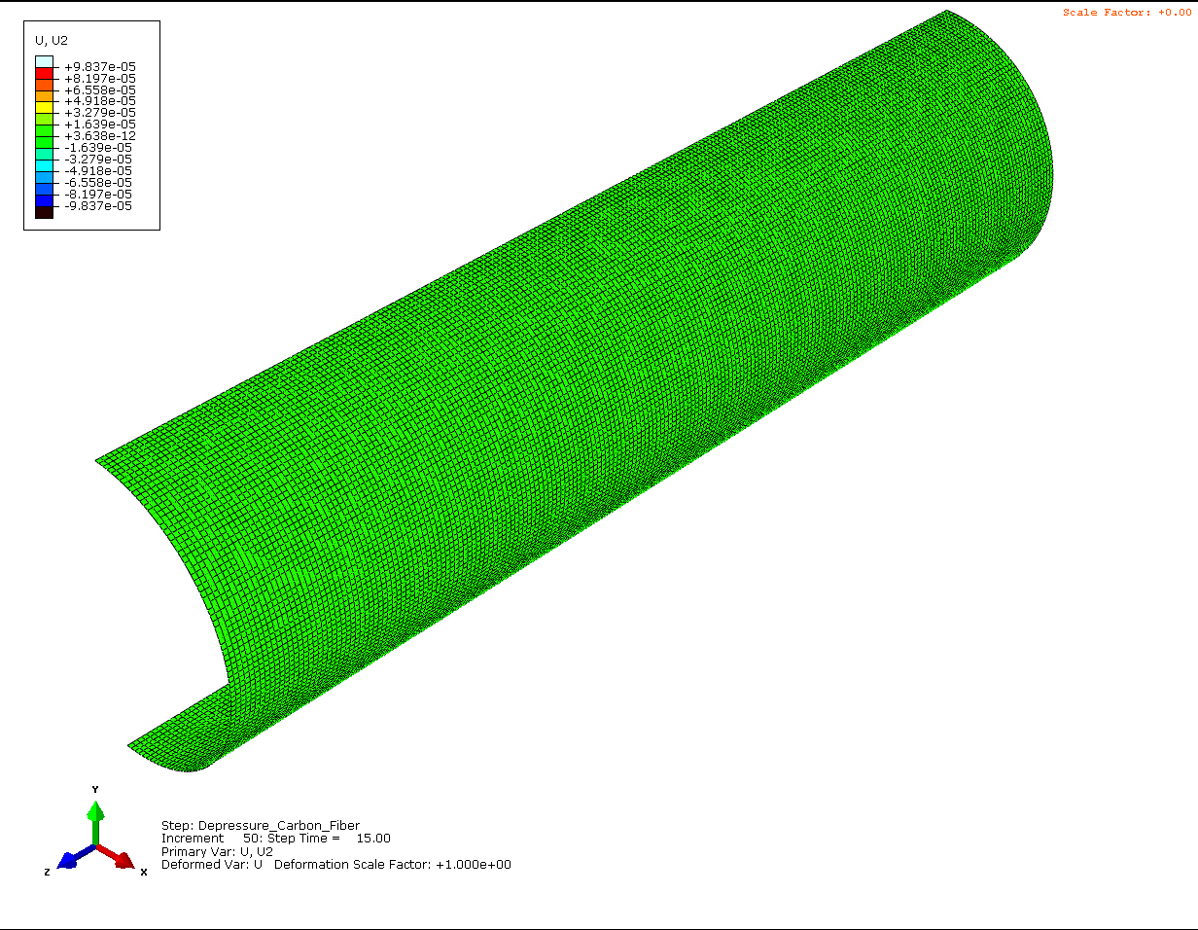
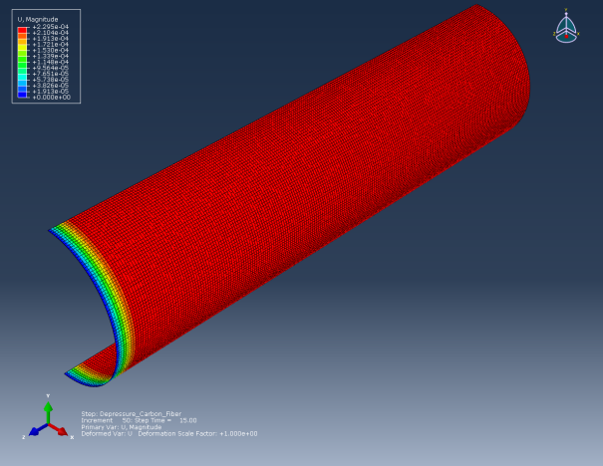
Weight Reduction for the PA117 Ammunition Containers
NSWCDD
Prof. Vijay K. Goyal, vijay.goyal@upr.edu
Case Kevlar/Epoxy 24 Layers: Displacement in U1 and U2 (x and y)
Layers in the following array [90/0/90/0/90/0/90/0/90/0/90/0] s

Slide 16
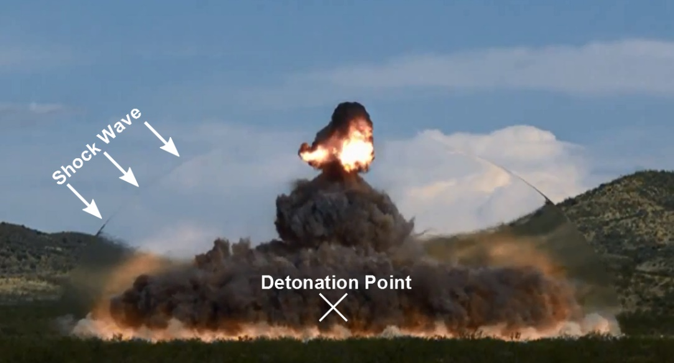
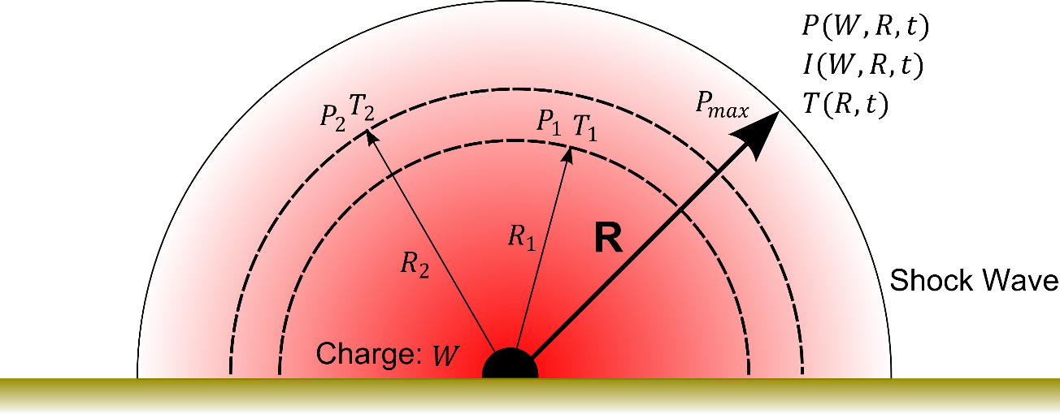
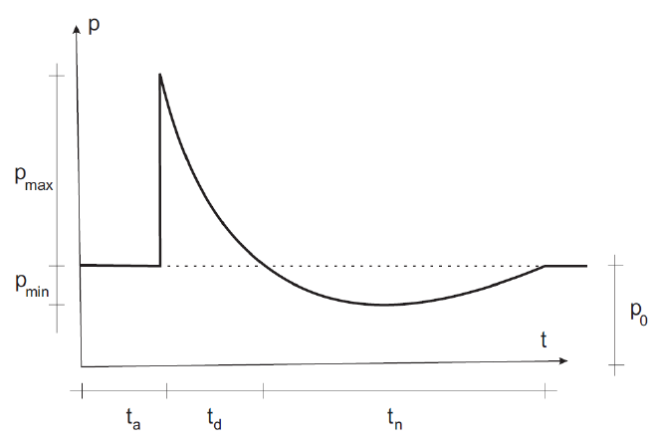
Uncertainty Prediction of Pressure and Temperature Signatures in Air-Blast
Prof. Vijay K. Goyal, vijay.goyal@upr.edu
Shockwave expansion during explosion

Slide 17
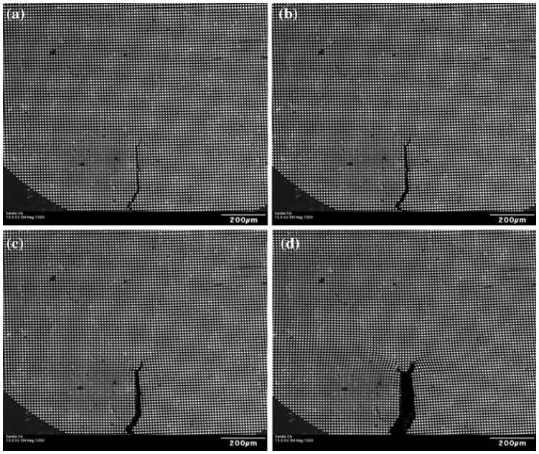
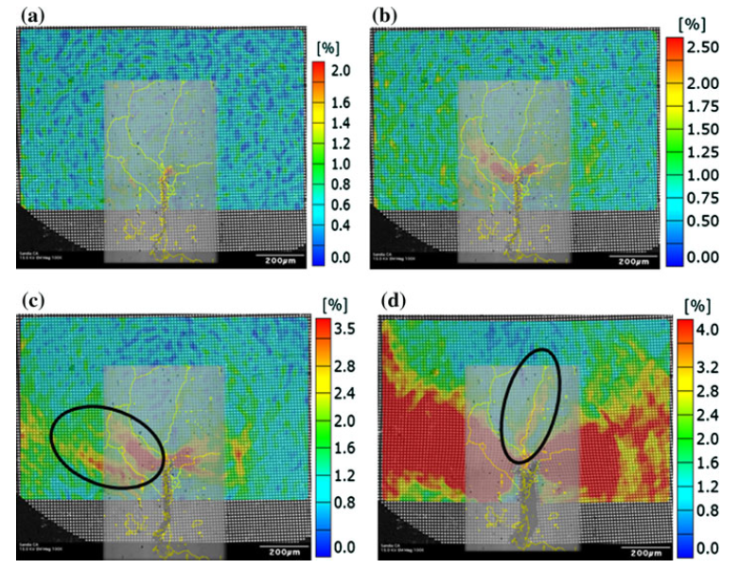
Micro-Scale Crack Propagation Analysis Using XFEM
Prof. Vijay K. Goyal, vijay.goyal@upr.edu
H. Jin, W. Lu, S. Haldar, H. Bruck; Microscale Characterization of Granular Deformation Near A Crack Tip. May 2011

Slide 18

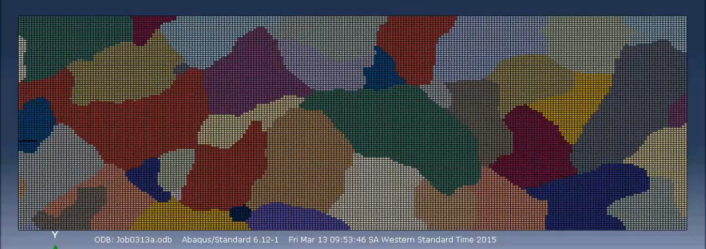
Microscopic Failure: 1 cm long of actual structure
Prof. Vijay K. Goyal, vijay.goyal@upr.edu

Slide 19
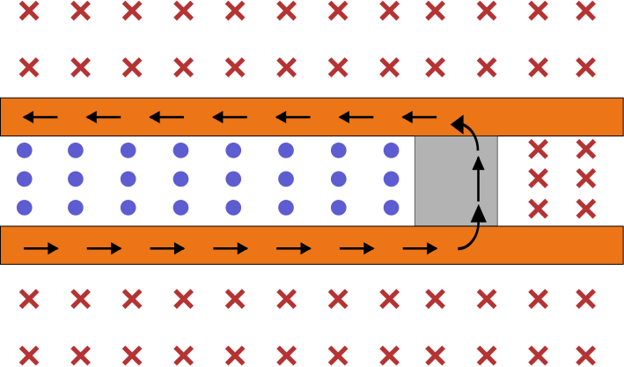
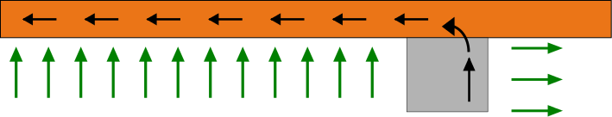
Composite Failure of Electromagnetic Launcher Subject to Hypersonic Speeds
Potential NSWCDD
As a current pulse is applied, forces due to the EM field generated launches de projectile.
Model force system as body forces.
Prof. Vijay K. Goyal, vijay.goyal@upr.edu

Slide 20
Environmental Effects on Degradation of Glass Fiber Reinforced Composites
Evaluate the hygrothermal effect on the mechanical properties of glass-reinforced
polymers at the micromechanical level.
Three types of materials are studied: vinyl ester resin (constituent of composites), E-Glass unidirectional laminated composite, and E-glass bidirectional laminated composite
Prof. Felipe J. Acosta, felipe.acosta1@upr.edu

Slide 21
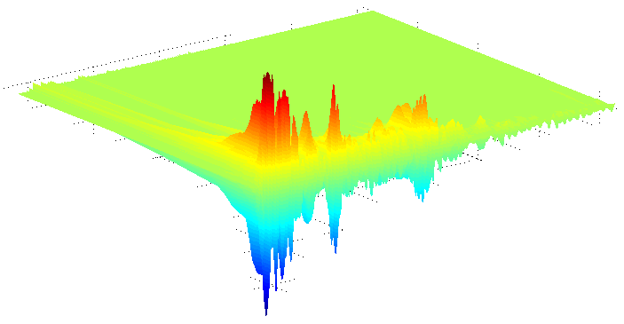
Dynamic, Damage, Nonlinear Analysis
Detection of damage in structures using measured time signals (e.g., wavelet transforms)
Dynamic response mitigation using passive damping devices (e.g., dashpots, damping treatments)
Dynamic response of equipment in nonlinear primary structures
Prof. Luis Suarez, luis.suarez3@upr.edu

Slide 22
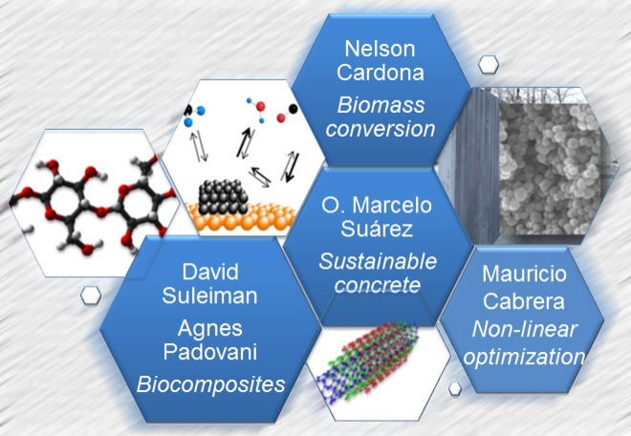
Nanostructured Composites and Catalysts for Sustainability
Finding new nanocatalysts for the conversion of renewable resources.
Develop new nanostructured composite materials using polymers
High performance and sustainable (low-energy consuming upon fabrication) concrete mixes
Prof. O. Marcelo Suárez, msuarez@ece.uprm.edu
Prof. Oscar Perales. Oscarjuan.perales@upr.edu

Slide 23
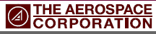
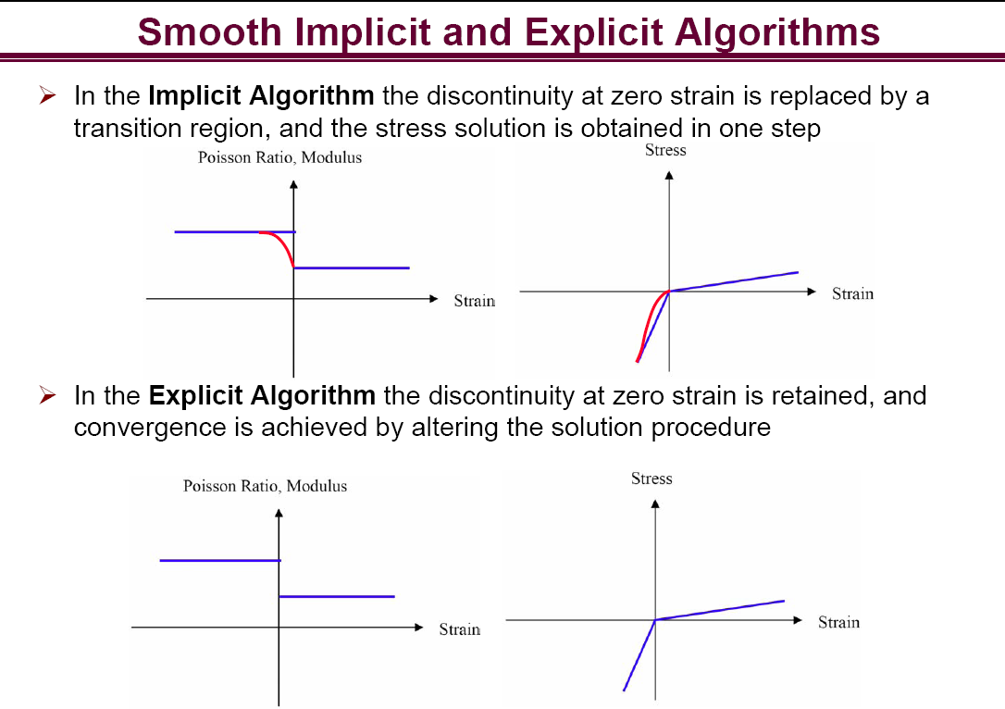
Efficient Algorithms for Composite Structural Analysis With Different Tension-compression Material Properties
Prof. Vijay K. Goyal, vijay.goyal@upr.edu
Goyal, V. K., J. I. Rome, V. K. Goyal and J. C. Klug, “Efficient Algorithms for Composite Structural Analysis with Different Tension-Compression Material Properties,” Composites Part B: Engineering, Under Review, 2012.

Slide 24
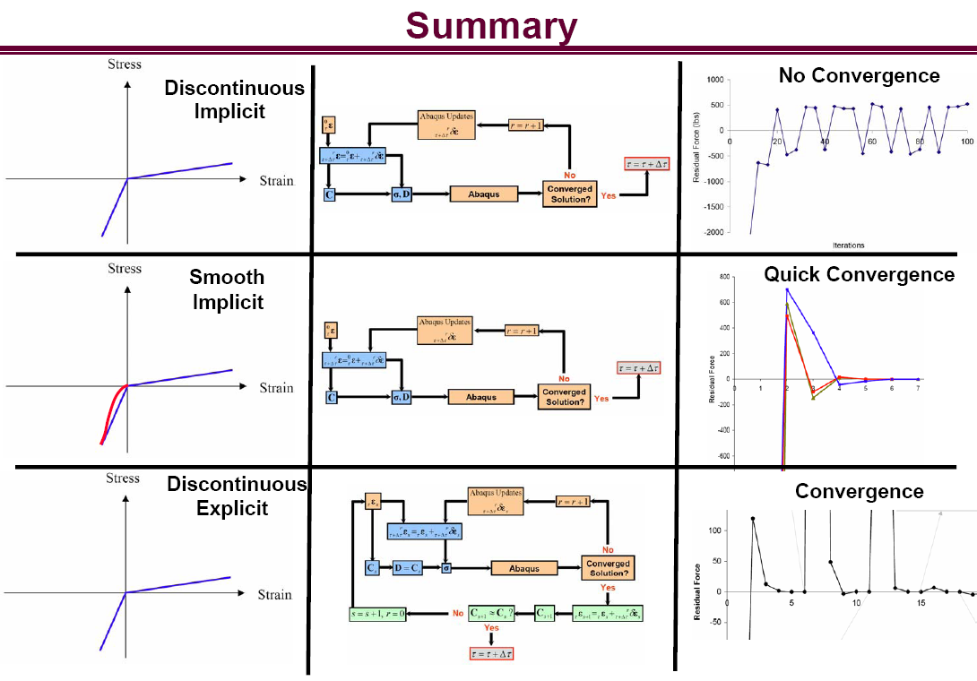
Efficient Algorithms for Composite Structural Analysis With Different Tension-compression Material Properties (cont.)
Prof. Vijay K. Goyal, vijay.goyal@upr.edu

Slide 25
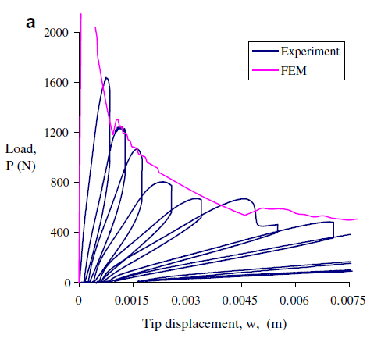
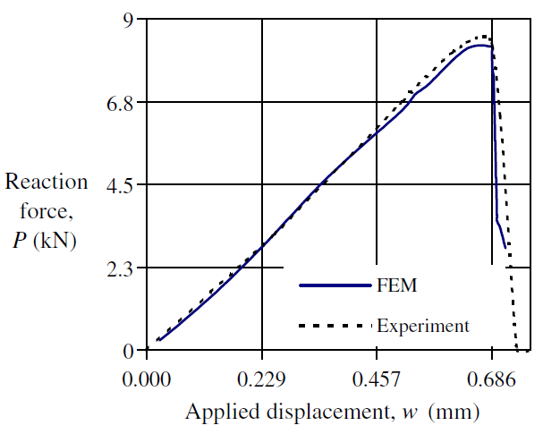
Predictive Strength-fracture Model for Composite Bonded Joints
Prof. Vijay K. Goyal, vijay.goyal@upr.edu
Mode I
Mode II
Composite Structures, Volume 82, Issue 3, February 2008, Pages 434-446

Slide 26
Aeroelasticity in Hypersonic Speeds
Numerical Model of the Full Air-Structure model subject to hypersonic speeds
Structural Failure Prediction for wings under such speeds
Status: Projects is just starting
Prof. Vijay K. Goyal, vijay.goyal@upr.edu

Slide 27
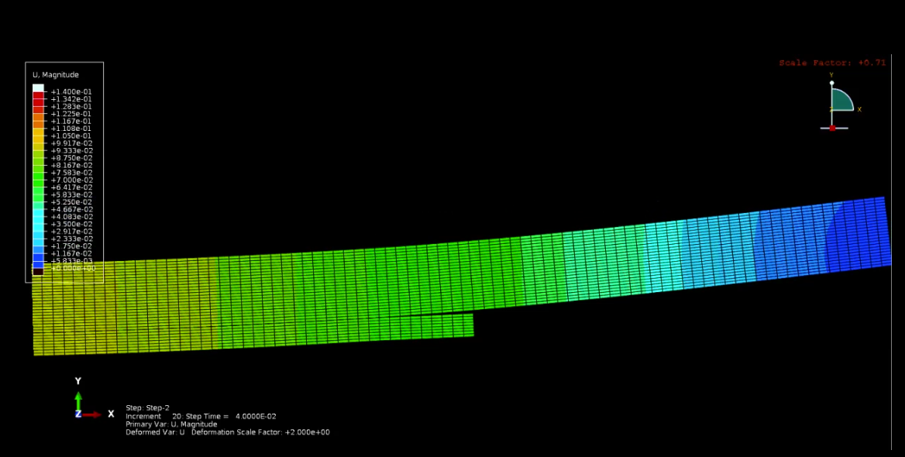
Combining XFEM and Cohesive Element Models
Prof. Vijay K. Goyal, vijay.goyal@upr.edu

Slide 28
THRUST AREA 3:
Thermo-Fluids
Department of Mechanical Engineering
Department of Civil Engineering
Department of General Engineering
Research Competence Fields

Slide 29
Thermo-Fluids
Characterization and modeling of the coupled dynamics, thermodynamics.
Aeroelasticity of aircraft subject to subsonic, hypersonic speeds.
Shock/Boundary Layer and Shock-Shock Interactions
Advanced Computational Fluid Dynamics methods
Electromagnetic Fields
Develop advanced propulsion systems.
Predict human behavior to long- and short- term effect when subject to prolonged exposure to low gravity and hyperspeeds
Research Competence Fields

Slide 30

3D stereoscopic PIV
Project
7
3D stereoscopic PIV (Particle Image Velocimetry) system with the capability to perform shadow-sizing, micro-PIV and Laser Induced Fluorescence (LIF).
Support research in:
aerospace (e.g. wing design, jet cooling),
wind engineering (wind turbines, wind structure interaction),
hydraulics (ship hull design, cavitation),
biomedical (nitrogen bubbles in blood, ultrasound imagining with UCA),
environmental and earth sciences (wave dynamics, sedimentation and transport of contaminants),
microfluidics and MEMs design, nuclear safety analysis, fundamental fluid dynamics and two-phase flows (e.g. two-phase plumes and jets, slug flow, spray cooling, bubble wall interaction, turbulence)
validation of computational fluid dynamic (CFD).
Prof. Silvina Cancelos, silvina.cancelosi@upr.edu
PI Dr. Cancelos, Co-PIs Dr. Leonardi, Dr. Cordova, Dr. Canals
Wind tunnel is available in Civil Engineering,
water tunnel in General Engineering

Slide 31

Wake Vortex Mitigation Using Roughness
Prof. Guillermo Araya, j.araya@upr.edu
t=0
rebound
Our goals are:
(1) to investigate the possibility of using topography to control vortex rebound near threshold so as to mitigate wake vortex encounters
(2) to assess the new potential danger of anomalous rebounds from typical topography currently found before runway thresholds in light of the possibility that Instrument Flight Rules separations will be diminished.
Smooth wall
Rough wall control

Slide 32
Integration of Experimental Data and Computational Fluid Dynamics for Accurate
Modeling and Prediction of Endwall Boundary Layer
Problem
Current CFD models used by aircraft engine designers are not able to accurately predict endwall boundary layers, particularly at off-design conditions.
Solution
By understanding the behavior of endwall boundary layers subject to external conditions such as pressure gradient, surface roughness and freestream turbulence (i.e. complex conditions present in practical applications) significant efficiency improvements can be attained without substantial increases in computational requirements.
Theoretical and empirical correction factors and correlations can be integrated into CFD models to validate and/or optimize current prediction capabilities.
Prof. Sheilla Torres, sheilla.torres@upr.edu
t=0
rebound

Slide 33
THRUST AREA 4:
Energy and Power Systems
Department of Electrical and Computer Engineering
Department of Mechanical Engineering
Research Competence Fields

Slide 34
Energy and Power Systems
Renewable energy sources
Power electronics development
Maximum power point tracking algorithms for satellites
Thermal heat transfer for energy production-management-consumption
Novel fuels/propulsion methods for aerospace systems, energy efficient aerospace systems
Advance mechanical power and thermal research conversion to forge novel technologies

Slide 35
Power Electronics and Nonlinear Control:
Smart Robot Design
Power Electronics for
Smart Robot Design
Prof. Eduardo Ortiz, Eduardo.ortiz7@upr.edu
Micromouse

Slide 36
Power Supply Design &Testing
UPRM: Design & Testing of Electronic Power Supplies (EPS) for Small Satellites.
UPRM: Development of Algorithms for Optimal Energy Use and MPPT.
UPRM: Use of High-Power Density Transistors (GaN) to regulate and control voltage.
Prof. Eduardo Ortiz, Eduardo.ortiz7@upr.edu

Slide 37
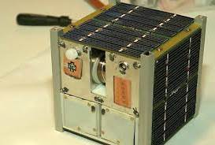
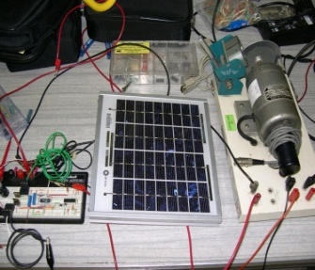


Power Electronics and Nonlinear Control:
Cubesat
Cubesat: Nonlinear Speed Control for Batteryless Applications
Prof. Eduardo Ortiz, Eduardo.ortiz7@upr.edu

Slide 38
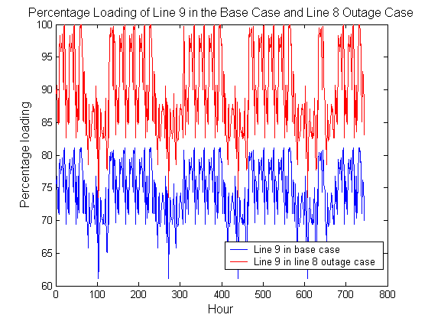
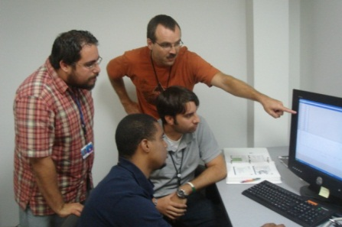
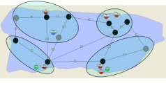



Power Electronics and Nonlinear Control:
Renewable Energy
Prof. Eduardo Ortiz, Eduardo.ortiz7@upr.edu

Slide 39
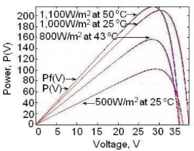

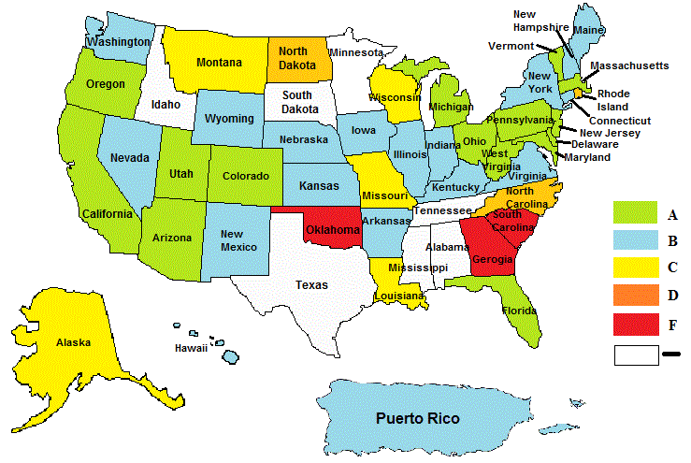
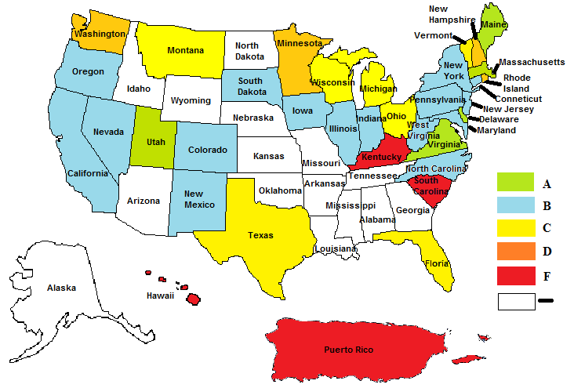

Power Electronics and Nonlinear Control:
Improving the PV
Permits Process in PR
Prof. Eduardo Ortiz, Eduardo.ortiz7@upr.edu
PV Net-metering Map.
Interconnection Map.

Slide 40
THRUST AREA 5:
Embedded Systems
Department of Electrical and Computer Engineering
Research Competence Fields

Slide 41
Embedded Systems
Cyber-security, prevention and detection of cyberattacks
Sensing/communication under uncertainty, remote sensing
Software/hardware on-the-loop integration
Implementation of real-time algorithms for complex dynamic systems
Artificial intelligence under uncertain conditions
Machine learning and decision for hardware management,
Algorithms for large-scale hardware complex systems
Nondestructive evaluation, cyber-human interaction,

Slide 42
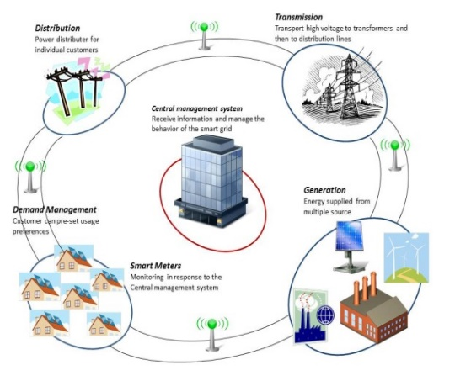
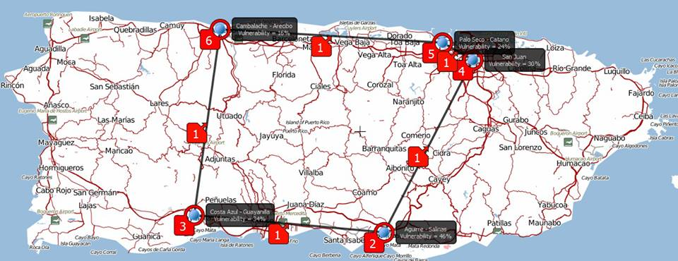
Cybersecurity in the Power Grid
Prof. Emmanuel Arzuaga, emmanuel.arzuaga@upr.edu

Slide 43
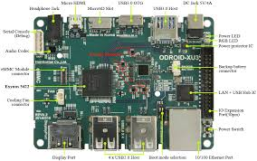
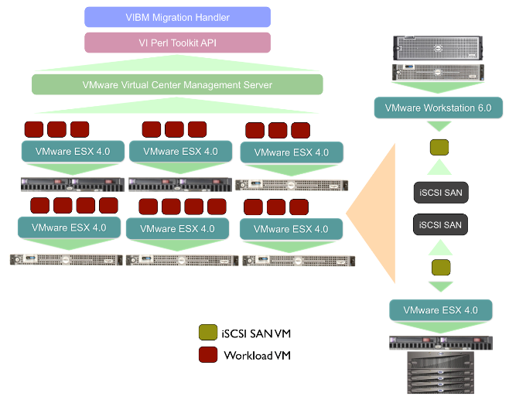
Virtualization, Operating Systems
Mobile deployable embedded computing cluster
Prof. Emmanuel Arzuaga, emmanuel.arzuaga@upr.edu
Dynamic VM placement and load balancing

Slide 44
THRUST AREA 6:
Radar, Photonics and Laser Systems
Department of Electrical and Computer Engineering
Research Competence Fields

Slide 45
Radar, Photonics and Laser Systems
Detection using phased-array radar systems
Lasers to improve the radars performance by generating accurate radio-frequency radar pulses
Software-defined radio for communication devices
Customized antennas for unmanned systems to improve communication
Photonic and opto-electronic transition technologies to improve the communication of multiple cyber-physical system

Slide 46
Hyperspectral Analysis for Imaging Processing
UPRM: Hyperspectral Image Analysis
UPRM: Development of Algorithms for Visualization
UPRM: Multiple use of Sensors for better resolution on multiple-spectral bands
Prof. Emmanuel Arzuaga, emmanuel.arzuaga@upr.edu
Spectral
Response

Slide 47
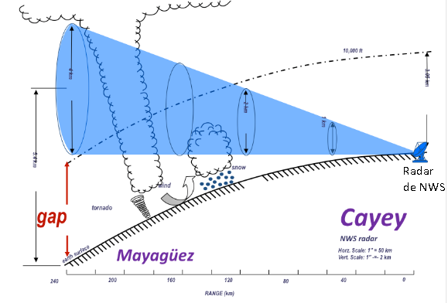
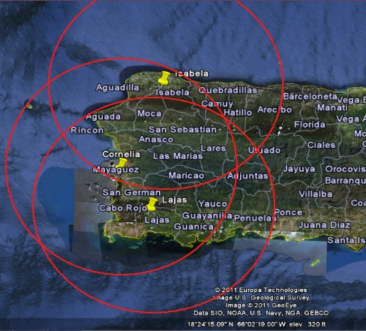
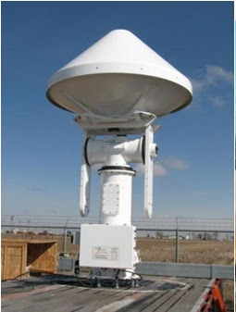
UPRMs’ Tropinet Weather Radar Network
UPRM: The NWS has problems monitoring PR’s west coast given the earth’s curvature.
UPRM: Development of Tropinet Weather Radar Network (TWRN) Systems using 3 shortrange dual polarized X-band Doppler radars and S-band radar.
UPRM:TWRN covers the lowest part of the atmosphere to detect weather phenomena.
Prof. Jose Colom, colom@ece.uprm.edu

Slide 48
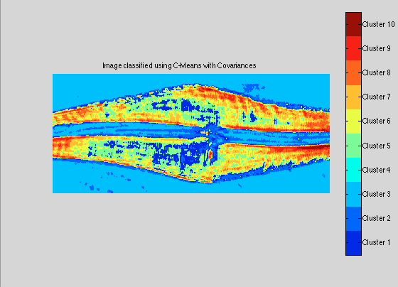




Image and Video Processing and Analysis
Hyperspectral Imaging: multi sensor fusion
Prof. Emmanuel Arzuaga, emmanuel.arzuaga@upr.edu
Biomedical Imaging: feature extraction and classification
Video processing for the hearing impaired

Slide 49

Antennas for Body Centric Communications
  Medical, military and emergency management applications.
  Three different classification of BCWC:
    Communications from Off-Body to On-Body device (Off-Body).
    - Radiation away from Body
    Communications within On-Body Networks (On-Body).
    - Radiation troughout the Body
    Communications to medical implants and sensor networks (In-Body).
    - Implant size and tissue losses
Prof. Rafael Rodriguez Rafael.rodriguez19@upr.edu

Slide 50



Microwave and Millimeter-Wave Systems Lab
Prof. Rafael Rodriguez Rafael.rodriguez19@upr.edu

Slide 51


BE PART OF THE HISTORY:
LET’S JOIN FORCES
JOIN US!!

Slide 52

http://cause.uprm.edu
Director.cause@upr.edu
DEAN OF COLLEGE OF ENGINEERING
decano.ingenieria@upr.edu
CONTACT INFORMATION

