Slide 1
Idea Platform

Slide 2
Idea Platform
Mission: To develop innovation leaders by providing students with hands-on experience in innovative and impactful projects.
Vision: A vibrant group of passionate students able to contribute to their community through innovation and creativity.

Slide 3
What’s an Innovation Leader?
Embraces Change
Self-learner
Multidiscipli-nary
Thrives in Uncertainty
Leader

Slide 4


Enablers & Entrepreneurs
Help others achieve their dream.
Learn directly from the entrepreneurs.
▪
Develop entrepreneurial and technical skills.
Spark your creativity:
- Events, workshops, and talks
Network
Synergize ideas
Business and marketing strategies
Engineering support
Digital presence:
-Videos -Graphic Design-Blogs-Website
Network

Slide 5
Empowering Enablers through our Agile Structure
Community Office
Executive Office
Partnership Office
Finance Office
Elicit Tribe
Social Media
Awesome Events
Starting Point Tribe
Empower3D
AppCreatrs
Root Ideas Blog
Operations
Environment
Supports Tribe
Lens
WebDev
Pixels
Achieve Tribe
E-Projects
Elicit Innovation
Notes:
Starting Point
Provide an innovative environment in which potential disruptive leaders are able to develop their skills and co-work.
Empower :
Integration engineering design courses
IP-Empower3D Community
Accessibility of technology
Innovation Workshops

Slide 6
Accelerated more than 10 innovative projects
Accelerated the first TEDx event in UPR
From 10 to 59 members
Notes:
Accelerated projects: Helei, Cerveza de Hector, Wonderens Food, Start-up Tools, Plan Action. Etc.

Slide 7
Top-3 most followed student organizations on Facebook
Administrators of the first makerspace at UPRM, Starting Point
Winners 3rd place Capstone Competition, “Justas Empresariales 2015”, and 4 Stanford’s UIF

Slide 8
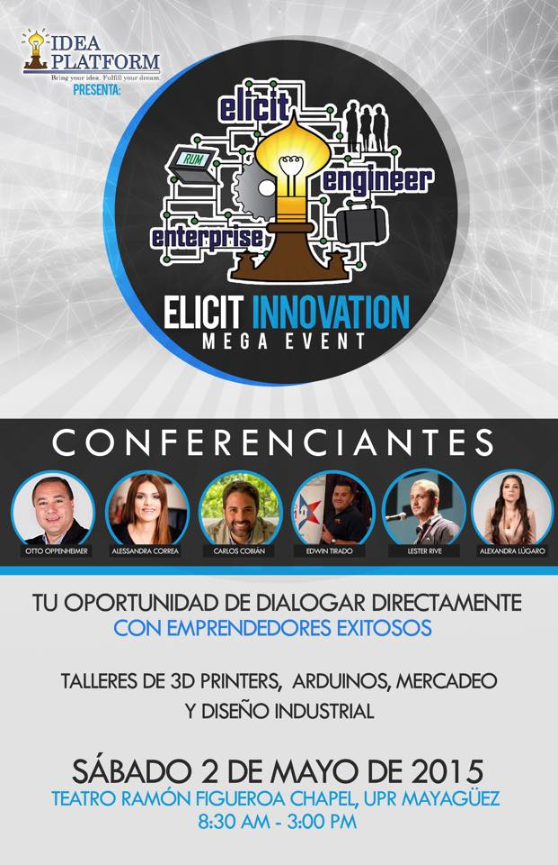
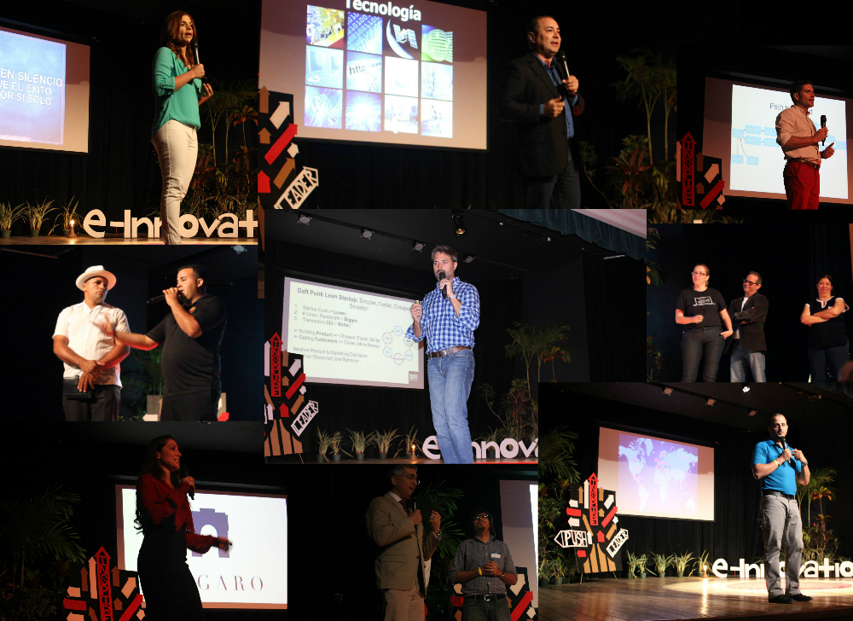
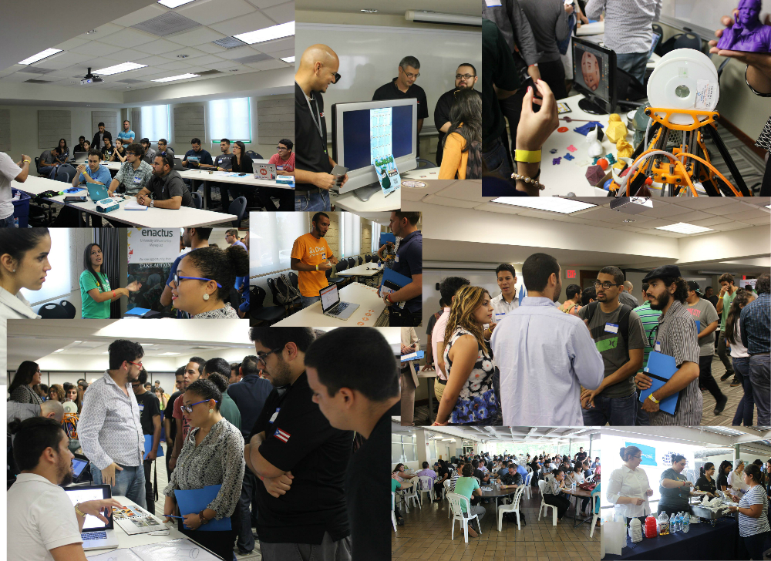
Speakers
Networking
Workshops

Slide 9
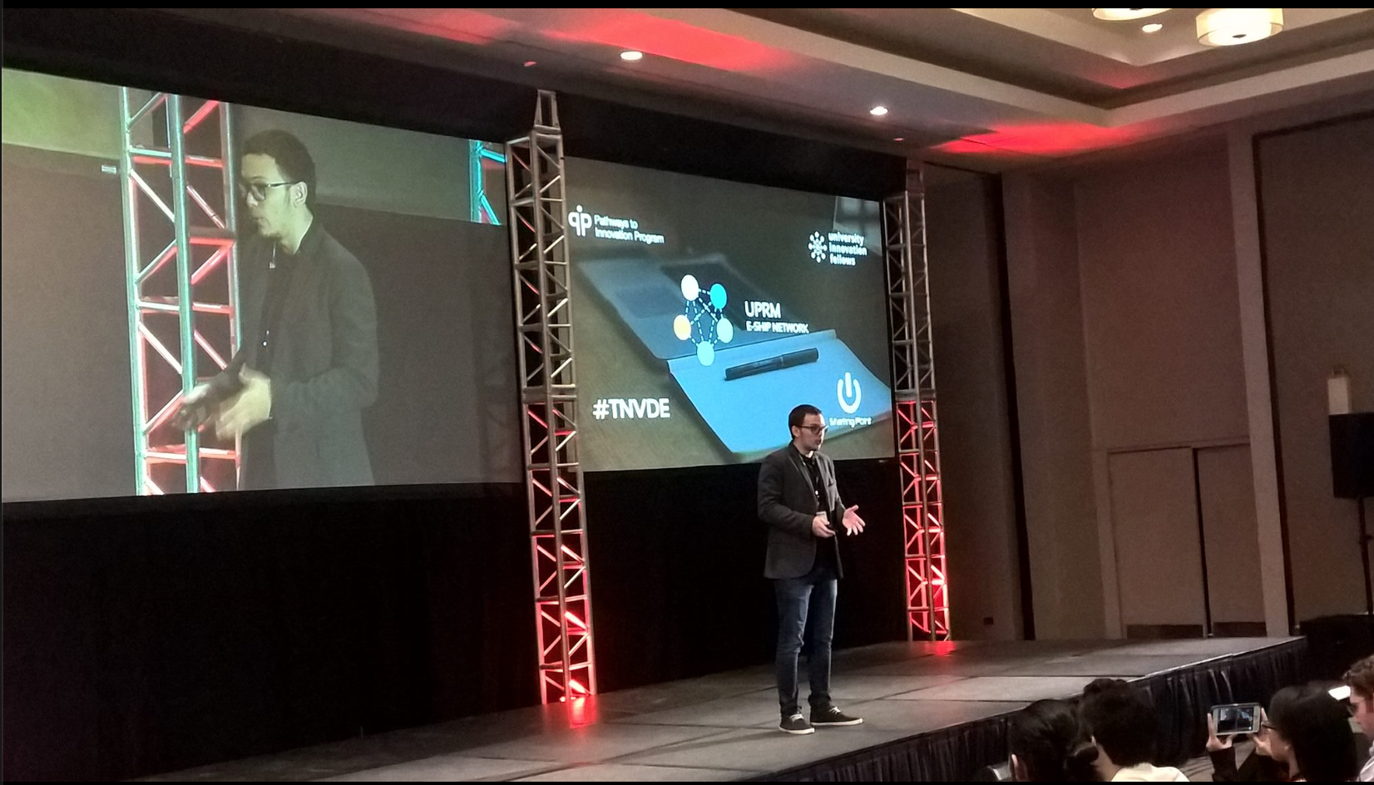
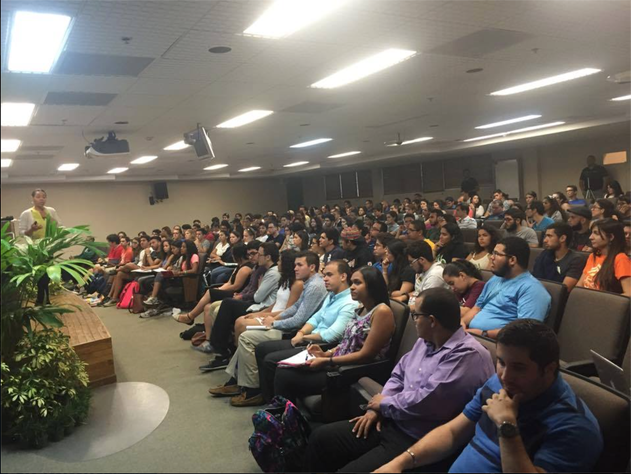
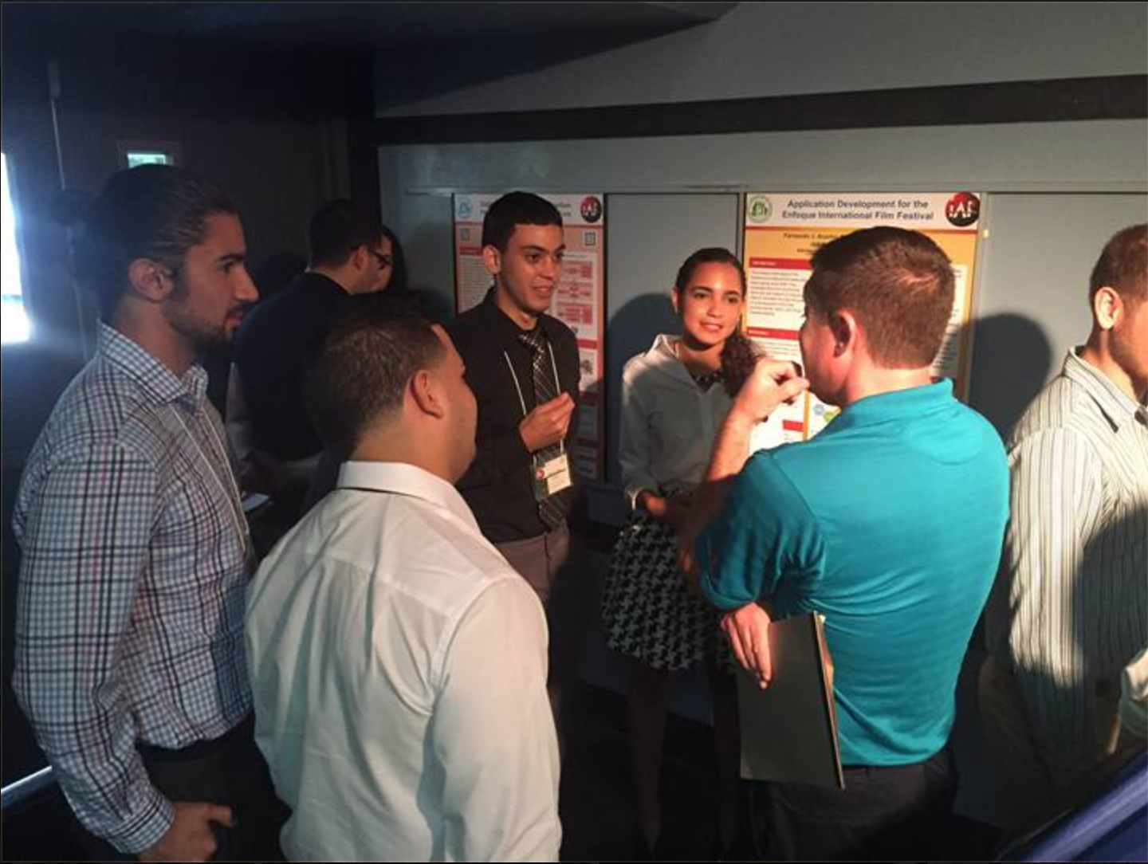
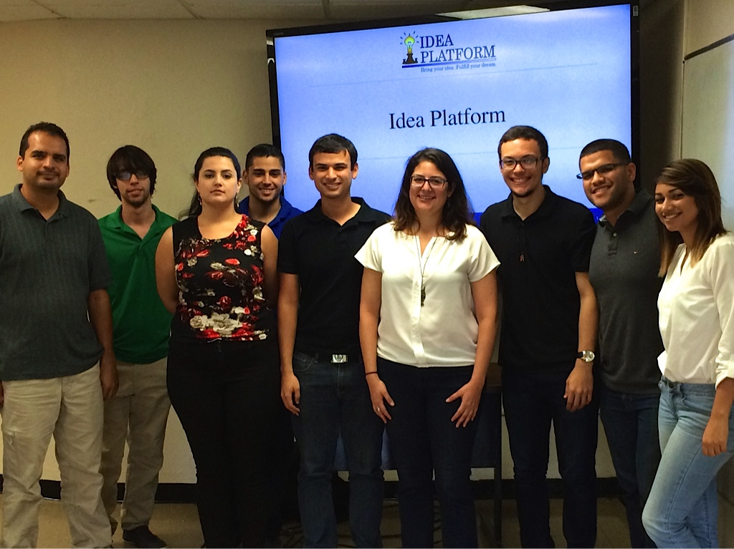
How to’s: Obtaining a Summer Research Experience within a Top University
H3 Conference
MIT & Berkeley Dean
App Team – IAP Conference
Giovanna Guerrero CPR Director
Notes:
How to’s: Obtaining a Summer Research Experience within a Top University

Slide 10
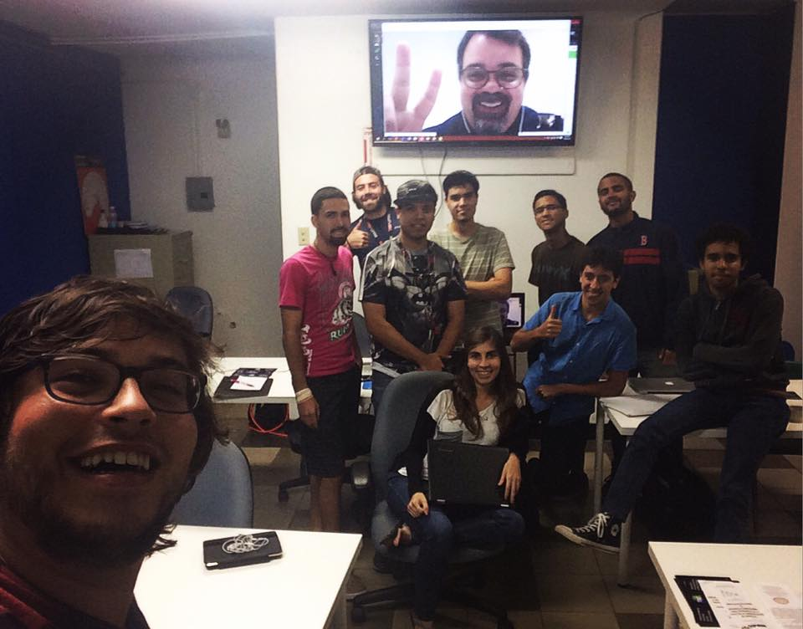
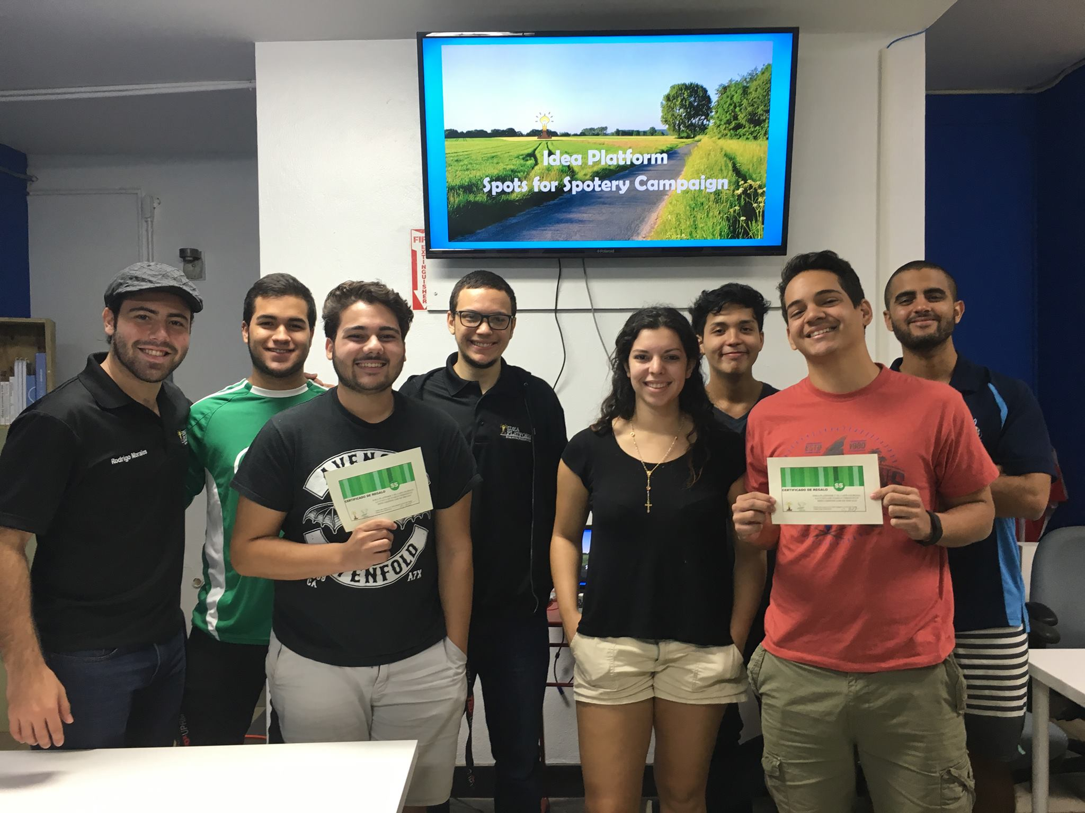
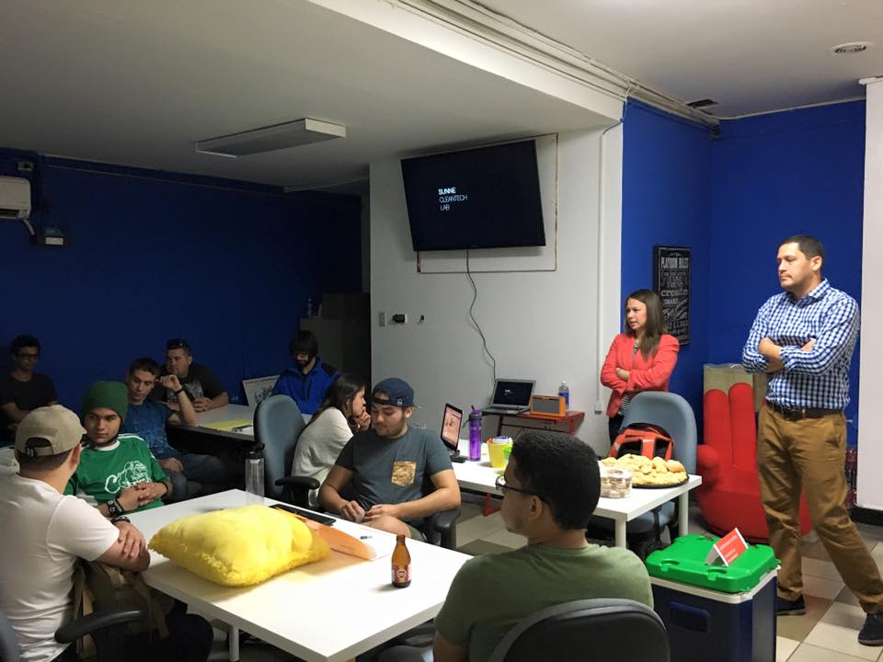
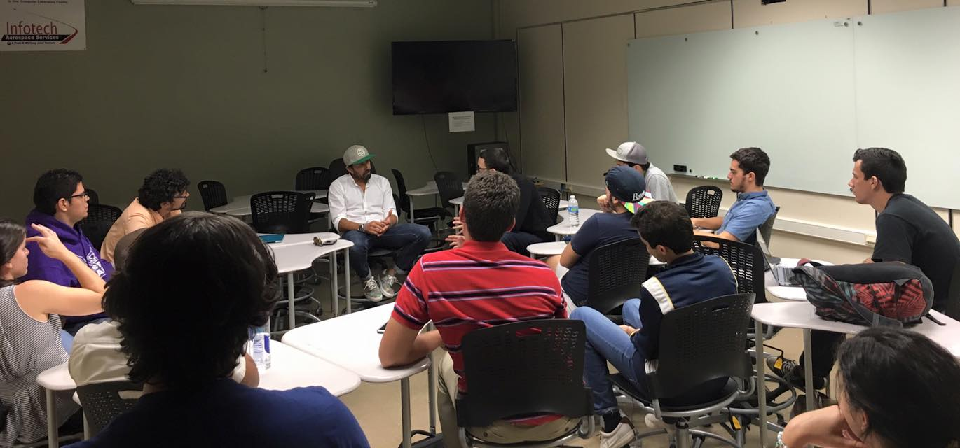
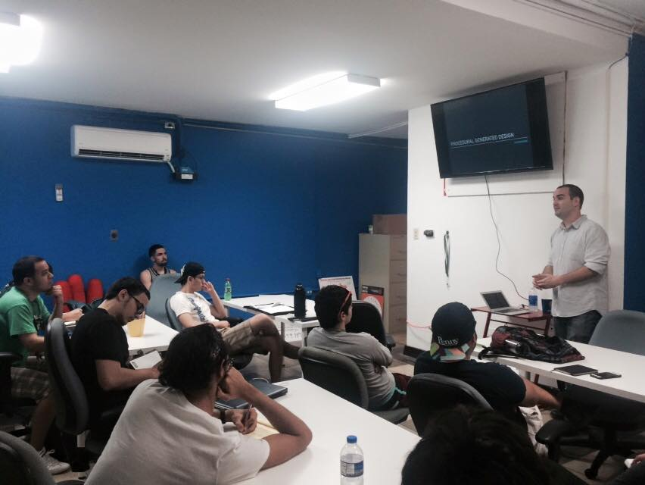
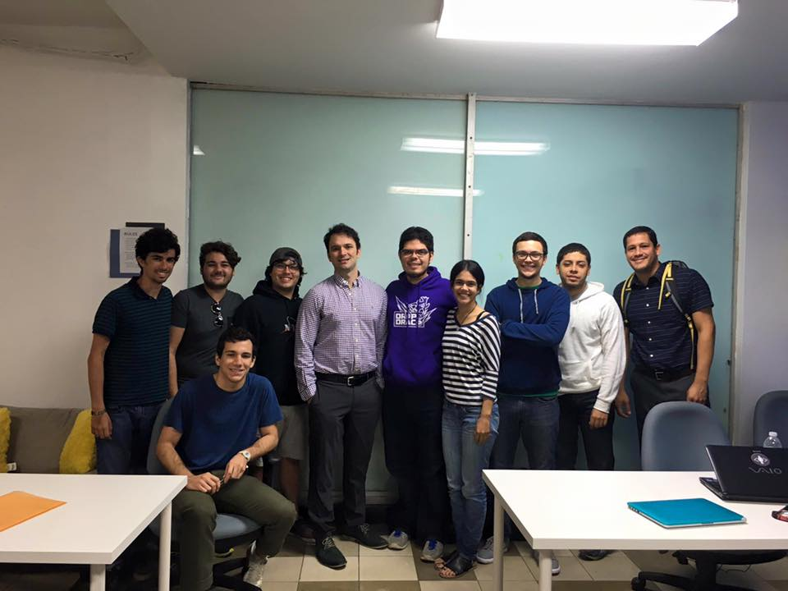
Sunne Labs
Antroket
Spotery
ArrancaPR
Yiftee

Slide 11













Collaborators

Slide 12




Interesting Numbers
21%-30%
0%-32%
7%-25%
10-56 members
Notes:
Womans 21-30%
Non-engineering students 7-25%
1-3year students 0-32%

Slide 13

Thanks!
Find us at:
facebook.com/IdeaPlatformPR

