Slide 1


Council for the
Accreditation
of
Educator
Preparation
Standard 5: Provider Quality Assurance and Continuous Improvement
Prof. Silvestre Colón, Capacitación CAEP UPRM
Rincón PR, Mayo 29, 2014
2014 CAEP –Conference
Nashville, TN
March 26-28, 2014
Presenters: Mark LaCelle-Peterson
Senior Vice President
Linda McKee
Director, Member and State Relations
CONNECT WITH CAEP | www.CAEPnet.org | Twitter: @CAEPupdates

Slide 2
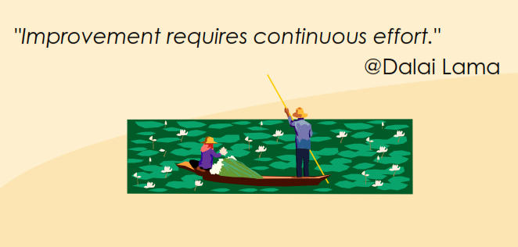
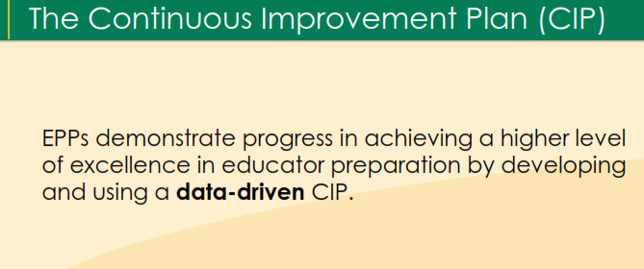

Slide 3

Goals
Explain Standard 5.
Identify and explain components.
Identify possible pieces of evidence for the components of standard 5.
Council for the Accreditation of Educator Preparation
CONNECT WITH CAEP | www.CAEPnet.org | Twitter: @CAEPupdates

Slide 4
Evidence Criteria
Data and rubrics must be developed with the best information that can be marshaled and it must be used as effectively as possible. Evidence should show that the EPP:
makes decisions informed by multiple measures.
judges the preparation of its completers by their impact on P‐12 student learning and development.
uses validated, reliable and fair evidence to demonstrate it meets CAEP standards.
maintains quality assurance systems that support continuous monitoring of a wide range of conditions and outcomes of preparation, and uses data to reach toward and surpass challenging goals.
Council for the Accreditation of Educator Preparation
CONNECT WITH CAEP | www.CAEPnet.org | Twitter: @CAEPupdates

Slide 5
Standard 5 – Provider Quality Assurance and Continuous Improvement (part 1)
The provider maintains a quality assurance system comprised of valid data from multiple measures, including evidence of candidates’ and completers’ positive impact on P‐12 student learning and development. The provider supports continuous improvement that is sustained and evidence‐based, and that evaluates the effectiveness of its completers.
Council for the Accreditation of Educator Preparation
CONNECT WITH CAEP | www.CAEPnet.org | Twitter: @CAEPupdates

Slide 6
Standard 5 – Provider Quality Assurance and Continuous Improvement (part 2)
The provider uses the results of inquiry and data collection to establish priorities, enhance program elements and capacity, and test innovations to improve completers’ impact on P- 12 student learning and development.
Council for the Accreditation of Educator Preparation
CONNECT WITH CAEP | www.CAEPnet.org | Twitter: @CAEPupdates

Slide 7
Quality and Strategic Evaluation
5.1 The provider’s quality assurance program is comprised of multiple measures that can monitor candidate progress, completer achievements, and provider operational effectiveness. Evidence demonstrates that the provider satisfies all CAEP standards.
Challenge: adapt current candidate measures and develop new ones to show UPRM meets CAEP standards
Council for the Accreditation of Educator Preparation
CONNECT WITH CAEP | www.CAEPnet.org | Twitter: @CAEPupdates

Slide 8
Quality and Strategic Evaluation
5.2 The provider’s quality assurance system relies on relevant, verifiable, representative, cumulative and actionable measures, and produces empirical evidence that interpretations of data are valid and consistent.
Challenge: validate data and used to show UPRM meets CAEP standards, show and defend use of data
Council for the Accreditation of Educator Preparation
CONNECT WITH CAEP | www.CAEPnet.org | Twitter: @CAEPupdates

Slide 9
Continuous Improvement
5.3 The provider regularly and systematically assesses performance against its goals and relevant standards, tracks results over time, tests innovations and the effects of selection criteria on subsequent progress and completion, and uses results to improve program elements and processes.
Challenge: establish and execute continuous improvement using data-based decisions
Council for the Accreditation of Educator Preparation
CONNECT WITH CAEP | www.CAEPnet.org | Twitter: @CAEPupdates

Slide 10
Continuous Improvement
5.4 Measures of completer impact, including available outcome data on P‐12 student growth, are summarized, externally benchmarked, analyzed, shared widely, and acted upon in decision‐making related to programs, resource allocation, and future direction.
Challenge: make validated data available to public in readily accessible, usable format
Council for the Accreditation of Educator Preparation
CONNECT WITH CAEP | www.CAEPnet.org | Twitter: @CAEPupdates

Slide 11
Continuous Improvement
5.5 The provider assures that appropriate stakeholders, including alumni, employers, practitioners, school and community partners, and others defined by the provider, are involved in program evaluation, improvement, and identification of models of excellence.
Challenge: involve the relevant stakeholders in UPRM’s teacher preparation program
Council for the Accreditation of Educator Preparation
CONNECT WITH CAEP | www.CAEPnet.org | Twitter: @CAEPupdates

Slide 12
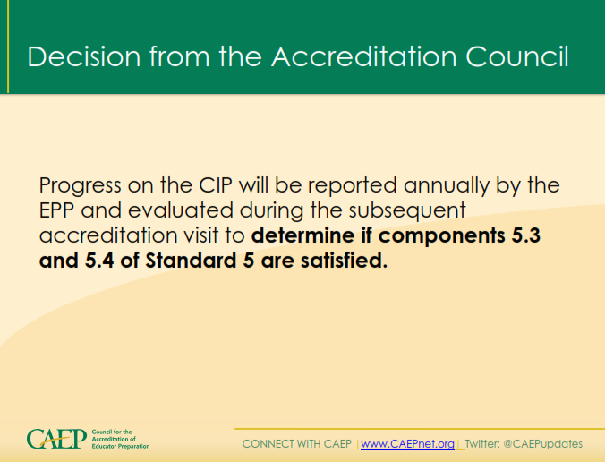

Slide 13
Now WHAT?
Outline!!!
Standard 5: Provider Quality, Continuous Improvement and Capacity
i. Evidence/data/tables (Upload each item of evidence under the appropriate
components of the standard and answer the following questions for each item.)
1. What is this item of evidence?
2. How was the quality of the evidence determined or assured?
3. What criteria of success have been established on the measure, and how?
4. What does the evidence mean?
5. How is the evidence used?
ii. Holistic summary statement (through comparison, benchmarking, trend
interpretation, etc.) that provides a narrative explication for how the evidence
collection, taken as a whole, demonstrates that the standard is met
Council for the Accreditation of Educator Preparation
CONNECT WITH CAEP | www.CAEPnet.org | Twitter: @CAEPupdates

Slide 14
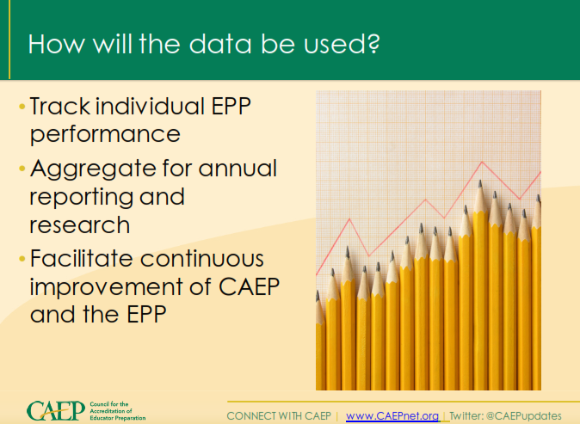

Slide 15
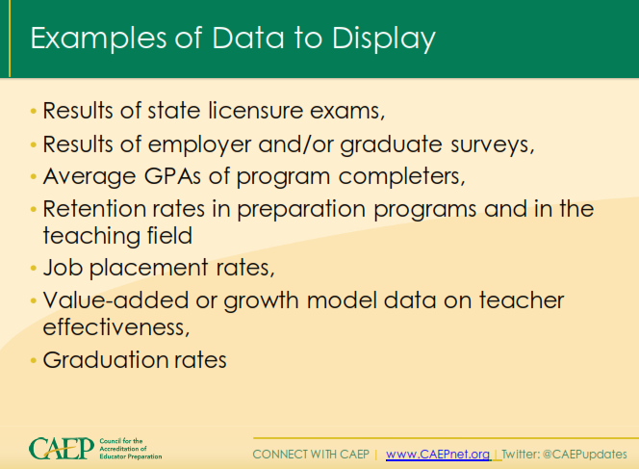

Slide 16
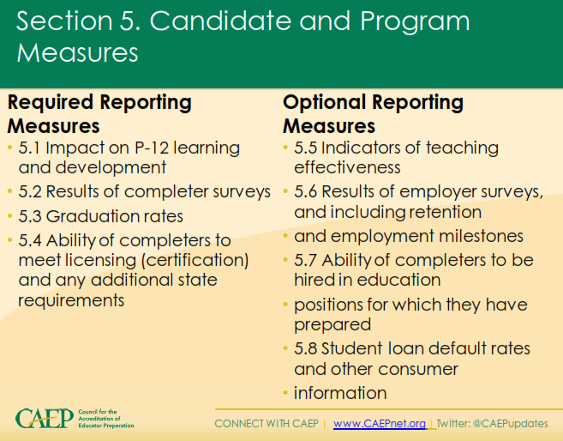

Slide 17
Continuous Improvement (CI)
An organizational process through which data are collected on all aspects of a provider’s activities; analyzed to determine patterns, trends, and progress; and used to define changes for the purpose of improving the quality of programs, faculty, candidates, policies, procedures, and practices of educator preparation.
Council for the Accreditation of Educator Preparation
CONNECT WITH CAEP | www.CAEPnet.org | Twitter: @CAEPupdates

Slide 18

“Coming together is a beginning. Keeping together is progress. Working together is success.”
Henry Ford
Council for the Accreditation of Educator Preparation
CONNECT WITH CAEP | www.CAEPnet.org | Twitter: @CAEPupdates

Slide 19
Thank you!
Questions?
Council for the Accreditation of Educator Preparation
CONNECT WITH CAEP | www.CAEPnet.org | Twitter: @CAEPupdates

