Slide 1

Achievable
Renewable
Energy
Targets
For Puerto Rico’s Renewable Energy Portfolio Standard
Agustín A. Irizarry Rivera, PhD, PE
agustin@ece.uprm.edu
José A. Colucci-Ríos, PhD, PE
Biodieselpr1@aol.com
Efraín O’Neill-Carrillo, PhD, PE
oneill@ece.uprm.edu

Slide 2
Objetivo: producir un estimado realista de la cantidad de electricidad que se puede producir con cada recurso renovable disponible en Puerto Rico.
Solar, fotovoltaica y solar termal*,
Océano, olas y oceánica termal
  mareas y corrientes descartadas en estudio preliminar
Viento, grande y pequeño,
Biomasa, incluyendo la basura*,
micro hidro*
celdas combustibles (“fuel cells”)*
* Solo en el estudio preliminar
Estudio detallado.

Slide 3
¿un estimado realista?
Estimado basado en:
Disponibilidad de cada recurso,
Espacio (área) necesario (“foot print”),
Efectos del clima,
  Ciclos por temporada, diurno/nocturno,
Tecnología disponible (comercial, prototipo, lab),
Costo (capital, mantenimiento y operación)
Interconexión a la red de electricidad
Otros según se necesiten

Slide 4

Renewable Portfolio Standards
Es una política pública estatal que le requiere a los proveedores de electricidad que obtengan, de fuentes renovables, cierto por ciento mínimo de la potencia que venden para una fecha específica.
El RPS de Hawai tiene como meta 20% de electricidad renovable para el 2020

Slide 5
¿Como se obliga a satisfacer el mandato de que en el estado se genere cierto por ciento mínimo de electricidad usando renovables?
Con un mercado
Los generadores o vendedores tienen que demostrar que generaron y vendieron electricidad renovable o que compraron y re-vendieron electricidad renovable.
  "renewable energy credits" = certificados de compraventa.

Slide 6
Renewable Energy Credits (REC)
Es un certificado de que un kWh de electricidad fue generado usando una fuente renovable y fue vendido a un abonado en el estado.
  Certificado de generación y venta no de capacidad.
  El REC es un producto separado del kWh mismo.

Slide 7

Renewable Energy Credits (REC)
El RPS se ejecuta con el requisito a cada generador o vendedor de que posea una cantidad de créditos (REC) equivalente a cierto por ciento de su generación (o venta) anual en kWh.
  Ejemplo: RPS = 5%, Si el generador vende 100,000 kWh en un año, necesita poseer 5,000 REC al final del año.

Slide 8
Renewable Energy Credits (REC)
El generador de electricidad renovable es el dueño de los REC y puede venderlos junto con los kWh o puede vender los kWh a un comprador y los REC a otro, cada cual al valor de su propio mercado.
  Se limita al valor de los REC, digamos, 2.5 ¢/KWh

Slide 9
Low density energy thus requires large areas
Varies with time and location
Varies with atmospheric conditions
wind → waves
Indirect capture
Ocean
(e.g. OTEC)
Direct capture
Thermal
Photonic
Pasive
(e.g. solar architecture)
Active
(solar thermal)
Photochemistry
(plants)
Photovoltaic
(solar PV)

Slide 10
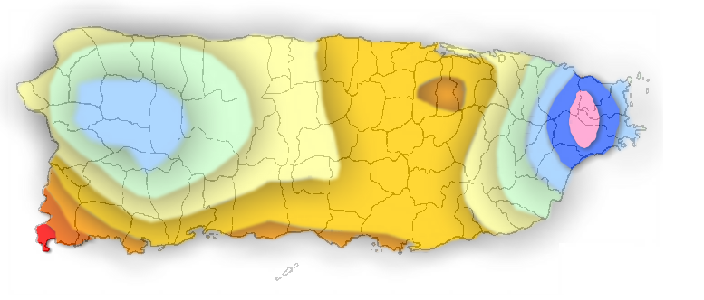



Average Insolation in Puerto Rico, kWh/m² per year
Hatillo
Barceloneta
Vega Baja
Toa Baja
Carolina
Quebradillas
Manatí
Vega Alta
Cataño
Canovanas
Dorado
Aguadilla
San
Juan
Rincón
Isabela
Arecibo
Loiza
Moca
Camuy
Aguada
Florida
Toa Alta
Guaynabo
Río Grande
Luquillo
San Sebastián
Morovis
Bayamón
Trujillo Alto
Añasco
Ciales
Corozal
Fajardo
Lares
Utuado
Naranjito
Aguas Buenas
Gurabo
Las Marías
Orocovis
Comerio
Juncos
Naguabo
Ceiba
Mayagüez
Jayuya
Barranquitas
Caguas
Hormigueros
Maricao
Adjuntas
Cidra
San Lorenzo
San Germán
Villalba
Aibonito
Humacao
Yauco
Coamo
Cayey
Cabo Rojo
Ponce
Yabucoa
Juana Díaz
Las Piedras
Lajas
Santa Isabel
Salinas
Guánica
Guayama
Maunabo
Sabana Grande
Guayanilla
Peñuelas
Arroyo
Patillas
1495
1343
1191
1952
1800
1648
2408
2256
2104

Slide 11
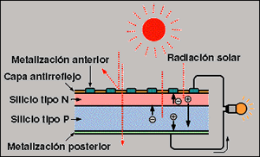
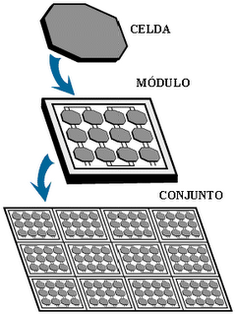
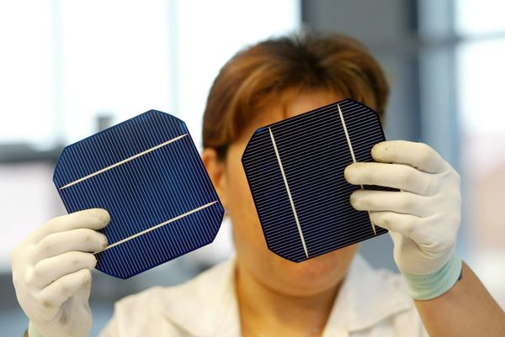
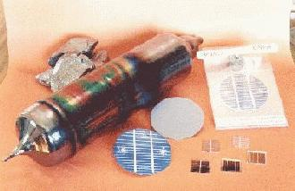
Solar cell - a device that converts the energy of sunlight directly into electricity by the photovoltaic effect.
Assemblies of cells are used to make solar panels, solar modules, or photovoltaic arrays.
obleas

Slide 12
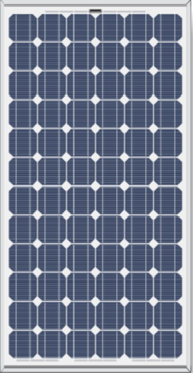
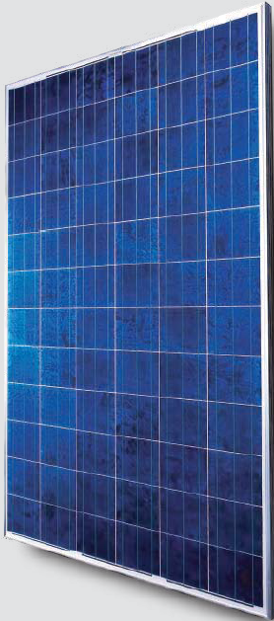
SUNTECH STP175S-24, 1.2 m²
Monocrystalline- single, continuous crystal lattice structure, almost no defects or impurities. High efficiencies, (14.1% Suntech 175 W, 18% SunPower 230 W), more complicated manufacturing = higher costs
Multicrystalline- produced using numerous grains of monocrystalline silicon. Molten polycrystalline Si made into ingots, ingots cut into very thin wafers and assembled into complete cells. cheaper to produce but tend to be slightly less efficient.
Suntech STP 270 24/Vb-1 ~ 16% efficiency.

Slide 13


Amorphous Silicon ("thin film" PV ) = silicon atoms in a thin homogenous layer rather (no crystal structure).
absorbs light more effectively than crystalline silicon,
can be deposited on a wide range of substrates, both rigid and flexible, (curved surfaces and "fold-away“)
less efficient than crystalline cells 6% (Suntech STP086Ts-AA)
easier and cheaper to produce
for many applications where high efficiency is not required and low cost is important.

Slide 14
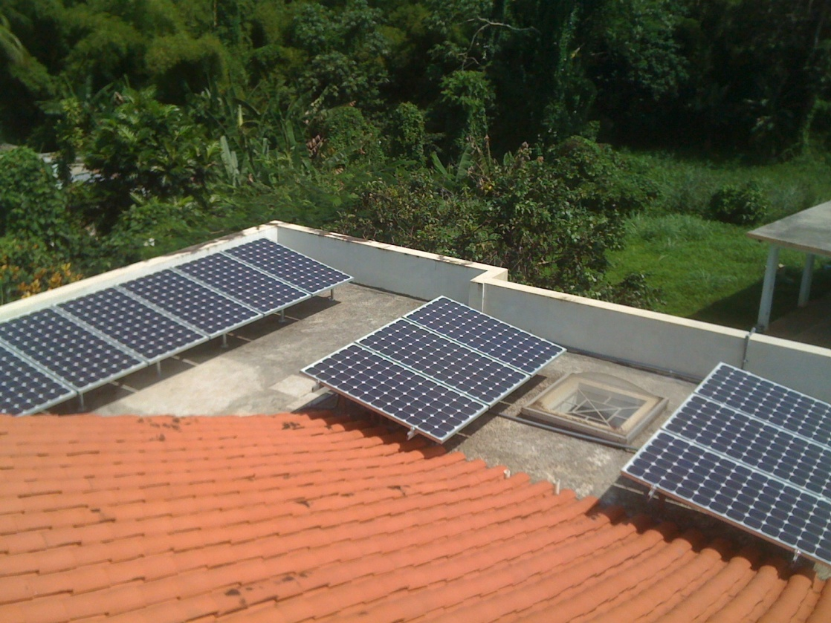
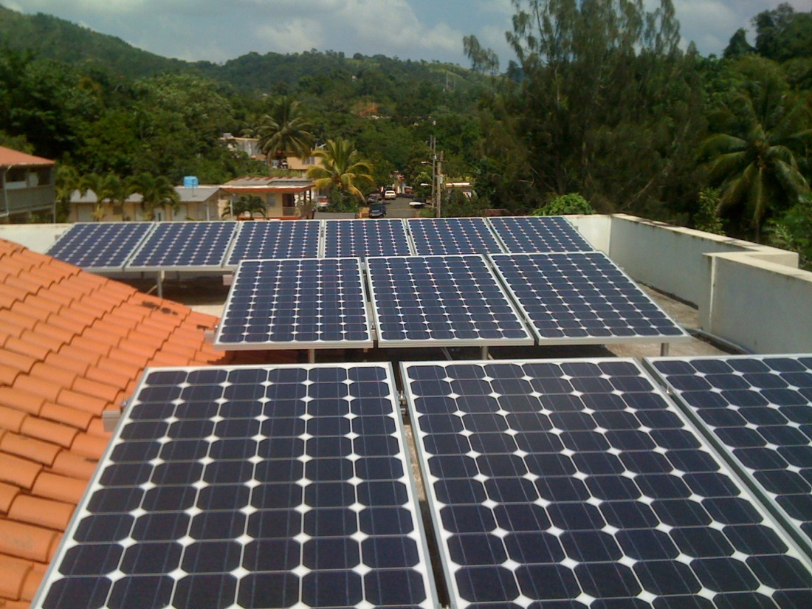

Slide 15
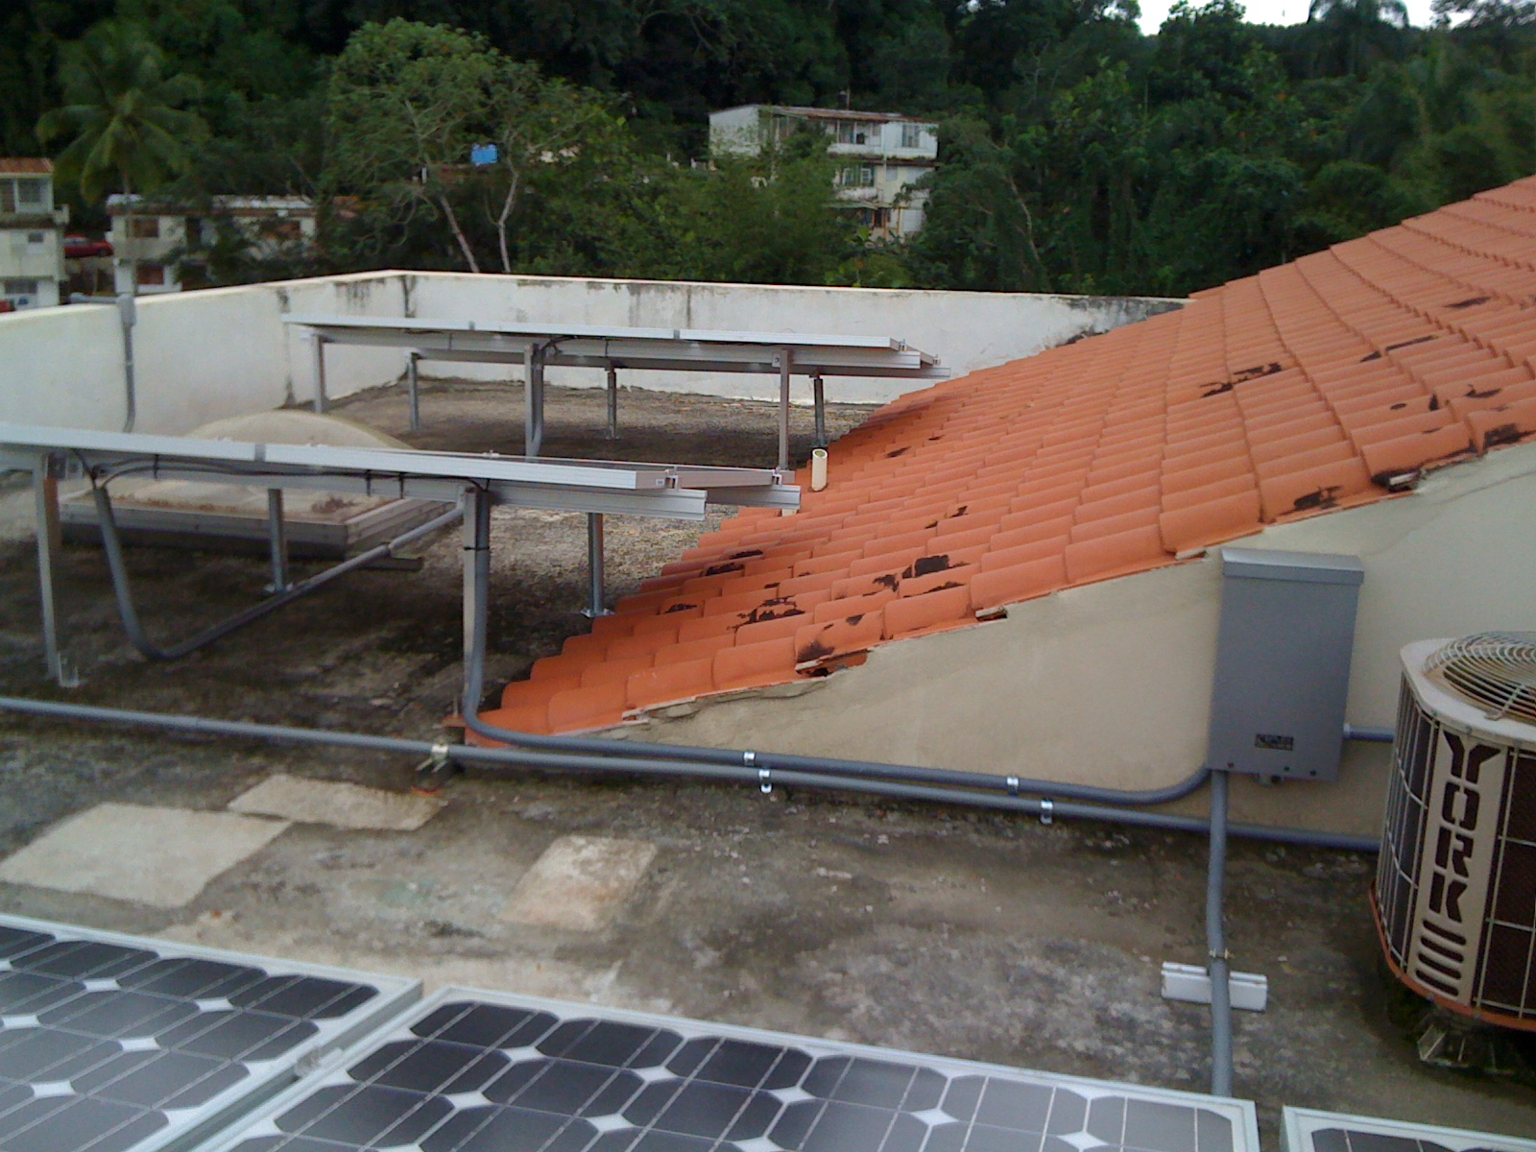
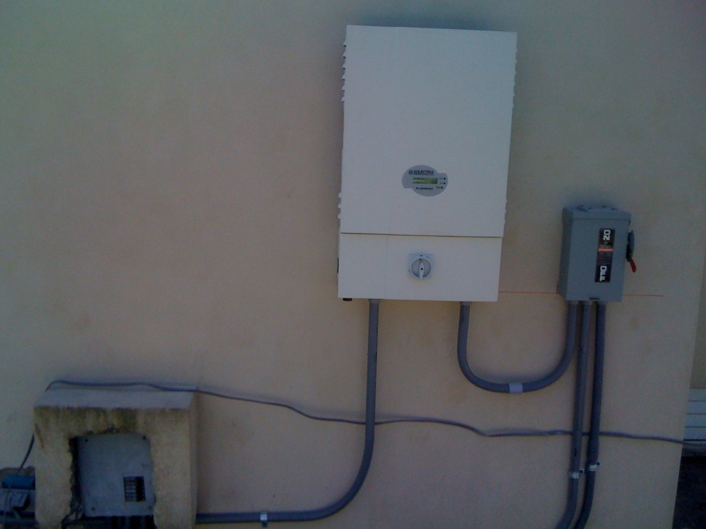
inversor
Entrada
DC
Salida
AC
Punto de conexión
del arreglo

Slide 16
Costo estimado sistema PV, 12 paneles, 2.1 kW
Elemento del sistema/trabajo | ($/W)
Paneles | 4.50
Invertidor | 0.95
Materiales eléctricos, cajas, herrajes | 1.00
Instalación | 0.90
Diseño, certificación, permisos | 0.50
Total estimado | 7.85
Costo estimado sistema PV, ~580 kW, 6.50 $/W

Slide 17
Estimated Average Insolation, kWh/m² per year
Hatillo
Barceloneta
Vega Baja
Toa Baja
Carolina
Quebradillas
Manatí
Vega Alta
Cataño
Canovanas
Dorado
Aguadilla
San
Juan
Rincón
Isabela
Arecibo
Loiza
Moca
Camuy
Aguada
Florida
Toa Alta
Guaynabo
Río Grande
Luquillo
San Sebastián
Morovis
Bayamón
Trujillo Alto
Añasco
Ciales
Corozal
Fajardo
Lares
Utuado
Naranjito
Aguas Buenas
Gurabo
Las Marías
Orocovis
Comerio
Juncos
Naguabo
Ceiba
Mayagüez
Jayuya
Barranquitas
Caguas
X
Maricao
Adjuntas
Cidra
San Lorenzo
Hormigueros
Villalba
Aibonito
Humacao
San Germán
Cayey
Yauco
Ponce
Coamo
Yabucoa
Cabo Rojo
Juana Díaz
Las Piedras
Lajas
Santa Isabel
Salinas
Guánica
Guayama
Maunabo
Sabana Grande
Guayanilla
Peñuelas
Arroyo
Patillas
 | Ave. Insol. kWh/m² / year | Elec. kWh/m² / year
Ponce | 2100 | 2100*0.13= 273
Mayagüez | 1800 | 234
San Juan | 2000 | 260
1495
1343
1191
1952
1800
1648
2408
2256
2104
η = 0.14 x 0.96 = 0.13

Slide 18
Cotejo del estimado de producción de energía
Estimado del
mapa
experimental

Slide 19
Costo evitado vs. medida neta
Public Utility Regulatory Policies Act of 1978 (PURPA) - Obliga a la compañía eléctrica a comprar electricidad producida por generadores independientes al costo evitado de producción de la compañía eléctrica.
  Costo de producción es menor que el precio de venta.
Hace falta ley local – El excedente de electricidad producida por el cliente, usualmente renovable, se inyecta a la red y el contador “da reversa”

Slide 20
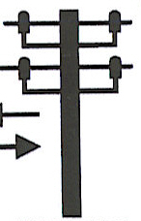
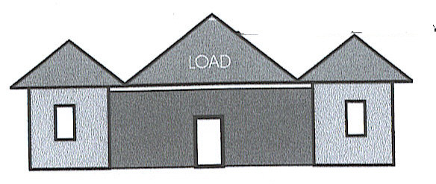
Costo Evitado
21 ¢/kWh
4 a 6 ¢/kWh
contador
Autor: Dr. Gerson Beauchamp

Slide 21
Costo Evitado
21 ¢/kWh
4 a 6 ¢/kWh
contador
Autor: Dr. Gerson Beauchamp

Slide 22
Medida Neta
21 ¢/kWh
21 ¢/kWh
contador
Autor: Dr. Gerson Beauchamp

Slide 23
PS 1212 es hoy la Ley 114 16 ago 07
Es mejor que nada.
Pobre comparado a lo que puede ser
  ES MEDIDA NETA mientras no excedas el consumo usual luego AEE paga 10 ¢kWh
  Solo PV y viento – hay límite diario que penaliza al viento
  Mas impuestos – 25% de lo que se acumula de un año a otro pasa a fondo de Escuelas
  No es explícito en necesidad/costos de estudios de conexión
REGLAMENTO

Slide 24
Medida Neta Actual en Puerto Rico
21 ¢/kWh
10 a 21 ¢/kWh
contador
Autores: Dr. Gerson Beauchamp, Agustín Irizarry

Slide 25
3,900,000 MWh
19% energía demandada el 2006
SOLO TECHOS!!!
Notes:
25

Slide 26
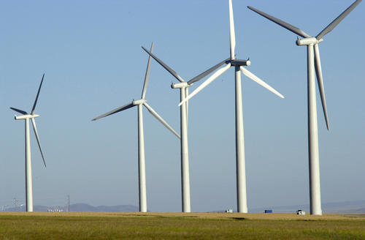
Las turbinas de vientos (molinos) convierten la energía cinética del viento a energía eléctrica …

Slide 27
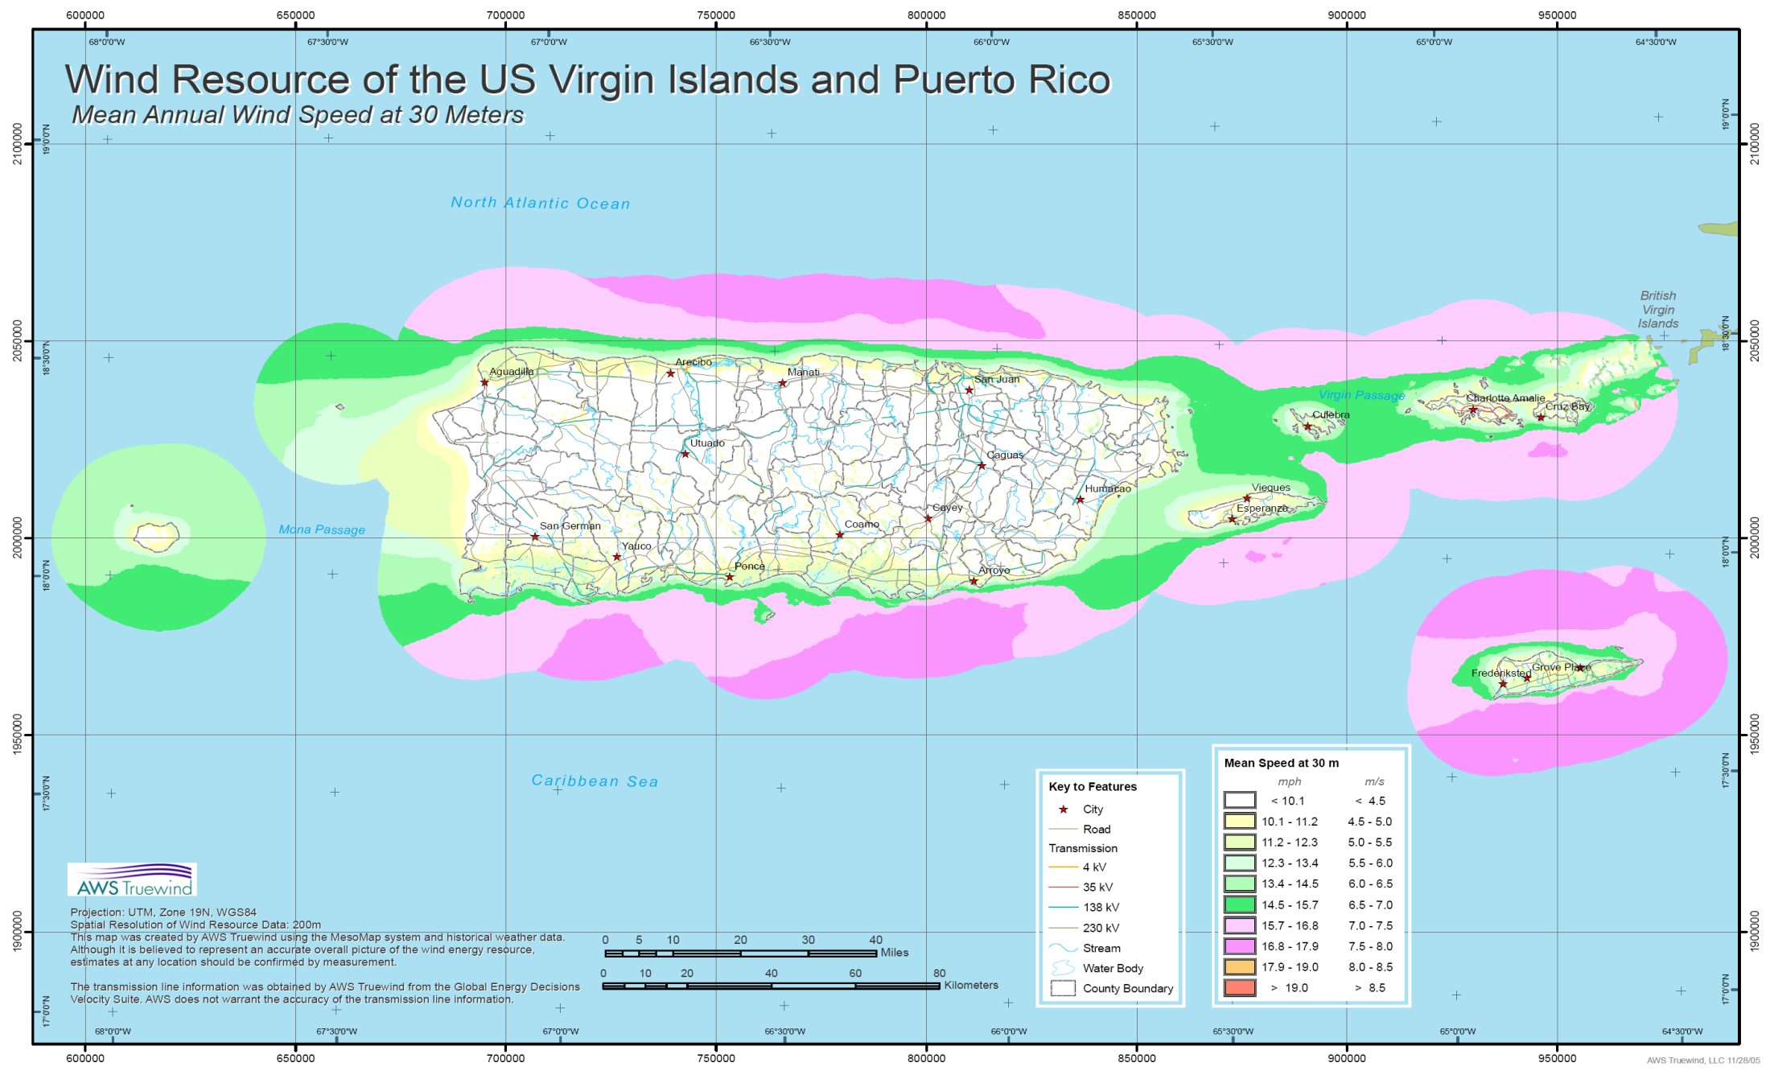
… si tienes viento.

Slide 28
Determination of Favorable Conditions for the Development of a Wind Power Farm in Puerto Rico
Financing via loan | Sell price ¢/kWh | Sell price ¢/kWh (PTC) | Sell price ¢/kWh (Tax free)
Private investor | 8.37 | 7.92 | 7.61
Utility [bonds] | 6.73 [5.54] | 6.48 [5.49] | 6.34 [5.44]
Puerto Rico’s east coast, 10 MW wind farm
Carlos A. Ramos Robles (MS Thesis 2005) and Agustin Irizarry Rivera
Notes:
28

Slide 29
Variability of Wind by month
More wind in summer, based on “Monthly Distribution of mean wind velocity in (m/s)”.
Average Monthly Wind Speed

Slide 30
Variability of Wind – day & night cycle
Diurnal effect is the change in wind speed from night to day. This effect is strong inland.
(m/s)
AM
PM
Puerto Rico Average Diurnal Wind Speed Effect
AM
PM
Hourly Average Wind Speed in Places with Diurnal Wind Effect Change Average
As the sun heats the ground during morning hours, the wind speed intensify. At sunset the wind return to the speed it had in the morning hours.

Slide 31
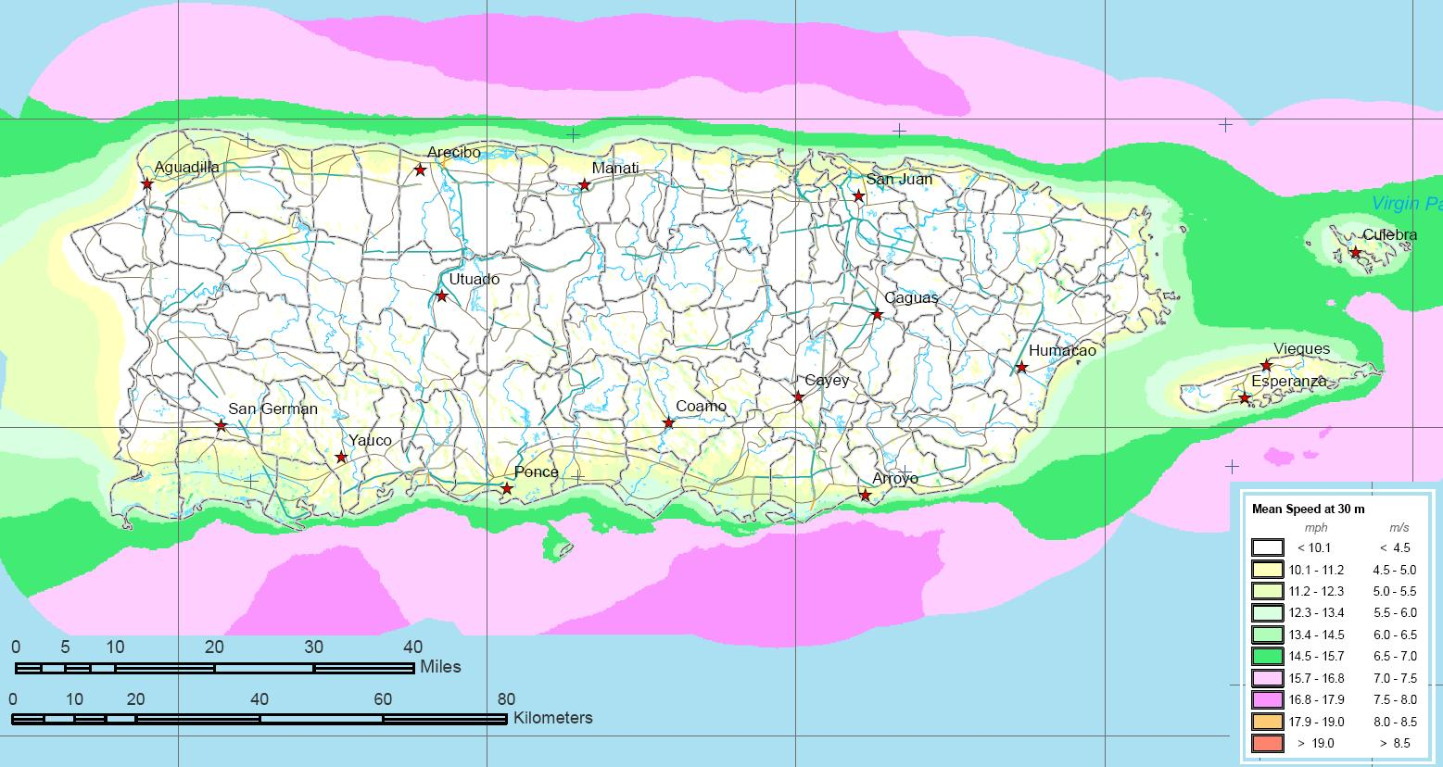
Annual energy production per turbine, in MWh, for large wind turbines @ 50 m height
Turbine | Power capacity [MW] | Rotor diameter [m] | Tallaboa | AES | Roosvelt Roads | Fajardo
Enercon E53 | 0.81 | 53 | 725 | 1127 | 1722 | 3142
Gamesa G58 | 0.85 | 58 | 681 | 1136 | 1793 | 3355
AAER A1000 | 1.00 | 58 | 354 | 714 | 1378 | 2614
The 850 kW turbine produces more energy than a 1 MW turbine
at all sites.
Populated Areas and Unpopulated Areas in Puerto Rico
3 km wide band
Populated areas for small wind
1 small turbine per 5 cuerdas =
12,000 small turbines (10 to 50 MW)
10% → 360,000 MWh/year

Slide 32
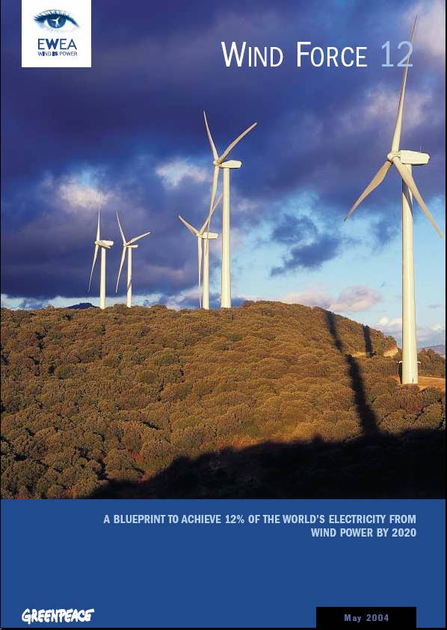
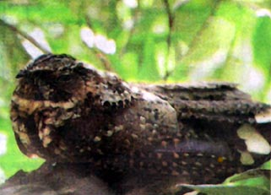
Generación Eólica en Puerto Rico
Agustín A. Irizarry Rivera, PhD, PE
Depto Ingeniería Eléctrica y Computadoras
ACEER 18 de agosto de 2007
Centro Cultural de Mayagüez
“En Puerto Rico, con lo sensitiva que es toda la Isla, ningun sitio es bueno para instalar turbinas de viento.”
Ernesto Santiago (SOPI)
El Nuevo Día
12 de septiembre de 2004

Slide 33
Un cambio global
Wind Force 12 es un estudio sobre la factibilidad de producir el 12% de la electricidad consumida en el Mundo para el 2020
El estudio concluye que no existen restricciones tecnológicas, comerciales o de recurso que impidan alcanzar la meta del 12%.
Si hacen falta cambios en las políticas energéticas nacionales e internacionales.

Slide 34

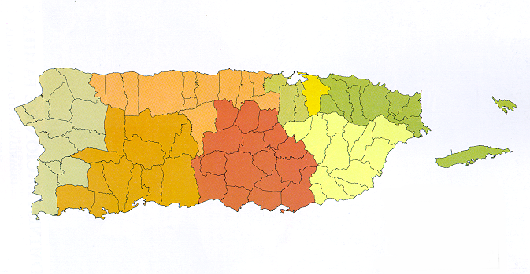
Los problemas que enfrenta la generación eólica en Puerto Rico (y las demás renovables también …)
NO PLAN de uso de terrenos
NO DIALOGO Nacional
  Ambiente, Justicia Social
  No petróleo, gas o carbón
NO ESTRUCTURAS PARTICIPATIVAS
Costa Sur, ecoElectrica,
CORCO, ¿Windmar?

Slide 35
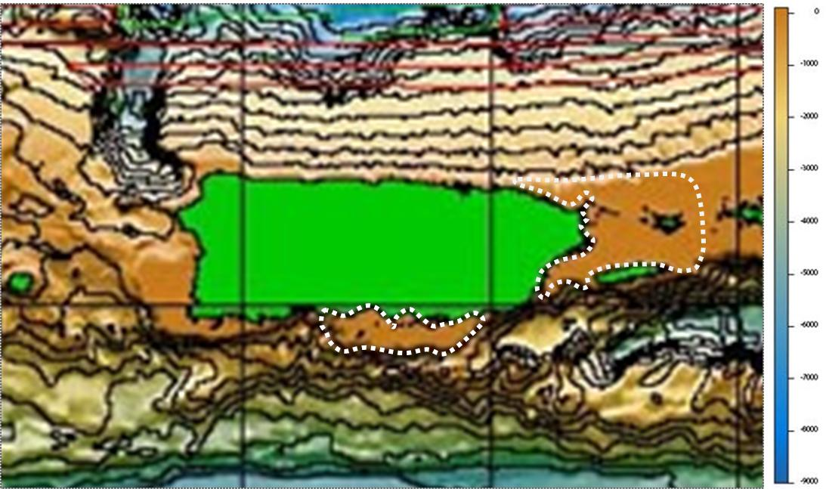
Off-shore wind turbines
60 x 32=1920 km²
55 x 15=825 km²
With a density of 5 MW/km² the 2,745 km² can accommodate 13,725 MW of installed wind capacity. If only 10% is used we still have 1,372 MW.
2,977,052 MWh per year = 14.4% 2006 electricity demand

Slide 36

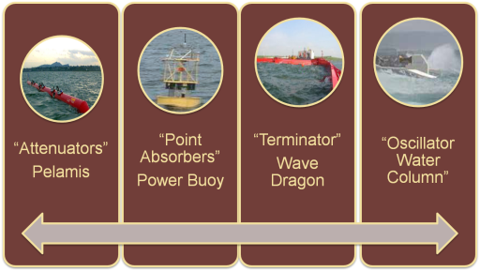

ENERGÍA OCEÁNICA, OLAS
Potencia estimada en mar abierto al norte de PR,
15 kW/m
El “por metro” se refiere al ancho del frente de la ola
Con 10% → 1080 kWh mensuales
36
Notes:
36

Slide 37
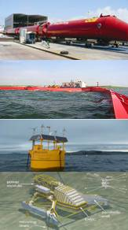
Offshore (> 40 m deep) Devices size, capital cost and rated power
Pelamis:150 m long, 4.63 m diameter
$2-3 million/device (without mooring)
750 kW (2.67 to 4 $/W)
Wave Dragon: 260-300 m wide
$10-$12 million/device
4 MW (2.5 to 3 $/W)
AquaBuOY: 6 m diameter
$0.75 million/device (without mooring)
250 kW (3 $/W)
Energetech: 35 m wide, spacing 60-90 m
$2.5-3 million/device
500 kW-2 MW (1.25-6 $/W)
Notes:
37

Slide 38
Availability of Ocean Wave Energy
Highest wave energy concentrates in the north coast.
Notes:
38

Slide 39
Variability of Ocean Wave Energy
Notes:
39

Slide 40
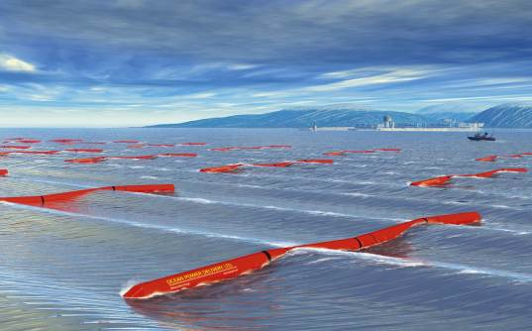
Economic Analysis - Net Present Worth
Wave farm of 10.5 MW (14 Pelamis®)located north of Puerto Rico.
Installed Capacity | 10.5MW
Number of Devices | 14
Project Life | 20
Installation Cost | $ 3,000/ kW
O & M & I | $ 90/kW
Energy Price | $0.08 & 0.125 /kWh
Income Tax Rate | 1%
Depreciation | MACRS 5 years
Discount Rate | 7%
Interest Rate | 6% & 7%
Inflation | 2.70%
40
Notes:
Explicar lo que es el analisis economico
40

Slide 41
Conclusions
[F. Aponte, MS Thesis 2009 UPRM]
The north coast of Puerto Rico has the highest wave energy.
The Pelamis® wave energy conversion device shows power absorption in seas with the characteristics of Puerto Rico’s.
The economic analysis shows that the wave farm can be feasible with energy sales close to 12 ¢/kWh.
41

Slide 42
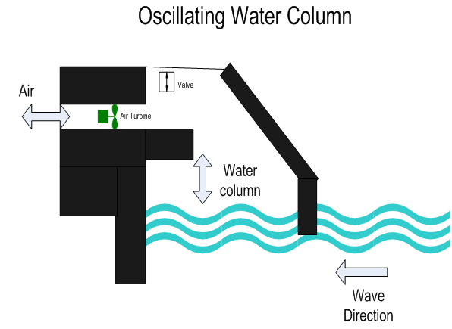
Shoreline Wave Energy Converters
LIMPET, 500 kW, 2000 Island of Islay, Scotland
42
Notes:
42

Slide 43
Conclusions
[M. Quintero, MS Thesis 2009 UPRM]
Puerto Rico average shoreline wave power on the north coast of between 11 and 14 kW/m.
The North Coast has the greatest potential to generate electricity with shorelines waves.
Oscillation Water Column is a mature technology for shoreline wave energy conversion.
A 4M OWC plant = 528 ft of shoreline = Annual Energy output of 557 to 716 MWh.
Cost effective with selling price of 12.5 to 16 ¢/kWh.
43
Notes:
43

Slide 44


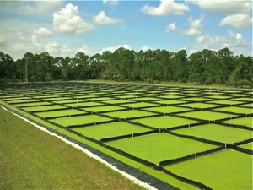

Biomasa & Biocombustibles
Dr. José Colucci, PE
The Biomass Research and Development Act of 2000 (P.L. 106-224; Title III) defines biomass as “any organic matter that is available on a renewable or recurring basis, including agricultural crops and trees, wood and wood wastes and residues, plants (including aquatic plants), grasses, residues, fibers, and animal wastes, municipal wastes, and other waste materials.” [Schnepf]
Notes:
44

Slide 45


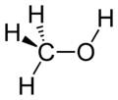
Bio combustibles
Ethanol: Drinking alcohol
C₂H₅OH
Biomass is unique among renewable energy resources in that it can be converted to carbon-based fuels and chemicals, in addition to electric power.
Biofuels are liquid fuels produced from biomass. Types of biofuels include ethanol, biodiesel, methanol, and reformulated gasoline components. They are primarily used as transportation fuels for cars, trucks, buses, airplanes, and trains. As a result, their principal competitors are gasoline and diesel fuel.
Methanol: wood alcohol
CH₃OH
Notes:
45

Slide 46
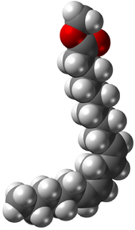
Biodiesel- A vegetable oil- or animal fat-based diesel fuel consisting of long-chain alkyl (methyl, propyl or ethyl) esters.
Biodiesel is typically made by chemically reacting lipids (e.g., vegetable oil, animal fat (tallow)) with an alcohol.
Biodiesel is meant to be used in standard diesel engines and is thus distinct from the vegetable and waste oils used to fuel converted diesel engines. Biodiesel can be used alone, or blended with petrodiesel.
The National Biodiesel Board (USA) also has a technical definition of "biodiesel" as a mono-alkyl ester. Much of the world uses a system known as the "B" factor to state the amount of biodiesel in any fuel mix: 100% biodiesel = B100, 20% biodiesel = B20, 5% biodiesel = B5 …
The higher the % of biodiesel, the more ecology-friendly the fuel is.
Notes:
46

Slide 47
No incluye 1,500 – 2,000 millones de galones anuales combustible para kWe
Notes:
47
47

Slide 48
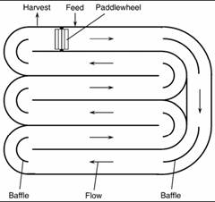
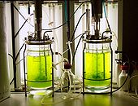
Microalgae - microscopic algae, a unicellular species which exist individually, or in chains or groups. Unlike higher plants, microalgae do not have roots, stems and leaves.
A photobioreactor is a bioreactor which incorporates some type of light source to provide photonic energy input into the reactor
Racetrack for growing microalgae
Notes:
48

Slide 49
Microalgas producen 50% de bioproductos (6Fs) adicionales.
Notes:
49
49

Slide 50
ARET conclusions
Renewable energy is ABUNDANT in PR
  Wind and PV: Abundant resource, commercial tech
  Biomass and wave energy: Abundant resources, prototype/commercial technologies, policy issues
  Need conservation!!!!
We recommend wind, PV and ocean waves to be targeted in the RPS in the immediate future. With 10% of these we can supply all electric energy demand at 2006 level.
The question should not be how to best integrate renewable resources into the existing energy infrastructures, but how the latter should change or transition in order to make way for the maximum penetration possible (technologically, economically, environmentally and socially) of renewable energy sources.

Slide 51
Achievable RETs
vs.
Socially Acceptable RETs
- Required surface area, or “footprint”
- Capital costs and potential electric energy contribution from each resource.
- Estimated availability and variability the resource
- The state of the technologies used to harvest their energy
- Perception of procedural justice in the decision-making process
- Perception of equity in the distribution of costs and benefits associated with the project.
- Perceived of economic, environmental and aesthetic consequences
Parameters for achievability:
Project
Parameters for acceptability:
Success
(Irizarry, O’Neill and Colucci, 2009)
(Ortiz and Perez, 2008)

Slide 52
Potential Timeline
1 – 5 years
  Energy Efficiency and Conservation (can achieve MW levels)
  Wind (from MW to GW level, altough it’s a variable resource)
  Fotovoltaico, (from MW to GW level, altough it’s a variable resource)
  Solar Thermal (water heaters, MW level)
  Landfills, 1-10 millions of gallons
  Biorefinery, 1-10 millions of gallons
  Wave energy, pilot project
6 – 10 years
  OTEC, MW, Pilot project
  Concentrated solar (MW to GW)
  Fuel Cells (MW level, Industrial, LNG/Propane)
  Biorefinery, 10-100 millions of gallons
  Waste to Energy (50 to 100 MW) vs Waste to Chemicals (100 to 200 MMGPY)
11 -20 years
  OTEC, MW, commercial

Slide 53
Dr. Agustín Irizarry Rivera, PE
Education:
B.S.E.E. (Magna Cum Laude), UPRM
M.S.E.E., University of Michigan
Ph.D., Iowa State University
Areas of interest: renewable energy resources such as eolic and solar thermal and electric power systems dynamics and operation
Honors: ECE Professor of the Year, CIAPR EE of the Year, Iowa State Progress in Engineering Award
Professional experience: Led projects totalling over $2M. Expert witness in civil court cases involving electric hazard, shock and/or electrocution. Consultant to the Puerto Rico Energy Affairs Administration on eolic generation projects.

Slide 54
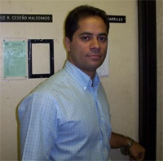
Dr. Efraín O’Neill Carrillo, PE
Education:
B.S.E.E. (Magna Cum Laude), UPRM
M.S.E.E., Purdue University
Ph.D., Arizona State University
Areas of interest: Power distribution systems, power quality, sustainable energy resources, load modeling and social implications of technology.
Honors: ECE Professor of the Year, CIAPR EE of the Year, IEEE/PES Walter Fee Outstanding Young Engineer Award
Professional experience: Led projects totalling over $4M, CPI del Caribe (Dorado, PR), TOR Engineering (Phoenix, AZ), Puerto Rico Electric Power Authority.

Slide 55
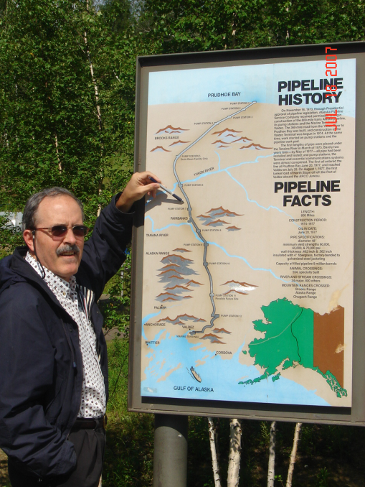
Dr. José A. Colucci Ríos, PE
Education:
B.S.Ch.E. (Magna Cum Laude), UPRM
Ph.D., University of Wisconsin-Madison
Areas of interest: Bio-refinery, biofuels, sustainable energy resources, fuel cells, nuclear engineering.
Honors: ChE Professor of the Year, UPR Distinguished Researcher, CIAPR ChE of the Year, 2008 EPA Environmental Award (Project Technical Director, Caguas Fluoresce)
Professional experience: Led projects totalling over $3M, Union Carbide, Chemical Industry Consultant, Associate Dean of Engineering, ChE Director.

Slide 56
Thanks
AAE
Graduate Students: Miguel Ríos, Franchesca Aponte and Magaby Quintero, Arlene Sosa, Luisa Feliciano and Johana Dumeng, Hillmon Ladner, Liliana Martínez, Edy E. Jiménez
You!

Slide 57
Achievable Renewable Energy Targets For Puerto Rico’s
Renewable Energy Portfolio Standard
Agustín A. Irizarry Rivera, PhD, PE
agustin@ece.uprm.edu
José A. Colucci-Ríos, PhD, PE
Biodieselpr1@aol.com
Efraín O’Neill-Carrillo, PhD, PE
oneill@ece.uprm.edu

