Slide 1
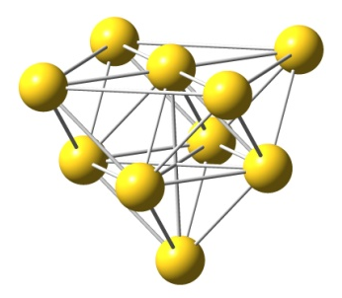
L-Tyrp neutral input
L-Tryp cationic input
L-Tryp anionic input
Ag 10 atoms surface (1,0,0)
Au 10 atoms surface (1,0,0)
L-Tryp neutral optimized
L-Tryp cationic optimized
L-Tryp anionic optimized

Slide 2
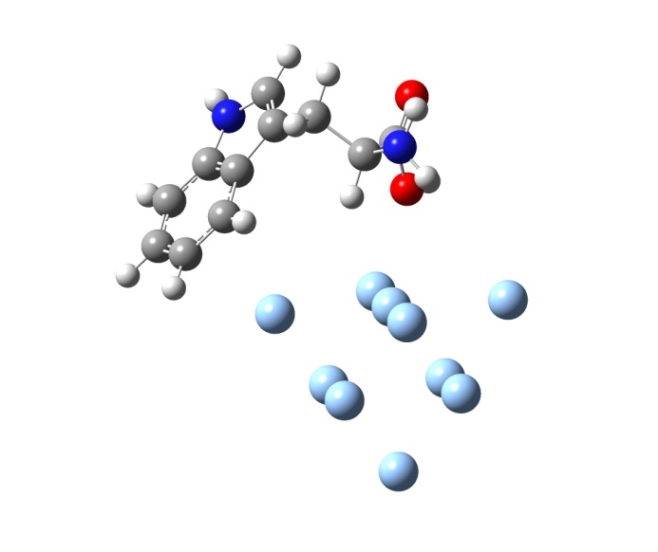
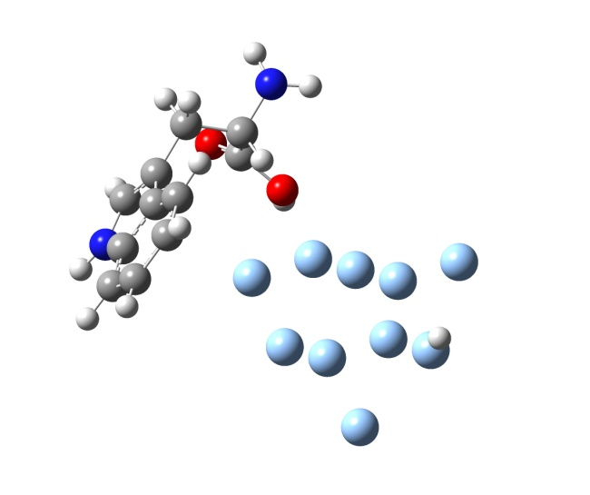
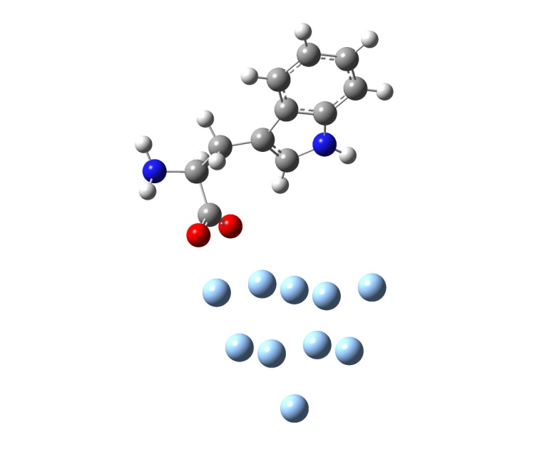
Tryp–Ag neutral input
Tryp-Ag cationic input
Tryp-Ag anionic input
Tryp–Ag neutral output
Tryp-Ag cationic output
Tryp-Ag anionic output

Slide 3
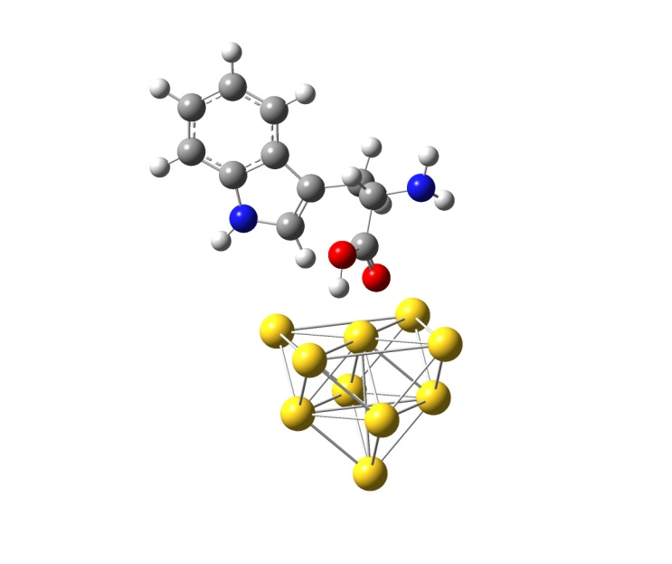
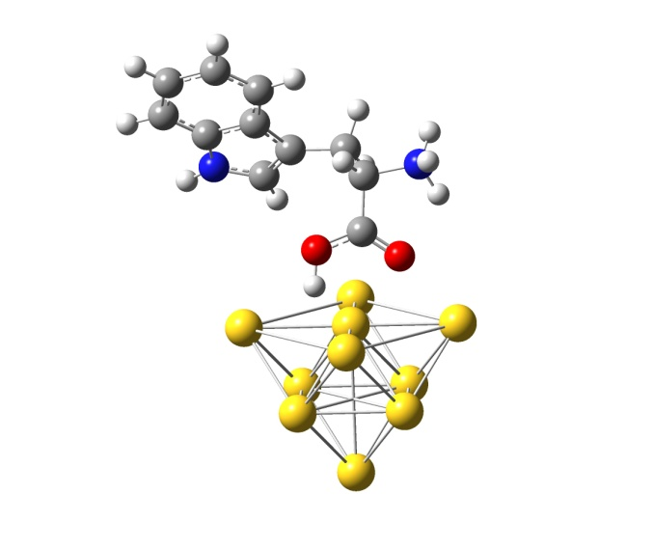
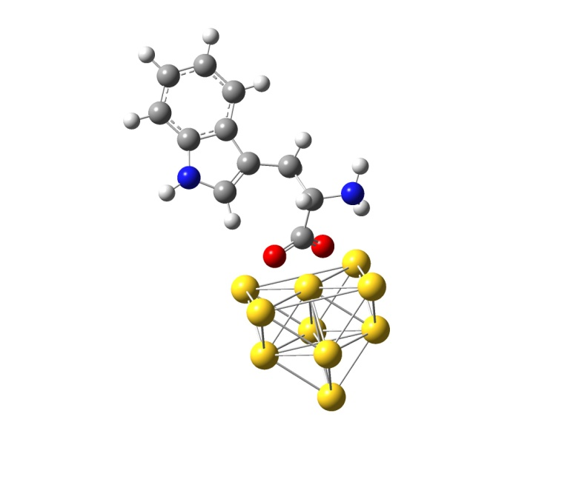
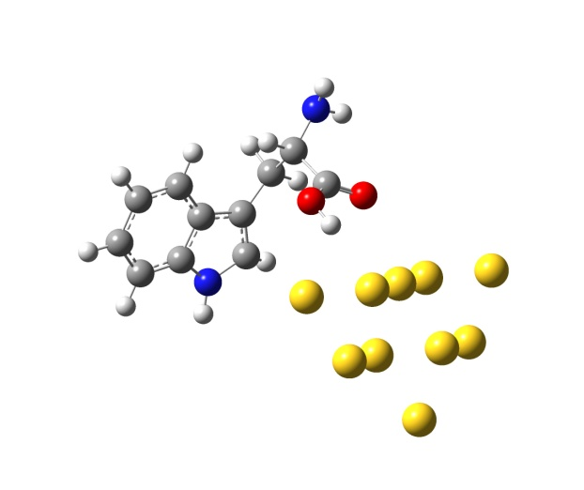
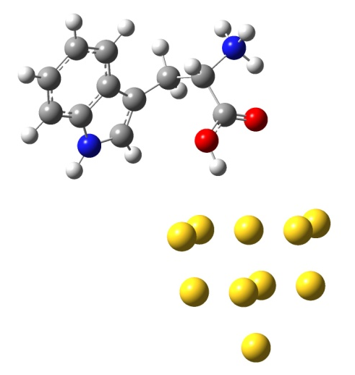
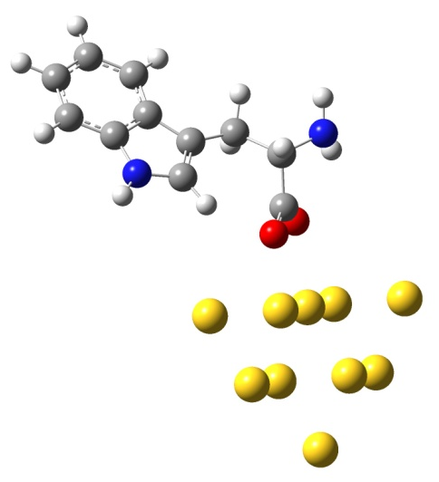
Tryp-Au neutral input
Tryp-Au cationic input
Tryp-Au anionic input
Tryp-Au neutral output
Tryp-Au cationic output
Tryp-Au anionic output

