Slide 1

Grupo Guayacán, Inc.
Foro Nacional Educación Empresarial
June 15th, 2016

Slide 2
Grupo Guayacán, Inc.
Grupo Guayacán, Inc. (GGI) was founded in 1996 as a private-sector driven non-for-profit organization.
Vision
Mission
“To lead in building an entrepreneurial ecosystem that develops global entrepreneurs and global ventures to be an engine of economic and social value creation in Puerto Rico.”
“To foster, promote and develop a vibrant market for private equity in Puerto Rico together with a rapidly growing community of global entrepreneurs and global ventures.”

Slide 3
Our Programs

Slide 4
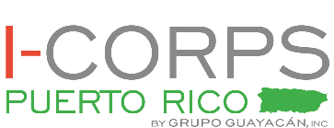
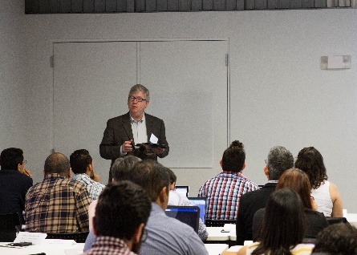
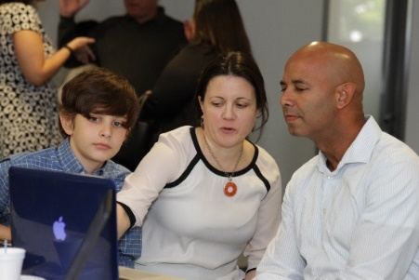
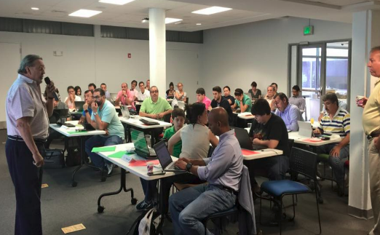
I-Corps Puerto Rico
I-Corps Puerto Rico is a five-week, hands-on program designed for small teams of entrepreneurs to learn how to launch innovative ventures through the Customer Discovery method and the Business Model Canvas.
Impact to date
  52 Participating Teams
  27 Teams Graduated
  7 Universities & Research Centers Represented
  40+ Mentors
  2 Team accepted into NSF’s I-Corps
  3 Cohorts - Cohort III @ University of Puerto Rico, Mayagüez Campus

Slide 5

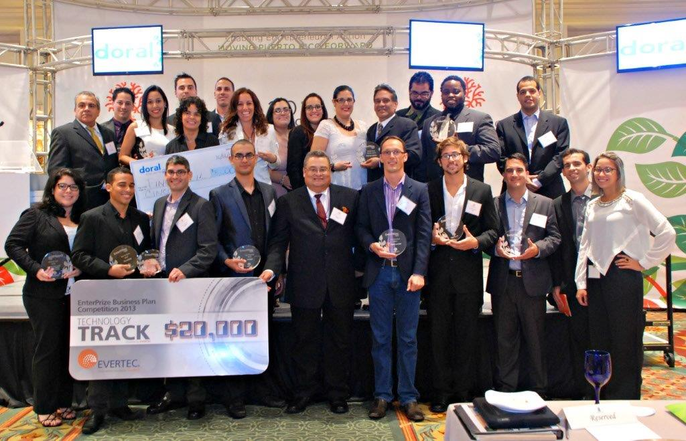
EnterPRize Competition
Leading Business Building Competition in Puerto Rico
  Operating uninterruptedly since 2005: Evolved from a Business Idea Competition, to a Business Plan, and currently a Business Building Competition
Provides:
  Educational Workshops
  Mentoring and coaching
  Equity-Free Seed Capital
  Special Track Prizes from Corporate Sponsors
Impact to date:
  1,800+ participants
  $800,000+ in seed capital awarded
  80%+ of past winners known to operate currently

Slide 6

Guayacán Venture Accelerator
The Guayacán Venture Accelerator (GVA) is designed to rapidly propel the business growth of existing companies by combining an advanced education curriculum with feedback and mentoring from top-level professionals, seasoned investors and world-class academics.
GVA Impact (as of December 2015):
  182 executives from 62 companies
  100+ contact hours per cohort
  49 workshops and 7 Demo Days
  20 world-class speakers and instructors
100%* agree that the GVA led to increasing revenues, higher chances of obtaining investment, improved business models, and tools to expand operations outside Puerto Rico.
After the GVA:
  50% experienced an increase in revenues
  63% experienced an increase in sales
  75% experienced an increase in human capital
GVA graduates & participants (2010-2015) represent 4,980 jobs
* Survey of 2010-12 participants

Slide 7
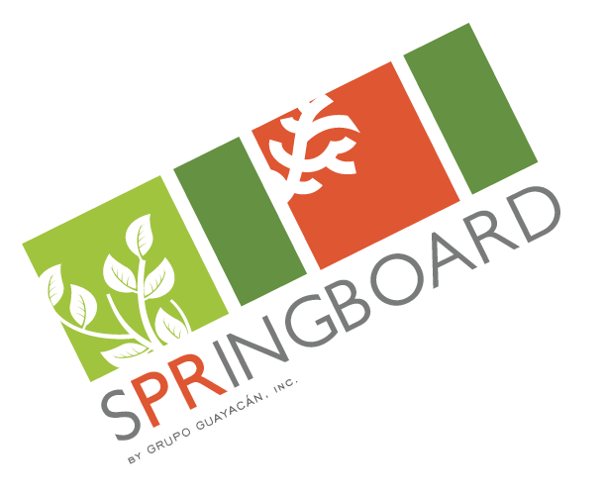


SPRINGBOARD
  PROGRAM OBJECTIVE
  Convene top startups from multiple entrepreneurial development programs within the local ecosystem for an investment-readiness curriculum focused on preparing entrepreneurs to raise capital
  The program is geared at start-ups with:
  • An innovative business concept
  • A proven, scalable business model
  • At least two team members
  • Interest in raising capital to launch or scale

Slide 8
SPRINGBOARD
  CURRICULUM
  • 6 educational workshops about:
  • Pitching
  • Financials
  • Governance
  • Due diligence, term sheets and negotiation
  • Exit Strategies
  • 3 interactive coaching sessions
  • Video Pitches evaluated by top ARI instructors and local mentors
  • Demo Day

Slide 9
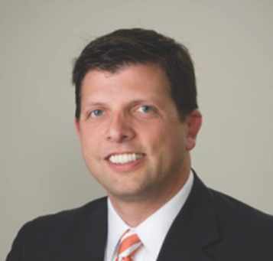
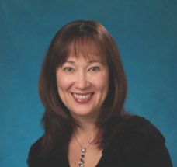
SPRINGBOARD
  INSTRUCTORS
LEAD INSTRUCTOR
TROY KNAUSS
VICE CHAIRMAN,
ANGEL RESOURCE INSTITUTE
CO- INSTRUCTOR
SUSAN PRESTON
TRUSTEE,
ANGEL RESOURCE INSTITUTE

Slide 10
Thank
You!
For additional information:
Katerina Sánchez
Program Associate
ksanchez@guayacan.org
(787) 641-6028

