Slide 1
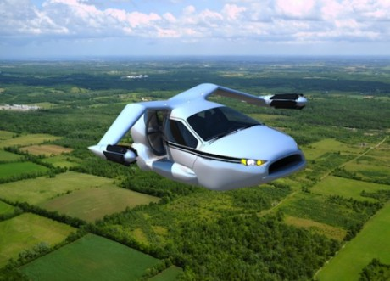
EMP 105
Are you ready for the ride?

Slide 2

EMP 105
Prof. Eva F. Vázquez Ortiz
E-mail: efvazquez@sagrado.edu
Tel: (787) 717-8022
LinkedIn: Eva Vazquez
Twitter: evafvazquez

Slide 3
The question is…
How many of you can
CHANGE the world now?
Do you have the tools,
money, power…?

Slide 4
Are you sure?

Slide 5
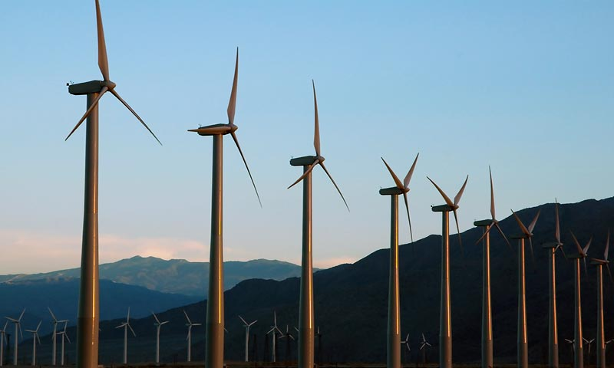
You have what it takes…
If William could build a windmill without money, formal education and 15 years old, then you have all the resources to make a whole windmill farm.

Slide 6
Rule #1: Build a new Mindset
Rule #2: Innovate
Think out of the box…or the roll

Slide 7
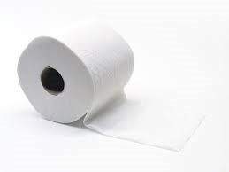
The Toilet Paper Challenge

Slide 8
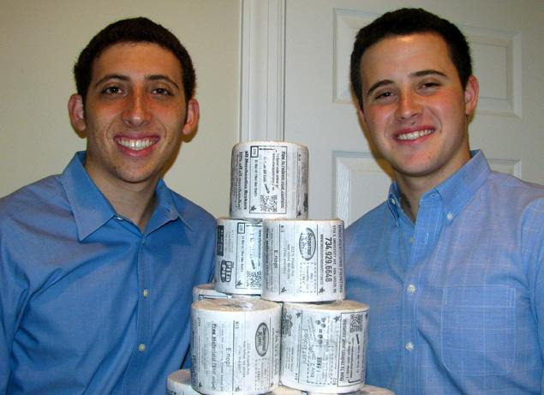
College Entrepreneur of the Year 2012
Bryan Silverman

Slide 9
Where does innovative business ideas come from?
Any Clue??

Slide 10
There is no magic formula
Find a problem. What is bugging you?
Try new things. Weird things (Legal things)
Find a passion.
Listen to people.
Test your ideas.
Read more @ http://online.wsj.com/article/SB10001424127887324445904578283792526004684.html

Slide 11
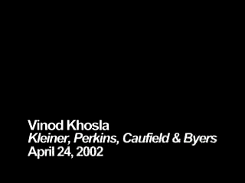

Slide 12
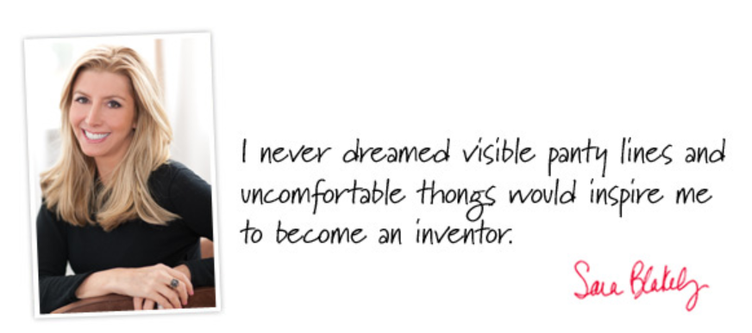
What kind of problem?
Spanx

Slide 13

Spanx
In March of 2012, Founder Sara was named the world’s youngest, self-made female billionaire by Forbes Magazine and one of TIME’s 100 Most Influential People.
Spanx can now be found worldwide in more than 50 countries.

Slide 14
Can you generate innovative business ideas now?

Slide 15
GOOD!
You’ll need as many ideas as possible

Slide 16
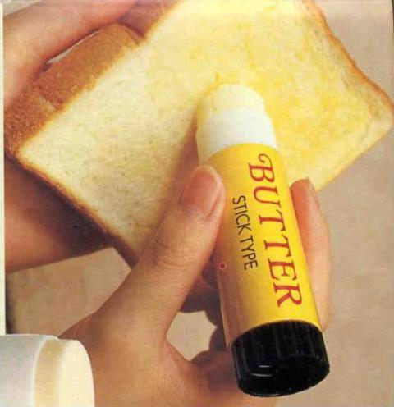
The ugly truth
Business Ideas
are not necessarily
Business Opportunities

Slide 17

Whatsapp Quiz!!
What is Lean Startup??

