Slide 1




PPMES-UPRM Methodology & Practice Working Retreat
Adapting the Teaching Practice evaluation instrument to align with InTASC as required by CAEP
UPRM September 19, 2014
Dra. Canny Bellido, CAEP Coordinator
CONNECT WITH CAEP | www.CAEPnet.org | Twitter: @CAEPupdates

Slide 2
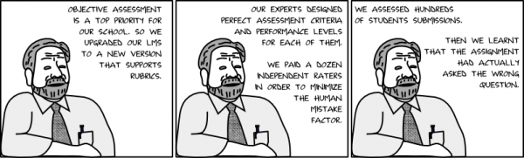
Today’s Working Objectives:
Adapt the teaching practice evaluation instrument to align with InTASC standards to meet CAEP accreditation requirements

Slide 3
Agenda
1:00 – 1:30 pm Introduction and instructions on adapting the teaching practice evaluation instrument to align with InTASC as required by CAEP
1:30 – 3:00 pm Fill out the Qualtrics sheet (Utah Valley Observation Rubric) and create or modify the items assigned to your group
2:30 pm Coffee break
3:00 – 4:00 pm Present work by groups by InTASC Standard
4:00 pm Plan next steps

Slide 4
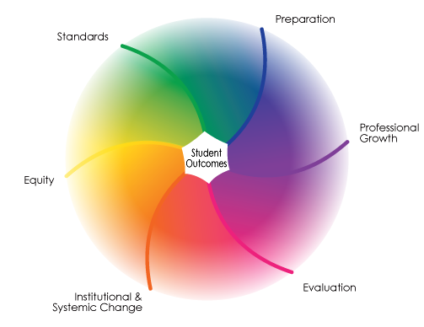

Slide 5
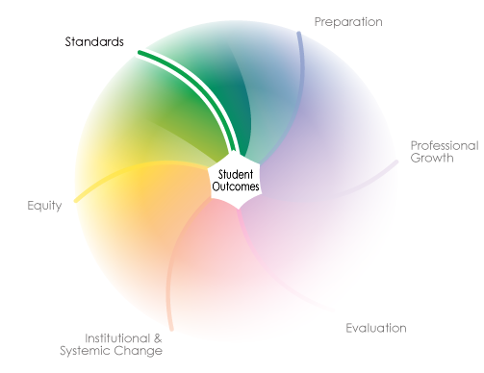

Slide 6
Key Changes from the 1992 Standards to 2011
Developmental Continuum: Standards no longer just for beginning teachers but ALL teachers.
  INTASC becomes InTASC (Interstate Teacher Assessment and Support Consortium)
A Focus on 21st Century Knowledge and Skills: Problem solving, curiosity, creativity, innovation, communication, interpersonal skills, the ability to synthesize across disciplines, global literacy, ethics, and technological expertise.
Personalized Learning for Diverse Learners: Teachers need knowledge and skills to customize learning for learners with a range of individual differences.

Slide 7
Key Changes from the 1992 Standards to 2011
Increased Emphasis on Assessment Literacy: Teachers need to have greater knowledge and skill around how to develop a range of assessments and how to use assessment data to improve instruction and support learner success.
A Collaborative Professional Culture: Teaching is no longer a private act.
New Leadership Roles for Teachers and Administrators:
A shift in leadership from teachers working autonomously in their classrooms to administrators, teachers, and others sharing leadership roles and responsibilities for student learning.

Slide 8
For each and every standard
Performance
Critical Dispositions
Standards 1 to 10
Essential Knowledge

Slide 9
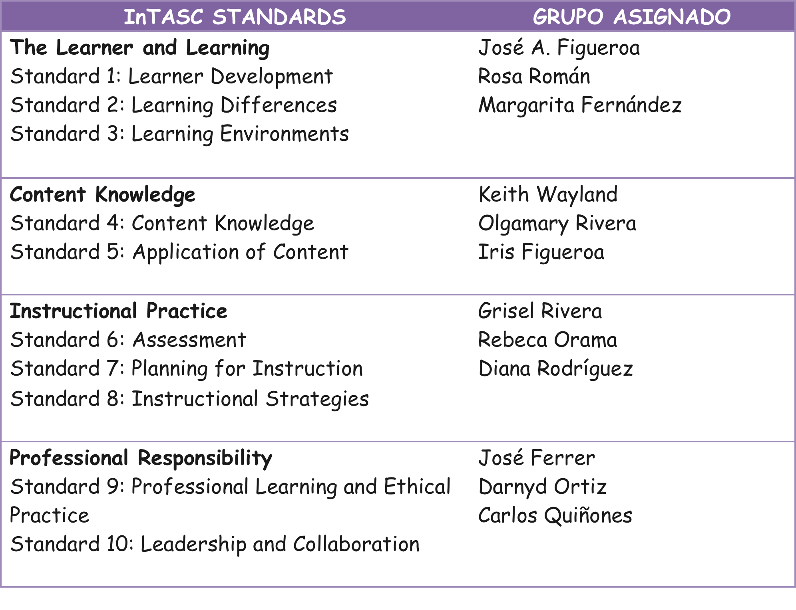
Groupings of Standards

Slide 10
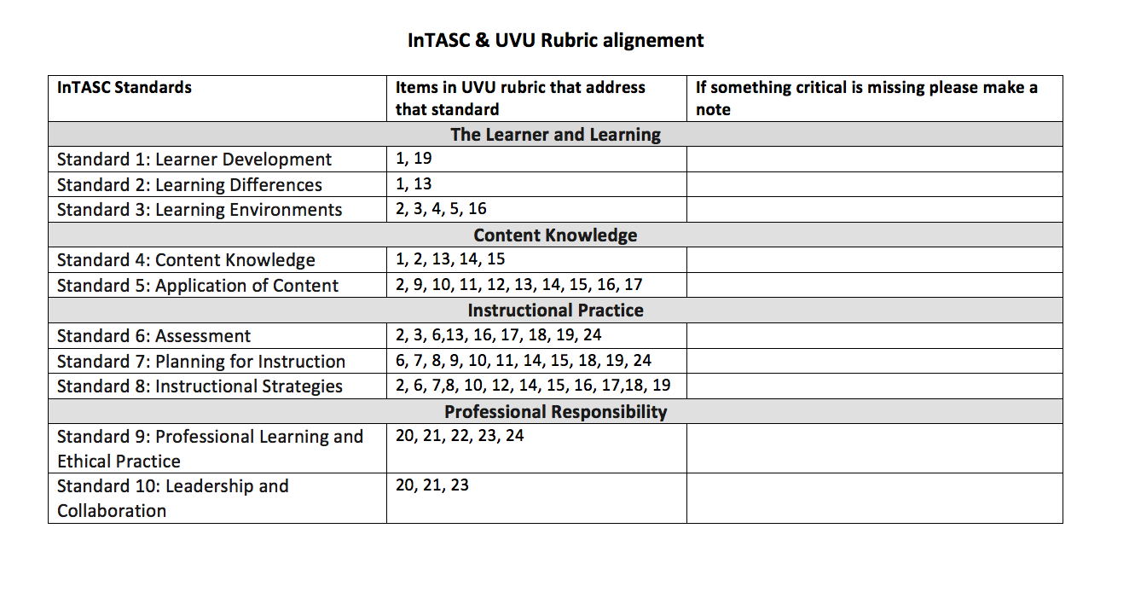

Slide 11
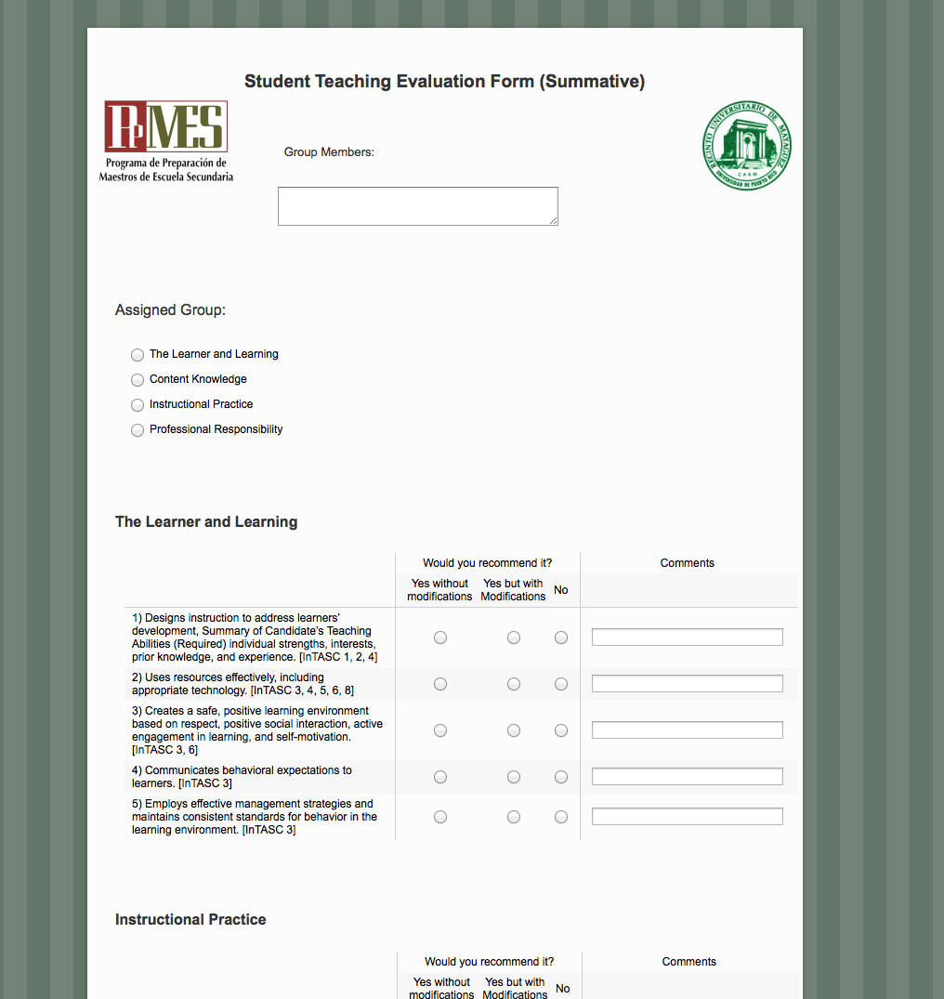
Feedback of UVU Rubric on Qualtrics

Slide 12
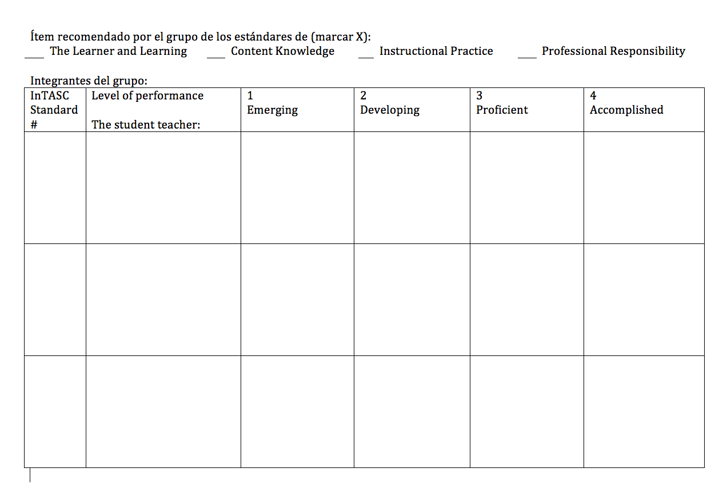

Slide 13
CAEP Recommendations for teaching evaluation rubrics
Do not exceed 25 to 30 total items in the rubric (the UVU rubric has only 24 in total)
Always show clear alignment with INTASC Standard phrasing
Use criteria that show continuous growth and explain how to improve. Example:
Emerging / Developing / Proficient / Accomplished
Developing / Competent / Exemplary
Not evident/ Needs substantial improvement/ Needs some improvement/ Meets expectations / Exceeds expectations

Slide 14
Agenda
1:30 – 3:00 pm Fill out the Qualtrics sheet and créate or modify ítems in the part assigned to your group
3:00 – 4:00 pm Present group’s work
4:00 pm Plan next steps
Designate a different person for each of the following tasks:
  Enter a summary of group in Qualtrics
  Note ítem modifications or new ítems needed
  Present results to all the groups

Slide 15

Group Work
Until 3:00pm
http://www.online-stopwatch.com/countdown-clock/full-screen/

Slide 16

Presentations of Gropus by InTASC Standard
Each group has 15 minutes to present

Slide 17
The Learner and Learning
Standard #1: Learner Development
The teacher understands how learners grow and develop, recognizing that patterns of learning and development vary individually within and across the cognitive, linguistic, social, emotional, and physical areas, and designs and implements developmentally appropriate and challenging learning experiences.

Slide 18
The Learner and Learning
Standard #2: Learning Differences
The teacher uses understanding of individual differences and diverse cultures and communities to ensure inclusive learning environments that enable each learner to meet high standards.
Notes:
We should use EITHER the statement of the standard OR the Wordle graphic.

Slide 19
The Learner and Learning
Standard #3: Learning Environments
The teacher works with others to create environments that support individual and collaborative learning, and that encourage positive social interaction, active engagement in learning, and self motivation.

Slide 20
Content Knowledge
Standard #4: Content Knowledge
The teacher understands the central concepts, tools of inquiry, and structures of the discipline(s) he or she teaches and creates learning experiences that make these aspects of the discipline accessible and meaningful for learners to assure mastery of the content.

Slide 21
Content Knowledge
Standard #5: Application of Content
The teacher understands how to connect concepts and use differing perspectives to engage learners in critical thinking, creativity, and collaborative problem solving related to authentic local and global issues.

Slide 22
Instructional Practice
Standard #6: Assessment
The teacher understands and uses multiple methods of assessment to engage learners in their own growth, to monitor learner progress, and to guide the teacher’s and learner’s decision making.

Slide 23
Instructional Practice
Standard #7: Planning for Instruction
The teacher plans instruction that supports every student in meeting rigorous learning goals by drawing upon knowledge of content areas, curriculum, cross-disciplinary skills, and pedagogy, as well as knowledge of learners and the community context.

Slide 24
Instructional Practice
Standard #8: Instructional Strategies
The teacher understands and uses a variety of instructional strategies to encourage learners to develop deep understanding of content areas and their connections, and to build skills to apply knowledge in meaningful ways.

Slide 25
Professional Responsibility
Standard #9: Professional Learning and Ethical Practice
The teacher engages in ongoing professional learning and uses evidence to continually evaluate his/her practice, particularly the effects of his/her choices and actions on others (learners, families, other professionals, and the community), and adapts practice to meet the needs of each learner.

Slide 26
Professional Responsibility
Standard #10: Leadership and Collaboration
The teacher seeks appropriate leadership roles and opportunities to take responsibility for student learning, to collaborate with learners, families, colleagues, other school professionals, and community members to ensure learner growth, and to advance the profession.

Slide 27

Next Steps
Group recommendations for proceeding with the Student Teaching Classroom Observation Instrument.

