Slide 1
Chapter 8: External World Interfaces

Slide 2
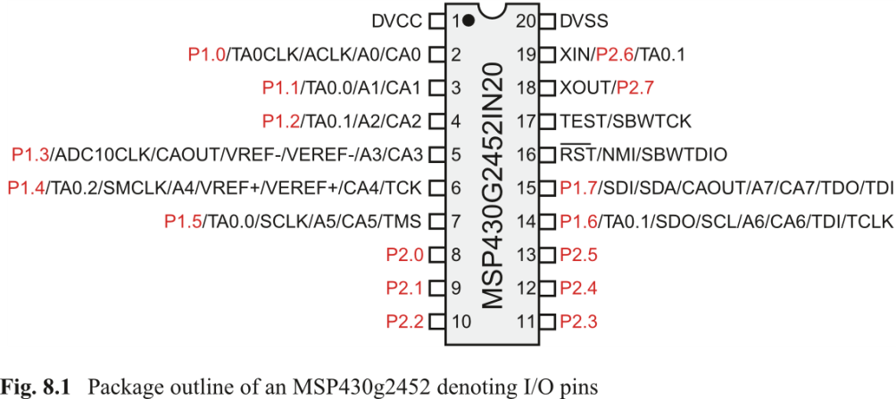

Slide 3
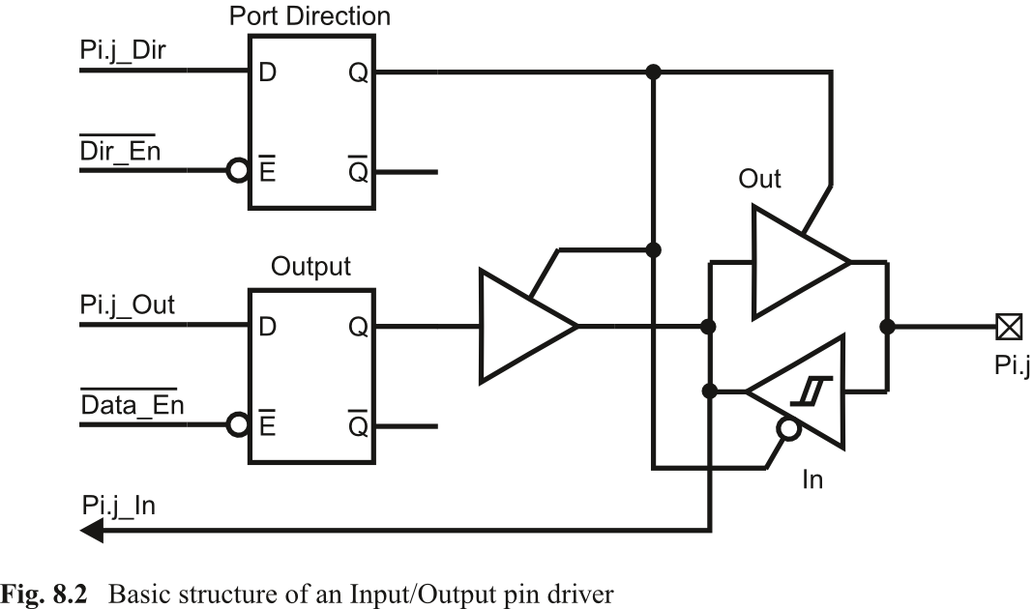

Slide 43
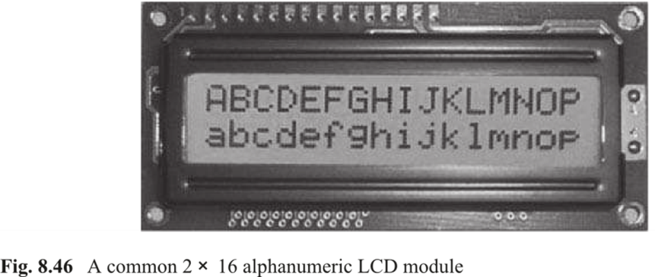

Slide 51
Fig. 8.55: Electromechanical relay with SPST NC/NO contacts, a) Structure, b) Symbol

Slide 56
Fig. 8.60: Pictorial view of internals of a small servomotor

Slide 68
Fig. 8.72: Rotor arrangement in a hybrid stepper motor, illustrating components and frontal view. a) Rotor components, b) Rotor front view

