Slide 1

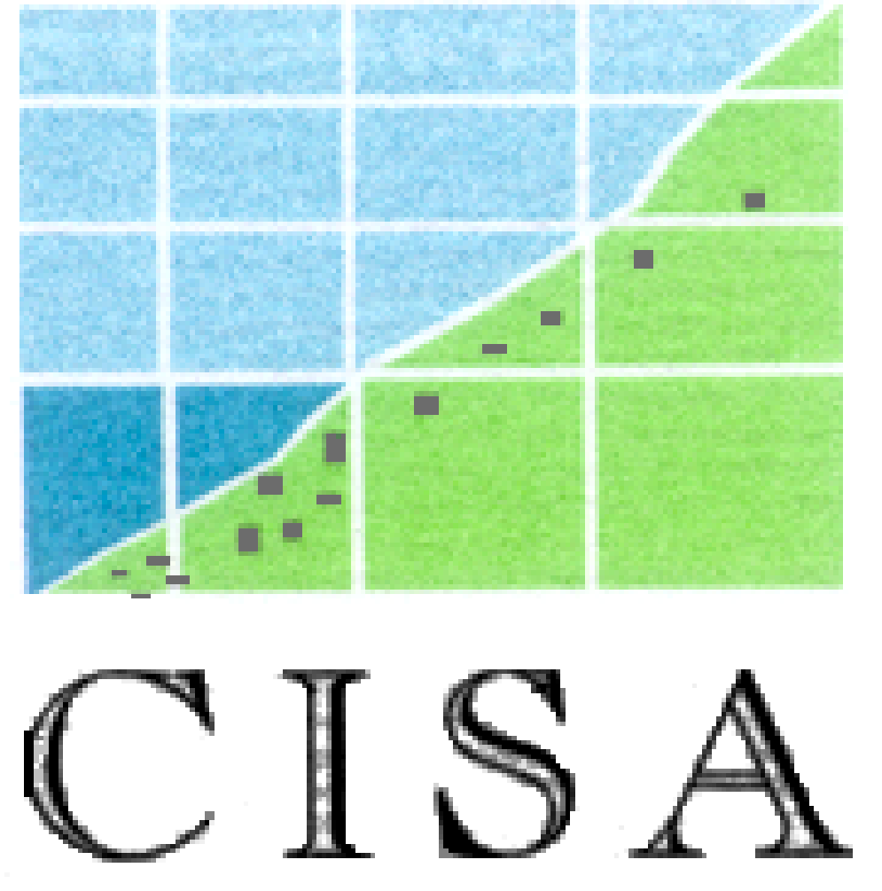

USE OF MENTAL HEALTH SERVICES AMONG UPRM UNDERGRADUATE STUDENTS: SATISFACTION WITH SERVICES
Authors: Sebastián Acosta, Laurette Casiano, Jesiel Díaz, Grace Mercado, Anais Roque, Sonylee Ruiz, Dana Saavedra,Yenill Taveras, & Leynice Vélez,
Social Sciences Department, University of Puerto Rico, Mayagüez Campus
Abstract
The American College Health Association has conducted regular studies to monitor the number of college students that present mental heath problems and the number of college students that use mental health services. In the last two decades, the gap between these numbers has increased significantly. While 30 to 40 percent of college students show some form of psychiatric symptoms, only 20% of them use mental health services. The objective of this study was to: 1) identify the percent of students that have use mental health services at the UPRM, and 2) describe their level of satisfaction with the mental health services. A random sample of 2,000 undergraduate students was provided by the Registration Office. This project was approved by the UPRM’s IRB. A self- report questionnaire yielding a 13.6% response rate. We found that only 19.1% of the participants have used mental health services at the UPRM while 56.9% expressed experiencing a problem they should have consulted with a mental health provider, but didn’t. The most common problems reported were: stress, family, personal problems and interpersonal problems. Participants (70%) were satisfied with the mental health services they received, 74.5% would use again these services, and 86% recommended these services to other students. The gap between mental health problem and use of mental health services found in this study is consisted with the finding reported among college students in the United States. The UPRM needs to create interventions to degrease this gap. Finally, the quality of the services doesn’t appear to be a barrier to the use of mental health services.
Literature Review
Results
Method
Objectives
Conclusions & Implications

