Slide 1
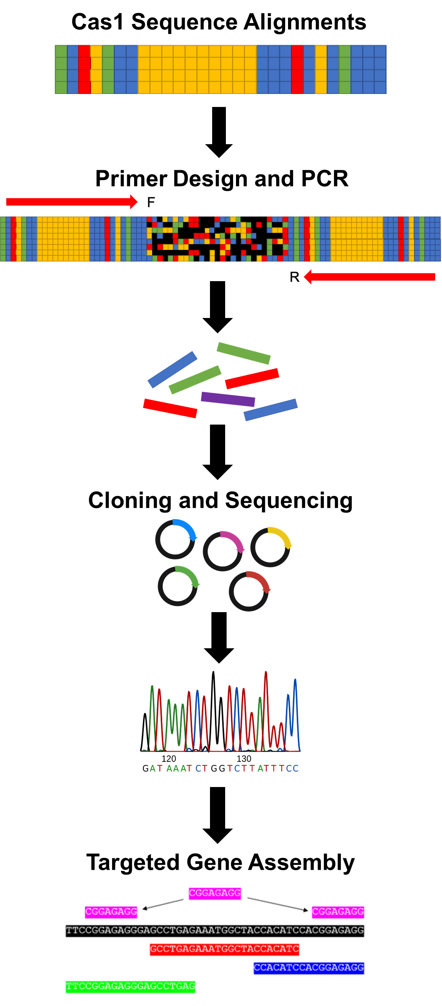
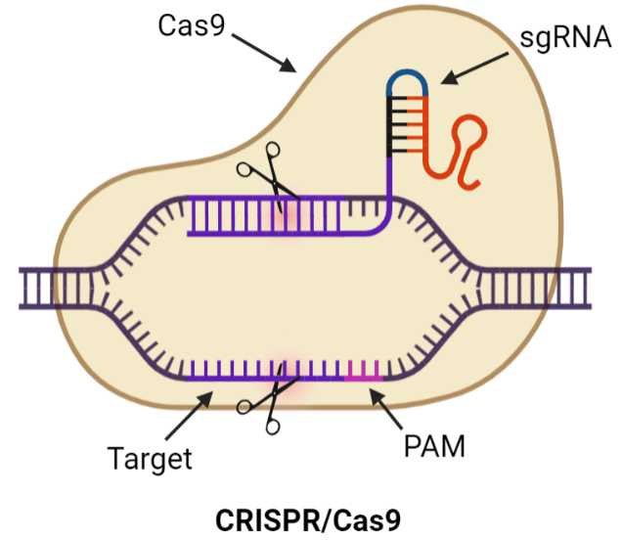
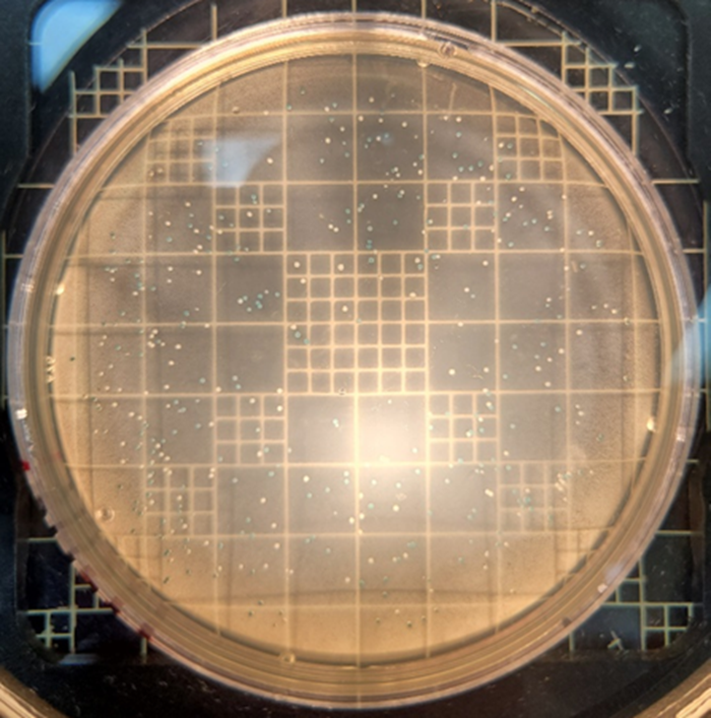
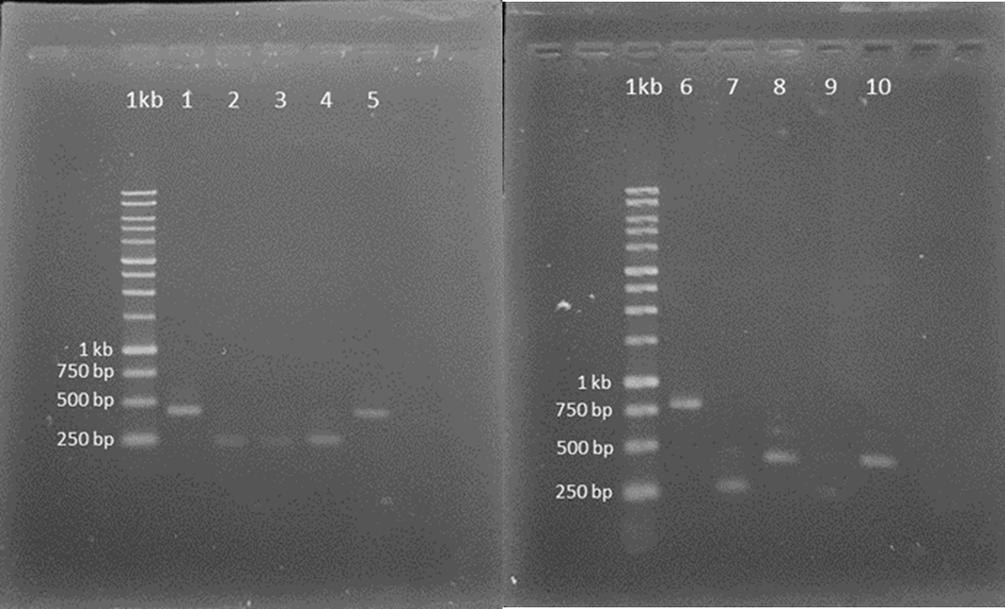
Identification of Novel Cas Proteins In Metagenomic Datasets of Microbiomes in Puerto Rican Ecosystems
RISE student: Gabriel Jiménez Pagán
RISE mentor: Dr. Carlos Ríos Velázquez
University of Puerto Rico – Mayagüez Campus
4. Results
MSA
Primer design
1. Significance
2. Innovation
PCR
Simple procedure
TA Cloning and Sequencing
Local metagenomic libraries
First Cas proteins isolated from Puerto Rican environments
Transcriptional activation and repression
5. Conclusions
Successful procedure
3. Approach
Amplifications could be new CRISPR-Cas systems
Epigenetic modifications
Hypothesis: If only 1% of microbes can be cultivated in lab conditions, then many new CRISPR-Cas systems can be found using methods independent of cultivation.
6. Future
Model neurological disorders
Targeted Gene Assembly
Protein expression and purification
Modify crops
Many species and cell types
7. Acknowledgements
Mr. Ángel M. Rubio Marrero and MBBL team
RISE-E-BASE Grant #: 5R25GM127191-04

