Slide 1
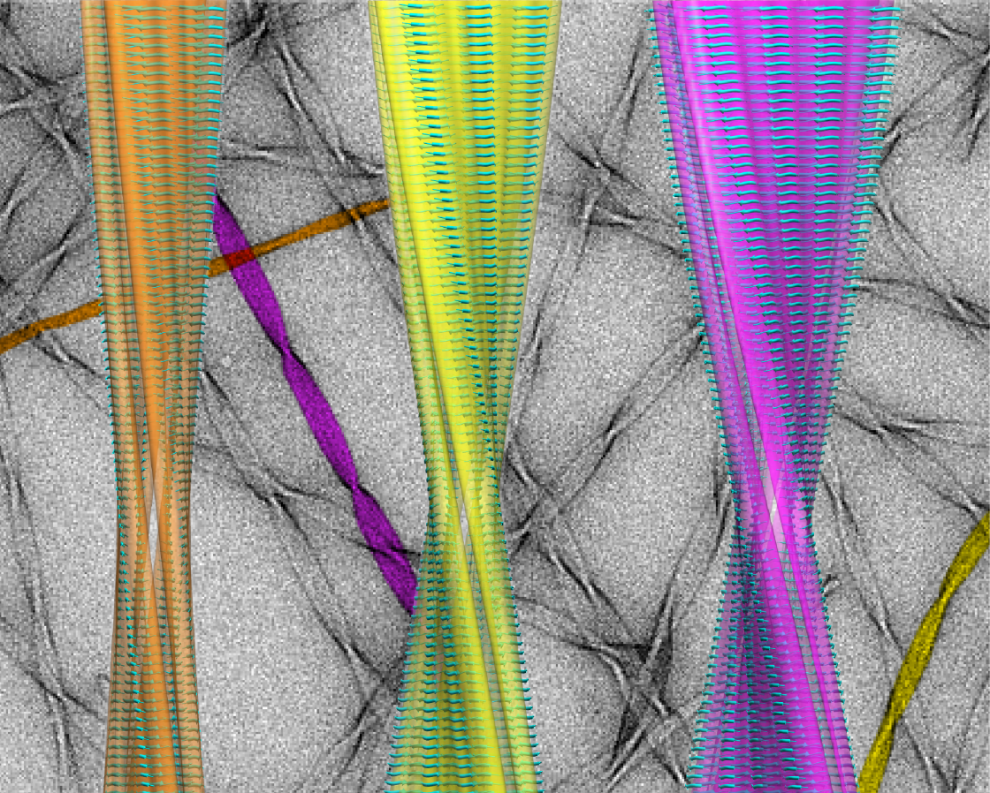
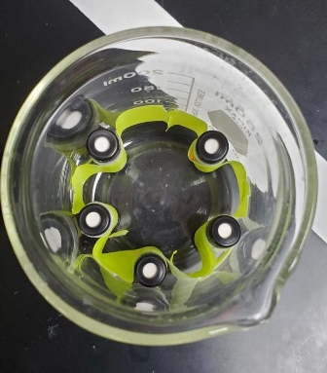
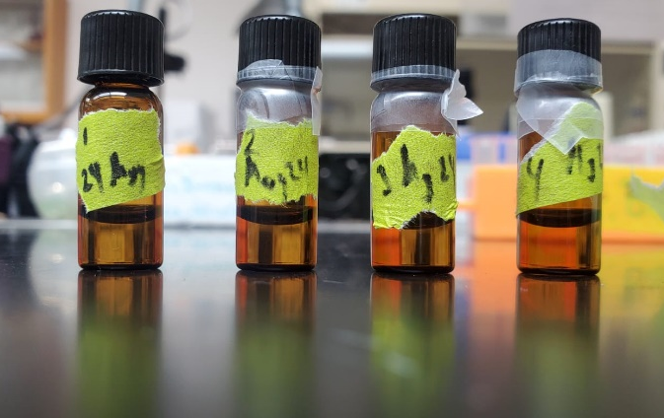
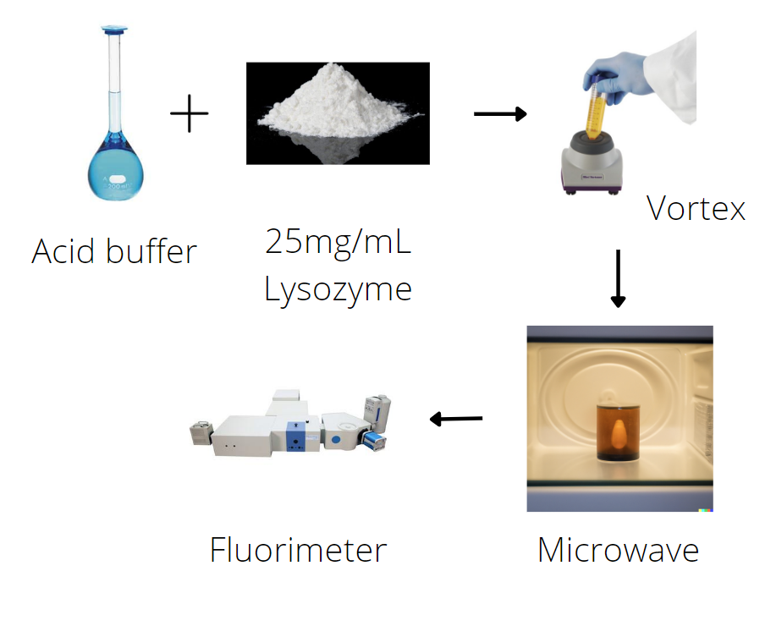
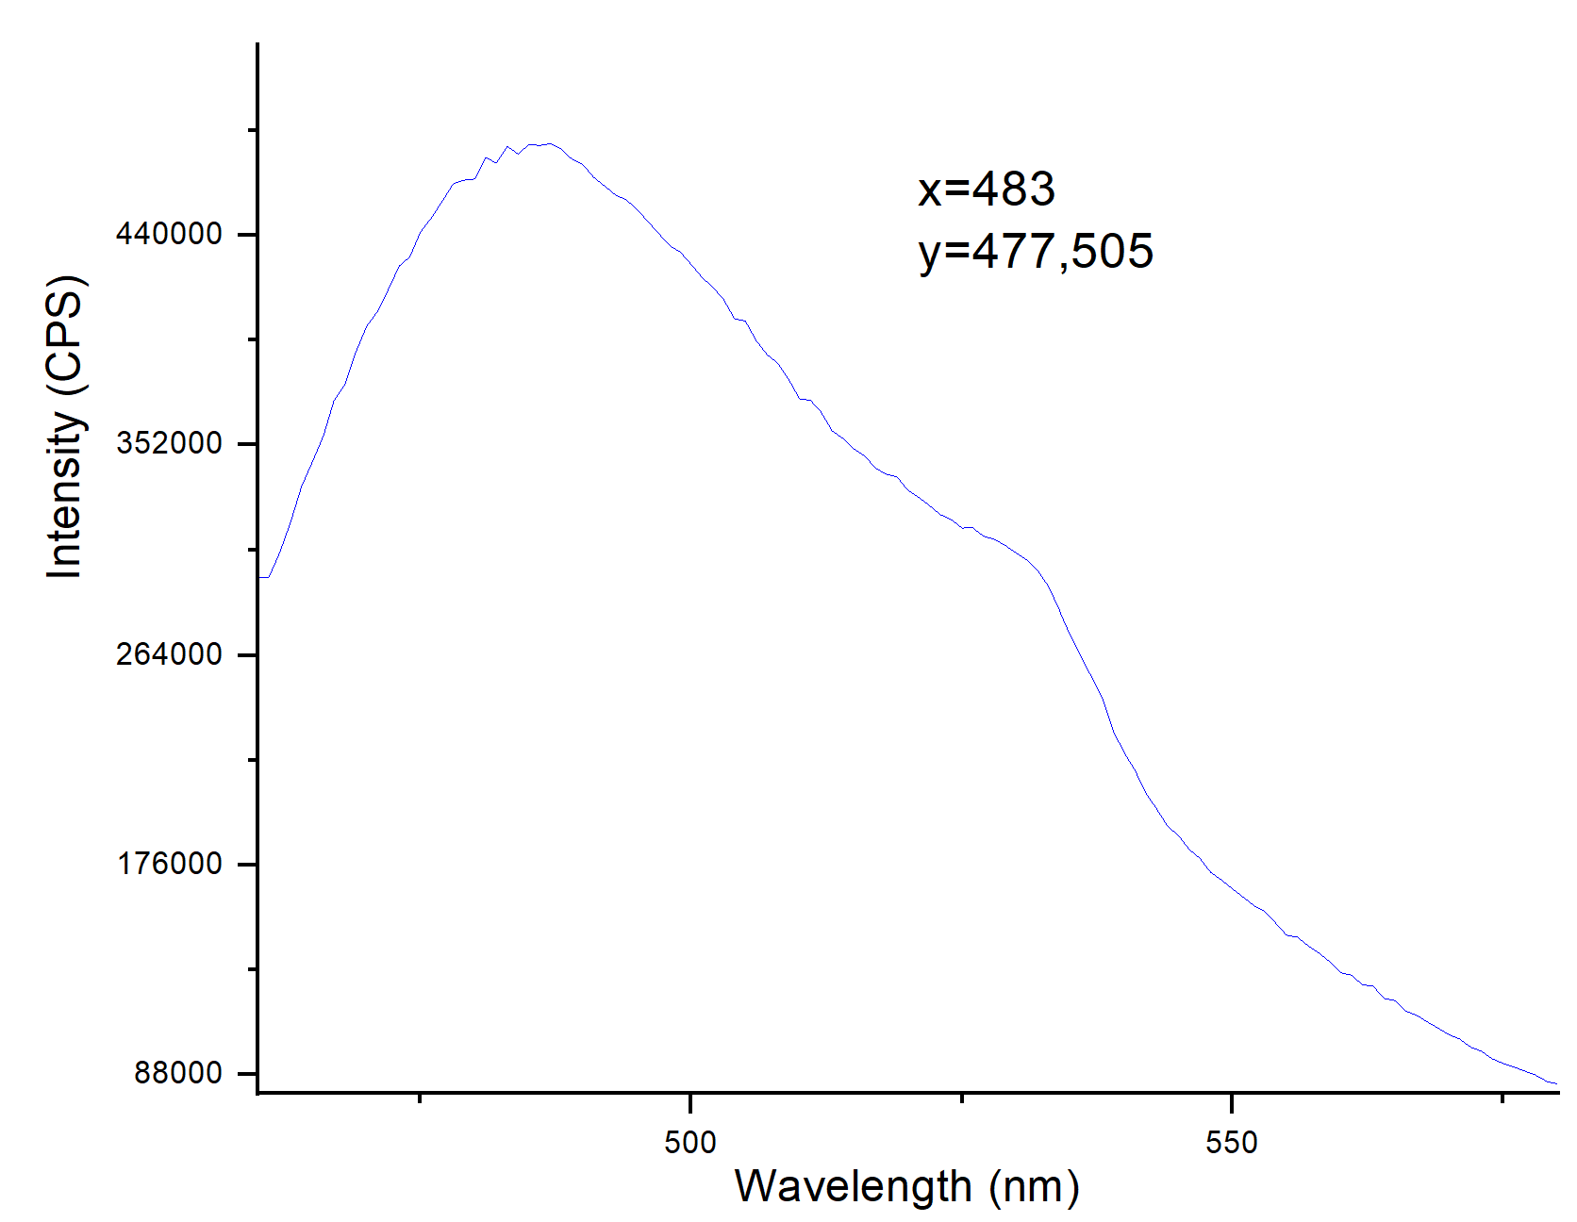
Synthesis of Microwave-Based Fibrils
Xavier A. Bonilla-Garcia¹, Dr. Juan Lopez Garriga¹
¹Department of Chemistry, University of Puerto Rico Mayagüez
Introduction
Optimizations
Data
Amyloid fibrils are toxic protein conformations that are associated with neurodegenerative diseases.
Table 1. Optimizations done to microwave technique
Figure 2. Tht max fluorescence at different number of irradiation (N). Y-axis normalized with N=0.
Currently the most widely reported method of synthesizing fibril in vitro is through the use of an oven.
Disadvantages of an oven:
Heats unevenly
Generates fibrils of different conformation and length
Takes 48 hours-1month to fully transform into fibrils.
Previous research, have reported that beta-lactoglobulin fibrils could be made in a microwave with less conformational heterogeneity and produce long, well-defined fibrils in a manner of hours.
The goal of this research was to apply and optimize this microwave technique to make Lysozyme fibril.
Problems | Solution
Cap from plastic microtube blew off due to high pressure | Change to glass vial with screw on cap.
Glass vial jumps around when heated | Attach to a pyrex beaker with masking tape.
Solution was evaporating | Retighten cap after each heating interval
Uneven heating of several vials | Heat just one vial and take small aliquots at set intervals.
Uneven heating of vial in time | Place the vial in the same place in the microwave.
https://griffingroup.mit.edu/amyloid-protein
Discussion
Difference in fluorescence was minimum.
Did not show clear trend of increasing fluorescence with increasing number of irradiation.
Some possible reasons for this include proteins already being denatured and cannot form fibrils.
Future Directions
Figure 1. Amber vials before heating in microwave
Make fibrils in the oven to learn how the Fluorimeter responds.
Use fresh reagents.
Use a different protein.
Experiment
Data
Figure 2. Fluorescence spectra of N=0. Peak at 480nm represents Tht and fibril.
Acknowledgements
I thank my mentor Dr. Juan Lopez Garriga and RISE-E-BASE, grant #R25GM127191-04, for funding the research.

