Slide 1

Show Cause Guidance Meeting with Institutions of the
University of Puerto Rico
Philadelphia, via Skype
January 15, 2019

Slide 2
© 2019, Middle States Commission on Higher Education. All Rights Reserved.
The presentation you are viewing has been prepared by and is the property of the Middle States Commission on Higher Education (MSCHE). Reproduction, distribution, or transmission of the presentation, in part or in whole, is expressly prohibited without prior written consent from MSCHE. For permission requests, write to MSCHE, 3624 Market Street, Philadelphia, PA 19104 or info@msche.org. For any questions about an institution’s accreditation status or for additional information about MSCHE’s Standards for Accreditation, Requirements of Affiliation, Policies, and Procedures, you should contact MSCHE staff. This presentation is not intended as a substitute for professional advice from MSCHE staff and use of the webinar does not guarantee any specific accreditation outcome.

Slide 3
MSCHE Staff
Dr. Hilda Colón Plumey, Vice President, MSCHE
Dr. Idna M. Corbett, Vice President, MSCHE
Please be aware that the presentation portion of this guidance meeting is being recorded. The Q&A portion will not be recorded.

Slide 4
Purpose of the Guidance Meeting
Highlight the various details of the Commission’s Show Cause action, including the show cause report
Discuss Show Cause team visit in February
Identify Middle States policies, procedures, and forms as they apply to Show Cause
Preliminary discussion on Show Cause appearance in March
Notes:
Our learning goals for today out line what we will be working on throughout the orientation. they were in the information handed out to you this morning. We had our goals drafted up for this before, but we also wanted to hear from you about what you wanted to learn about today…

Slide 5
What a Show Cause action means
The institution has the opportunity to demonstrate compliance.
The institution remains accredited during the show cause period.
Per USED regulation, an institution may be in non-compliance for a maximum period of two years.
It is possible to extend for good cause, up to one year beyond the maximum two years. The institution must demonstrate a good faith effort to improve and move toward compliance.
It is MSCHE practice to provide support to the institutions during this period. Contact the VP liaison if you have any questions/concerns.

Slide 6
Show Cause Report
A show cause report is required when an institution is required to show cause why its candidate status or accreditation should not be withdrawn.
The show cause report must provide evidence that the institution has made all necessary improvements and meets fully the Commission’s Standards for Accreditation, Requirements of Affiliation, policies and procedures, or federal compliance requirements.
The institution is also required to submit a teach-out plan and teach-out agreement(s) as directed.
A show cause report is always accompanied by a show cause visit.
Notes:
Substantive change is where you will find some of the most varied peer evaluators. This is also a paper process, with visits occurring only occasionally depending on the complexity of the change and commission policy Everything done in the name of an institution is covered by its accreditation status. Because institutions are dynamic, they must be re-evaluated on a regular basis. Certain types of institutional changes -- defined as “substantive” by the United States Department of Education (USDE) -- require approval by the Commission prior to their implementation. The types of substantive change are listed here and defined in the Substantive Change Policy. Some of these types of evaluators come up far more frequently that others – Establishing a new campus or additional location or different credential level or alternative delivery method are fare more frequent than clock to credit hour or experimental site initiative.
Staff, peer evaluators, and members of the Commission have the authority to determine whether or not a substantive change request is complete and to request additional information from the institution before proceeding with the review process. When institutions are asked to submit additional information, they are usually given the opportunity to withdraw their request and re-submit at a later date. Substantive change requests are first reviewed by staff and peer evaluators who develop a proposal for action that is subsequently considered by an appropriate Committee; final action is taken by the Commission.
When you assign people to a sub change review... how many people per review? 2 Complex sub change involves a visit of 2-3 depending on the complexities; may require a visit
Detailed
Give good feedback
Available on short notice
Specialized knowledge

Slide 7
Show Cause Report
Include an Introduction to provide context.
Address each item in the Commission action. Each item should be a separate section of the report.
Refer to the policy statements and procedures as needed. Particularly notice the Related Entities Policy, as you will need to include information about the system, i.e. UPR Central Administration. Include signed certification for the related entity.
If the certified financial statements are available, include them as appendices to the report.
Notes:
Substantive change is where you will find some of the most varied peer evaluators. This is also a paper process, with visits occurring only occasionally depending on the complexity of the change and commission policy Everything done in the name of an institution is covered by its accreditation status. Because institutions are dynamic, they must be re-evaluated on a regular basis. Certain types of institutional changes -- defined as “substantive” by the United States Department of Education (USDE) -- require approval by the Commission prior to their implementation. The types of substantive change are listed here and defined in the Substantive Change Policy. Some of these types of evaluators come up far more frequently that others – Establishing a new campus or additional location or different credential level or alternative delivery method are fare more frequent than clock to credit hour or experimental site initiative.
Staff, peer evaluators, and members of the Commission have the authority to determine whether or not a substantive change request is complete and to request additional information from the institution before proceeding with the review process. When institutions are asked to submit additional information, they are usually given the opportunity to withdraw their request and re-submit at a later date. Substantive change requests are first reviewed by staff and peer evaluators who develop a proposal for action that is subsequently considered by an appropriate Committee; final action is taken by the Commission.
When you assign people to a sub change review... how many people per review? 2 Complex sub change involves a visit of 2-3 depending on the complexities; may require a visit
Detailed
Give good feedback
Available on short notice
Specialized knowledge

Slide 8
The UPR show cause report must include evidence of:
documented financial resources, funding base, and plans for financial development adequate to support its educational purposes and programs and to ensure financial stability (Standard VI and Requirement of Affiliation 11);
updated information on the impact of the Fiscal Oversight Management Board's plan and proposed restructuring on the institution's status and finances (Standard VI);
an annual independent audit confirming financial viability with evidence of follow-up on any concerns cited in the audit’s accompanying management letter (Standard VI);
a record of responsible fiscal management, has a prepared budget for the current year, and undergoes an external financial audit on an annual basis (Standard VI and Requirement of Affiliation 11); and
certification by the related entity that it recognizes the Commission's compliance requirements and will ensure that responsibilities of the related entity are fulfilled, including making freely available to the Commission accurate, fair, and complete information through disclosure of information required by the Commission to carry out its accrediting responsibilities (Related Entities Policy; Requirement of Affiliation 14).

Slide 9
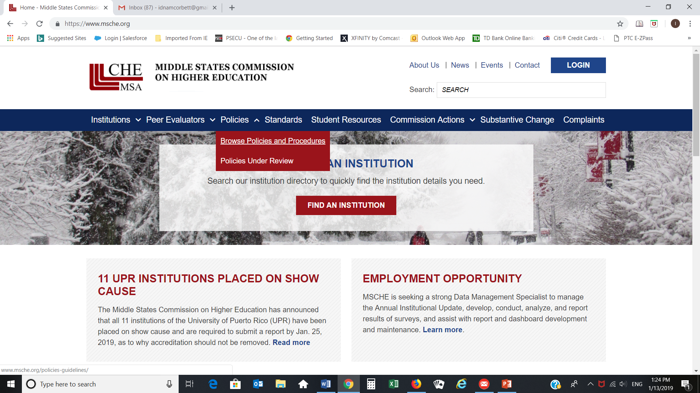
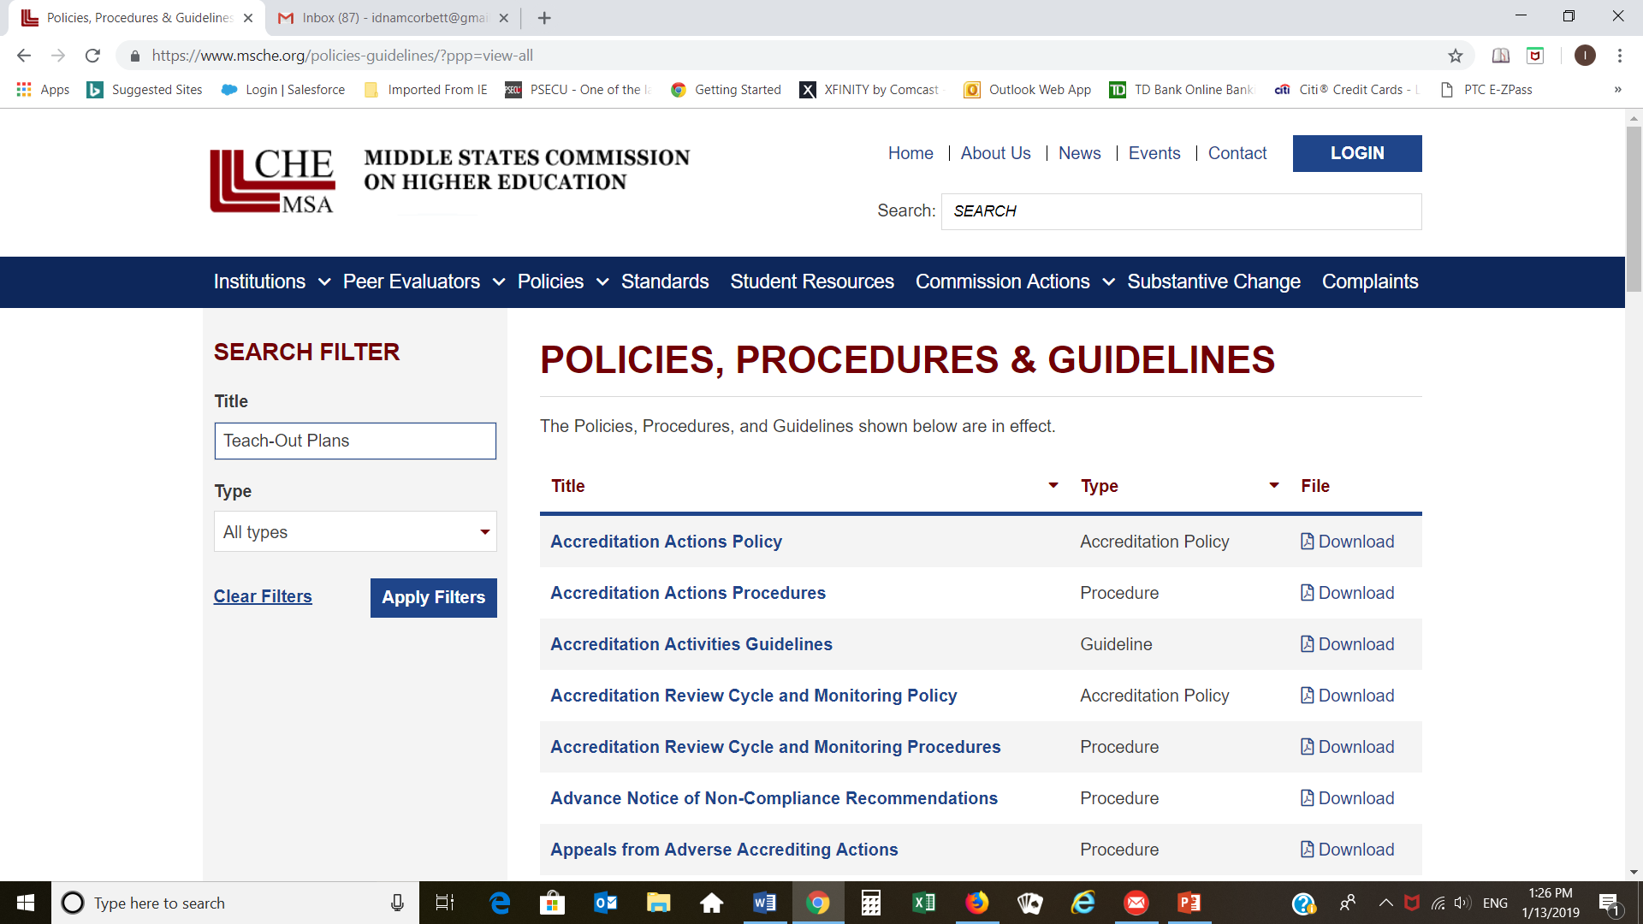
Where can I find MSCHE Teach-Out Policy, Procedures, and Forms?
www.msche.org
Teach-Out Plans and Agreement(s) Policy
Teach-Out Plans and Agreement(s) Procedures
Teach-Out Plans and Agreement(s) Form
Also look at Resources for Institutions for additional information related to site visits
Notes:
But what about handbooks and guides? The “publications” section of our website is chock full of them!
The ones listed here are the likely suspects that you’ll be looking for, but….

Slide 10
The Teach-Out Plan
The Teach-Out Plan is required as part of the show cause report.
Must include “the institution’s orderly plan for closure.”
The start date and end date for the teach-out period are estimates. The teach-out period can range from 18-24 months.
The timeline must indicate key milestones.
The inventory of academic programs must include all programs offered.
If there are students who will not complete by program end date, teach-out agreements with other institutions must be planned. The Commission may require agreements as part of the Teach-Out Plan.
Notes:
Substantive change is where you will find some of the most varied peer evaluators. This is also a paper process, with visits occurring only occasionally depending on the complexity of the change and commission policy Everything done in the name of an institution is covered by its accreditation status. Because institutions are dynamic, they must be re-evaluated on a regular basis. Certain types of institutional changes -- defined as “substantive” by the United States Department of Education (USDE) -- require approval by the Commission prior to their implementation. The types of substantive change are listed here and defined in the Substantive Change Policy. Some of these types of evaluators come up far more frequently that others – Establishing a new campus or additional location or different credential level or alternative delivery method are fare more frequent than clock to credit hour or experimental site initiative.
Staff, peer evaluators, and members of the Commission have the authority to determine whether or not a substantive change request is complete and to request additional information from the institution before proceeding with the review process. When institutions are asked to submit additional information, they are usually given the opportunity to withdraw their request and re-submit at a later date. Substantive change requests are first reviewed by staff and peer evaluators who develop a proposal for action that is subsequently considered by an appropriate Committee; final action is taken by the Commission.
When you assign people to a sub change review... how many people per review? 2 Complex sub change involves a visit of 2-3 depending on the complexities; may require a visit
Detailed
Give good feedback
Available on short notice
Specialized knowledge

Slide 11
The Teach-Out Form
Answer all applicable questions. If a question is not applicable to the specific type of teach-out, please answer “not applicable” with a short explanation.
Maintain student privacy protections in accordance with state and federal law and regulations.
Provide all required attachments to the Commission (as applicable). The Commission may not process the submission until all attachments are submitted or the Commission may process the request and require an updated teach-out plan.
Label all attachments exactly as indicated.
Combine the form and all attachments into a single bookmarked PDF file.
Upload the PDF document into the secure MSCHE portal.

Slide 12
Checklist of Attachments (1)
Teach-OutTimeline: Section A.1.c – Provide a comprehensive timeline for the teach-out, including critical milestones.
FinAidCounseling: Section A.2.c - Evidence that financial aid counseling has been conducted.
ArticulationEvents: Section A.2.c - Evidence that onsite articulation events have taken place.
NotifAddCharges: Section A.3.a - Evidence that the institution has notified students of any additional charges.
NotifTeach-Out: Section A.3.b - Evidence that the institution has notified all relevant stakeholders about the teach-out.
Transcripts: Section A.4.a - Evidence that transcripts have been produced.

Slide 13
Checklist of Attachments (2)
Transfers: Section A.4.a - Evidence that transfers have been released.
TransfertoRepository: Section A.4.d - Evidence that student records have been transferred to the final repository.
NotifStudentRecords: Section A.4.e – Evidence that communications regarding student records has occurred.
ExternalRequirements: Section A.5.b - Documentation outlining state or federal requirements for the type of teach-out plan.
CharterDGAStatus: Section A.5.c - Documentation of the status of the charter or DGA.
TeachOutAgree_ShortInstitutionName: Section B.1 - Signed Teach-Out Agreement(s) for each teach-out institution. Include any additional documentation supporting the teach-out agreement(s) (i.e. course equivalencies, etc.).

Slide 14
The Show Cause Visit
A show cause visit will follow submission of the report.
The purpose of the on-site show cause visit is
to verify the information provided in the show cause report and
to assure the Commission that the institution has made all necessary improvements and has resolved its non-compliance issues
The Show Cause Team (5 members) has already been chosen. Institutions will receive official notification, including the names of the team chair and team members within the next few days.
Four MSCHE staff members will accompany the team.
The UPR Central Administration has already been notified so they can make the logistical arrangements.

Slide 15
Show Cause Visit
Selection of Team Chair and Team Members
Preparation for the Visit
The Visit
Team Report
Oral Exit Report
Institutional Response
Committee on Follow-Up
Commission Meeting
Notes:
Description – these are the individuals that I think most of you are familiar with. These are the people you see on campus once every 10 (soon 8) years. I’m wiling to bet a lot of you also thought that this is the only way to participate as a peer evaluator in accreditation. And while this is the most common, I can assure you its not the only one. With an average around 65 institutions per academic year in self study, you’re looking at about 4-500 of these types of evaluators per academic year.
That doesn’t mean that you’ll be selected every year – each team is built with the institution under review in mind – looking for “peerness”, a knowledge balance – by knowledge we mean experiences, positions, standards knowledge, etc – Some years will see a lot of community colleges or a lot of large research universities up for self-study, other years only a few.
There’s a lot of work involved in this type of review – from both sides. I’m sure those of you in the rom that have worked on the self-study o your own campus can attest to amount of time you put in to it? The other side, the evaluator side is no less – the preparation leading up to the actual visit itself can be a lot of reading and reviewing.
Friend who is a evaluator and in his preparation for a team visit. . . Reading three times how & why.
Steps on the screen are simplified, but this is a lengthy process for everyone involved - the institutions, the commission and you as a evaluator. Typically, you would only do one of these visits a year.
So generally speaking, what kinds of qualities do these kinds of evaluators have?
Positive; institutionally minded; advocates (for the institutions and the commission); can ask the tough questions without seeming or being threatening; Knowledgeable: in the MSCHE and the Higher ed landscape; Ability to see across the whole institution; Consistent; Unbiased; Tough-minded; Good listeners

Slide 16
Show Cause Visit Agenda
The Show Cause Team will meet with:
UPR Central Administration
UPR Governing Board
Representatives from the FOMB
The Team will meet with representatives from each of the institutions
Chancellor
ALO
Budget Director
All meetings will be in San Juan
Exit reports will be done individually in San Juan.
More details of the agenda will be sent next week.

Slide 17
What will the team look for?
Systematic evidence vs. assertions, anecdotes, and future plans
Evidence of current and sustainable compliance
Implemented processes and results
Structures to ensure sustainability
Institutional accomplishments and outcomes
Data summaries/supporting documentation
Ability to meet and sustain compliance with Standards, Requirements of Affiliation, and Commission Policies
Notes:
Overall, you and your team will be reviewing the self-study and other documentation and looking for accomplishment and outcomes (not assertions and future plans), evidence and institutional analysis, and supporting data that has been summarized by the institution that clearly demonstrates continued compliance with the standards for accreditation.
The self-study should be an honest appraisal of the institution as opposed to selective reporting that featured the institution in the best light. The Commission expects our member institutions to have strengths, challenges, and opportunities for improvement. In fact, institutional improvement remains one of the main tenets of the exercise of self-study. The Commission want our institutions to be able to identify those areas for improvement as well as the initiatives and timeframes in which they can move toward improvements.
Further, you need to evaluate if the activities of the institution are sustainable – in that they will be able to continue to meet the Standards, Requirements of Affiliation, federal regulations, and other MS policies within the context of their mission, well after the team has left campus

Slide 18
The Show Cause Appearance
Refer to the document Show Cause Appearance Before the Commission Prior to Withdrawal of Accreditation (Version 091715).
Each UPR institution must inform the Commission of its intent to appear before the Commission at least 14 days prior to the Commission meeting at which the withdrawal of accreditation will be considered. The notification of intent to appear must be sent in writing to the Commission’s President.
The confirmation should include the name, title, and role of each individual who will appear before the Commission on behalf of the institution.
The appearance is an opportunity for the institution to present, in the nature of a presentation, its reasons why accreditation should not be withdrawn.
Each UPR institution will have its own show cause appearance.
Notes:
Institutional representatives attending the appearance may include the Chief Executive Officer, senior administration officials, those responsible for or needed to address compliance with a particular standard or requirement, members of the board of trustees, and/or counsel.

Slide 19

Commission Meeting Dates
March 13-14, 2019

Slide 20

Questions?
¿Preguntas?

